Slide 1
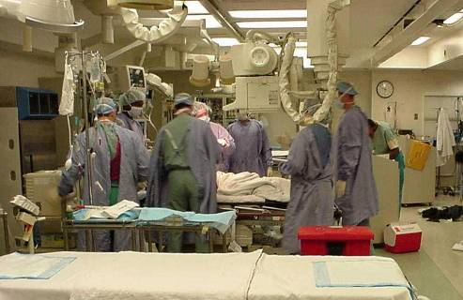
Trauma
Dr. Nishan Silva
(MBBS)

Slide 2
Trauma
Epidemiology
Leading cause of death in the first 4 decades
150,000 deaths annually in the US
Permanent disability 3 times the mortality rate
Trauma related dollar costs exceed $400 billion annually

Slide 3
Why ATLS?
Trimodal death distribution
First peak instantly (brain, heart, large vessel injury)
Second peak minutes to hours
Third peak days to weeks (sepsis, MSOF)
ATLS focuses on the second peak…..Deaths from:
TBI, Epidurals, Subdurals, IPH…
Basilar skull fractures, orbital fractures, NEO complex injury…
Penetrating neck injuries…
Spinal cord syndromes…
Cardiac tamponade, tension pneumothorax, massive hemothorax, esophageal injury, diaphragmatic herniation, flail chest, sucking chest wounds, pulmonary contusion, tracheobronchial injuries, penetrating heart injury, aortic arch injuries …
Liver laceration, splenic ruptures, pancreatico-duodenal injuries, retroperitoneal injuries
Bladder rupture, renal contusion, renal laceration, urethral injury…
Pelvic fractures, femur fractures, humerus fractures…
You get the point

Slide 4
Concepts of ATLS
Treat the greatest threat to life first
The lack of a definitive diagnosis should never impede the application of an indicated treatment
A detailed history is not essential to begin the evaluation
“ABCDE” approach

Slide 5
Initial Assessment and Management
An effective trauma system needs the teamwork of EMS, emergency medicine, trauma surgery, and surgery subspecialists
Trauma roles
Trauma captain
Interventionalists
Nurses
Recorder

Slide 6
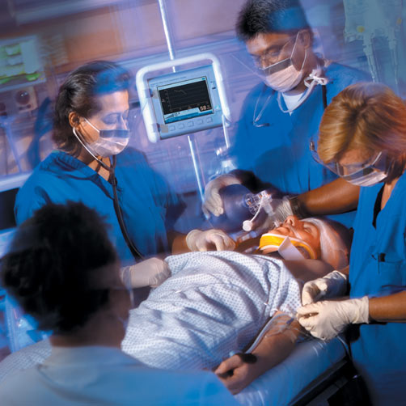
Trauma Team

Slide 7
Primary Survey
Patients are assessed and treatment priorities established based on their injuries, vital signs, and injury mechanisms
ABCDEs of trauma care
A Airway and c-spine protection
B Breathing and ventilation
C Circulation with hemorrhage control
D Disability/Neurologic status
E Exposure/Environmental control

Slide 8
Airway
How do we evaluate the airway?

Slide 9
A- Airway
Airway should be assessed for patency
Is the patient able to communicate verbally?
Inspect for any foreign bodies
Examine for stridor, hoarseness, gurgling, pooled secrecretions or blood
Assume c-spine injury in patients with multisystem trauma
C-spine clearance is both clinical and radiographic
C-collar should remain in place until patient can cooperate with clinical exam

Slide 10
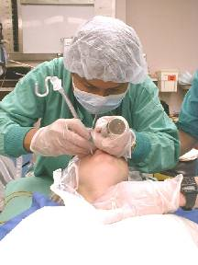
Airway Interventions
Supplemental oxygen
Suction
Chin lift/jaw thrust
Oral/nasal airways
Definitive airways
RSI for agitated patients with c-spine immobilization
ETI for comatose patients (GCS<8)

Slide 11
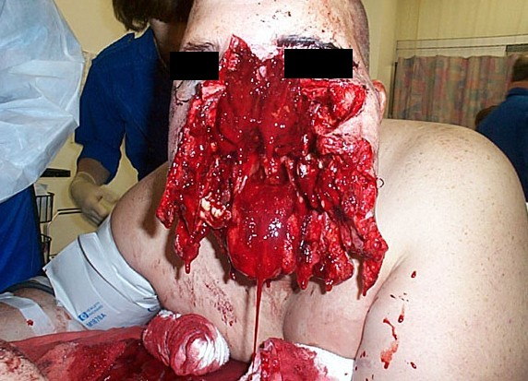
Difficult Airway

Slide 12
Breathing
What can we look for clinically to assess a patient’s ‘breathing’ status?

Slide 13
B- Breathing
Airway patency alone does not ensure adequate ventilation
Inspect, palpate, and auscultate
Deviated trachea, crepitus, flail chest, sucking chest wound, absence of breath sounds
CXR to evaluate lung fields

Slide 14
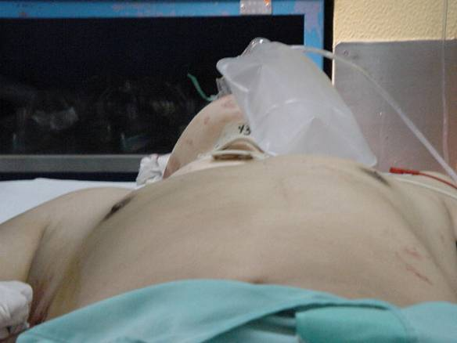
Flail Chest

Slide 15
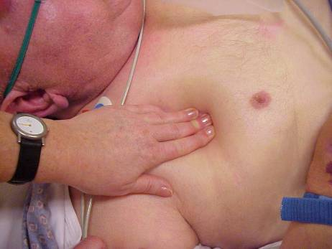
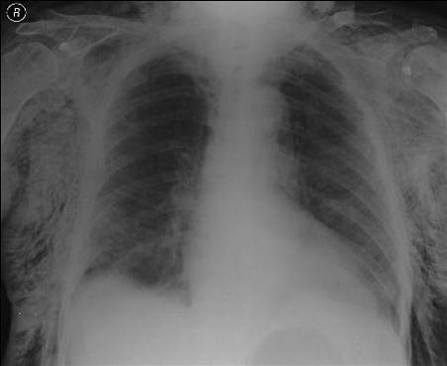
Subcutaneous Emphysema

Slide 16
Breathing Interventions
Ventilate with 100% oxygen
Needle decompression if tension pneumothorax suspected
Chest tubes for pneumothorax / hemothorax
Occlusive dressing to sucking chest wound
If intubated, evaluate ETT position

Slide 17
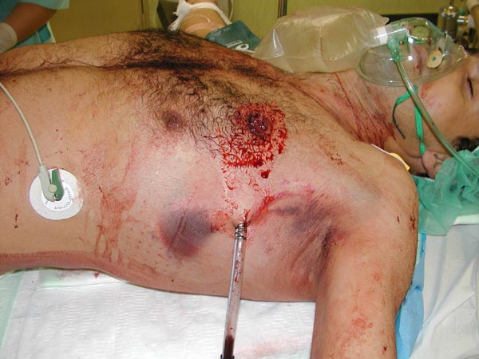
Chest Tube for GSW

Slide 18
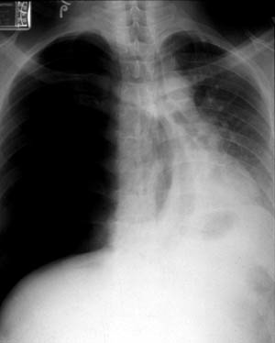
What would we do for this patient who is having difficulty breathing?

Slide 19
C- Circulation
Hemorrhagic shock should be assumed in any hypotensive trauma patient
Rapid assessment of hemodynamic status
Level of consciousness
Skin color
Pulses in four extremities
Blood pressure and pulse pressure

Slide 20
Circulation Interventions
Cardiac monitor
Apply pressure to sites of external hemorrhage
Establish IV access
2 large bore IVs
Central lines if indicated
Cardiac tamponade decompression if indicated
Volume resuscitation
Have blood ready if needed
Level One infusers available
Foley catheter to monitor resuscitation
Notes:
Contraindications of foley catheter (signs of possible urethral injury): 1. Blood at urethral meatus 2. Perineal eccymosis 3. Blood in the scrotum 4. High riding prostate 5. Pelvic Fractures
If suspicious of urethral injury---retrograde urethrogram prior to insertion

Slide 21
D- Disability
Abbreviated neurological exam
Level of consciousness
Pupil size and reactivity
Motor function
GCS
Utilized to determine severity of injury
Guide for urgency of head CT and ICP monitoring

Slide 22
GCS
EYE | VERBAL | MOTOR
Spontaneous 4 | Oriented 5 | Obeys 6
Verbal 3 | Confused 4 | Localizes 5
Pain 2 | Words 3 | Flexion 4
None 1 | Sounds 2 | Decorticate 3
 | None 1 | Decerebrate 2
 |  | None 1

Slide 23
Disability Interventions
Spinal cord injury
High dose steroids if within 8 hours
ICP monitor- Neurosurgical consultation
Elevated ICP
Head of bed elevated
Mannitol
Hyperventilation
Emergent decompression

Slide 24
E- Exposure
Complete disrobing of patient
Logroll to inspect back
Rectal temperature
Warm blankets/external warming device to prevent hypothermia

Slide 25
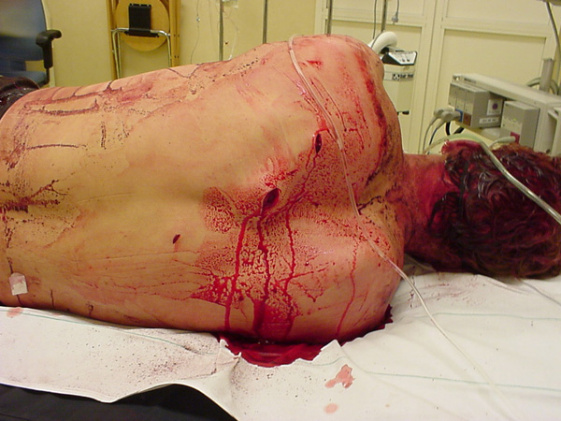
Always Inspect the Back

Slide 26
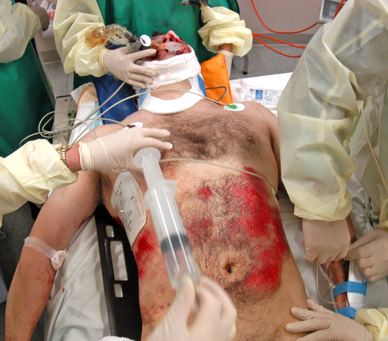
Lets do a Case! Stabilize this patient

Slide 27
Case
28 yo M involved in a high speed motorcycle accident. He was not wearing a helmet. He is groaning and utters, “my belly”, “uggghhh”.
HR 134 BP 87/42 RR 32 SaO2 89% on 100% facemask
Brief initial exam: pt is drowsy but arousable to voice, has large hematoma over L parietal scalp, airway is patent, decreased breath sounds over R chest, diffuse abdominal tenderness, obvious deformity to L ankle

Slide 28
ABCDE
What are the management priorities at this time?
What are this patient’s possible injuries?
What are the interventions that need to happen now?
Notes:
. Always ABCDE first! A – airway patent; go to NRB mask, frequent reassessment, don’t forget proper C-spine immobilization B – tachypnea, decr. BS, hypoxia (? PTX, hemothorax); consider needle decompression , CXR, then chest tube C- hypotensive, tachycardic (? Tension PTX v. massive hemothorax v. intraabdominal hemorrhage, ? Pelvic fractures); needs large bore IV v. CVL, IVF, blood available D – do quick GCS, pupils, motor assessment E – exposure, blankets

Slide 29
Secondary Survey
AMPLE history
Allergies, medications, PMH, last meal, events
Physical exam from head to toe, including rectal exam
Frequent reassessment of vitals
Diagnostic studies at this time simultaneously
X-rays, lab work, CT orders if indicated
FAST exam

Slide 30
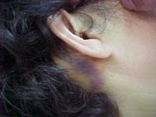
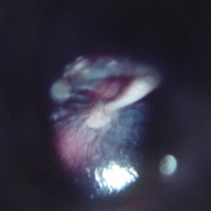
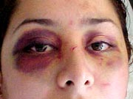
HEENT
What are the names of these signs?

Slide 31
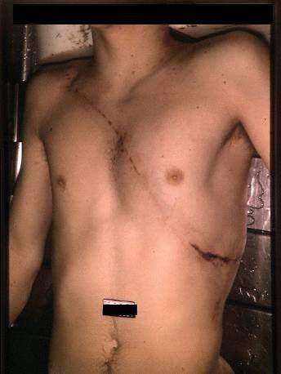
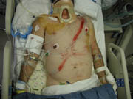
Seatbelt Sign

Slide 32
Diagnostic Aids
Standard trauma labs
CBC, K, Cr, PTT, Utox, EtOH, ABG
Standard trauma radiographs
CXR, pelvis, lateral C-spine (traditionally)
CT/FAST scans
Pt must be monitored in radiology
Pt should only go to radiology if stable

Slide 33
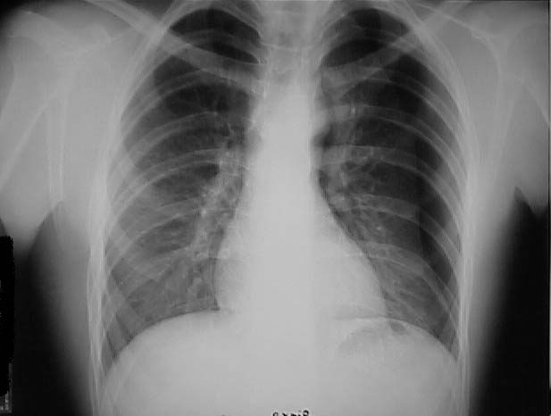
Simple Pneumothorax

Slide 34
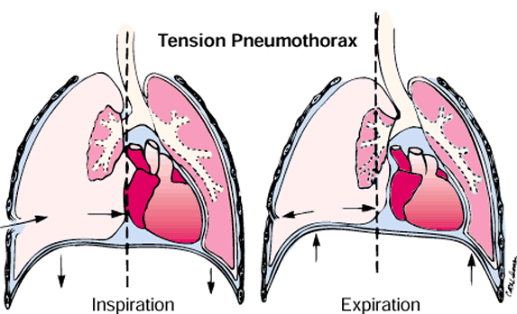
Tension Pneumothorax
How do you treat this?

Slide 35
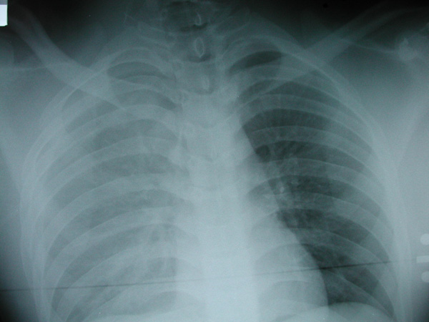
Hemothorax
Is this patient lying or upright?

Slide 36
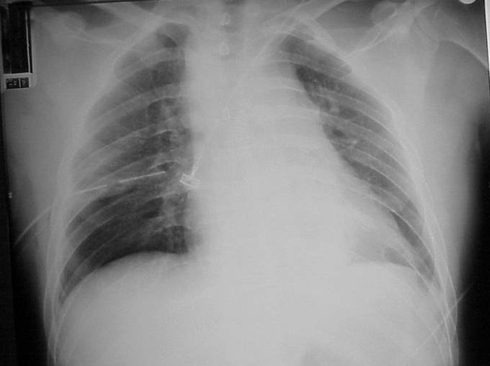
Widened Mediastinum
What disease process does this indicate?

Slide 37
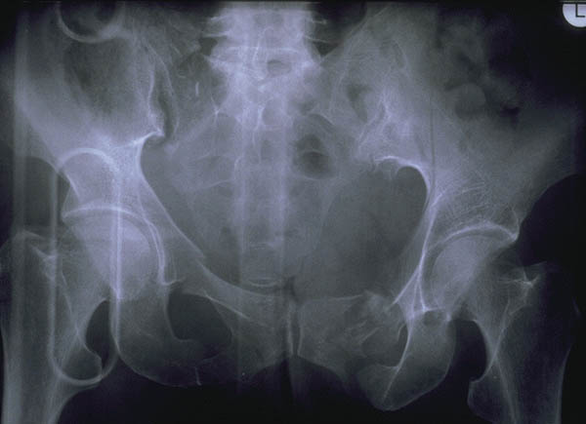
Bilateral Pubic Ramus Fractures and Sacroiliac Joint Disruption
What should this injury make you worry about?

Slide 38
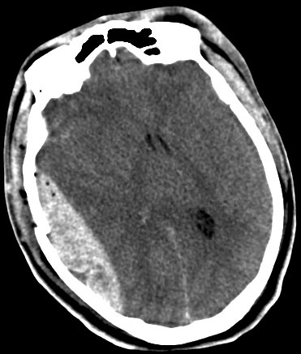
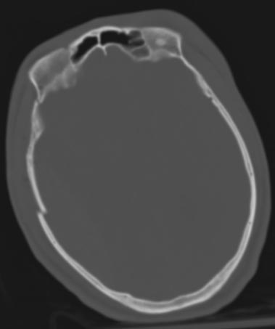
Epidural Hematoma

Slide 39
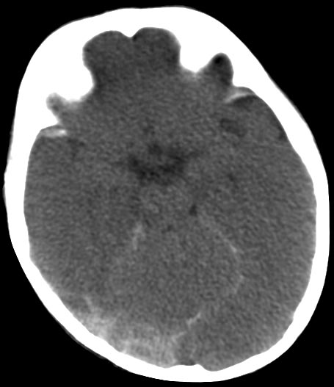
Subdural Hematoma with SAH

Slide 40
Abdominal Trauma
Common source of traumatic injury
Mechanism is important
Bike accident over the handlebars
MVC with steering wheel trauma
High suspicion with tachycardia, hypotension, and abdominal tenderness
Can be asymptomatic early on
FAST exam can be early screening tool

Slide 41
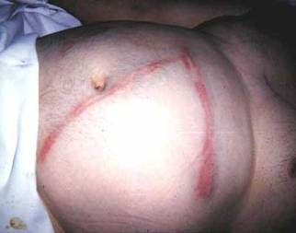
Abdominal Trauma
Look for distension, tenderness, seatbelt marks, penetrating trauma, retroperitoneal ecchymosis
Be suspicious of free fluid without evidence of solid organ injury

Slide 42
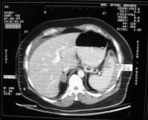
Splenic Injury
Most commonly injured organ in blunt trauma
Often associated with other injuries
Left lower rib pain may be indicative
Often can be managed non-operatively
Blood from spleen
Tracking around
liver
Spleen with surrounding
blood

Slide 43
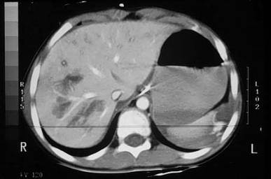
Liver injury
Second most common solid organ injury
Can be difficult to manage surgically
Often associated with other abdominal injuries
Liver contusions

Slide 44
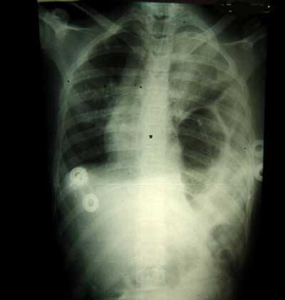
What’s wrong with this picture?
Trace the Diaphragm
Outline. Where is the
Diaphragm on the left?
May only see the nasogastric tube appear to be coiled in the lung.
Left > right due to liver protection of the diaphragm.
Abdominal contents
Up in the chest on the
left

Slide 45
Hollow Viscous Injury
Injury can involve stomach, bowel, or mesentery
Symptoms are a result from a combination of blood loss and peritoneal contamination
Small bowel and colon injuries result most often from penetrating trauma
Deceleration injuries can result in bucket-handle tears of mesentery
Free fluid without solid organ injury is a hollow viscus injury until proven otherwise

Slide 46
bowel
mesentery
Mesenteric and bowel injury from blunt abdominal
trauma. Notice the bowel and mesenteric disruption.

Slide 47
CT Scan in Trauma
Abdominal CT scan visualizes solid organs and vessels well
CT does NOT see hollow viscus, duodenum, diaphram, or omentum well
Some recent surgery literature advocates whole body scans on all trauma
Keep in mind that there is an increase in mortality related to cancer from CT scans

Slide 48
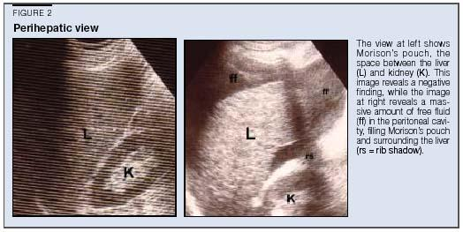
FAST Exam
Focused Abdominal Scanning in Trauma
4 views: Cardiac, RUQ, LUQ, suprapubic
Goal: evaluate for free fluid
See normal
Liver and kidney
Free fluid in Morrison's
Pouch between liver and
kidney

Slide 49
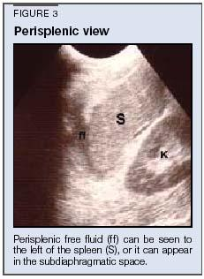
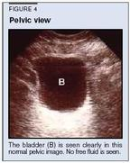
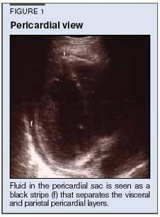
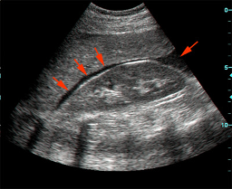
momor
Morrison’s pouch

Slide 50
Non-accidental Trauma
Key is SUSPICION!!!
Incongruent stories of mechanism
Delay in seeking treatment
Multiple stages of injuries
Pattern Injuries
Multiple hospital visits
Injury mechanism beyond the scope of the age of child (6week old rolled over off the bed)
Bite marks, submersion injury, cigarette burns

Slide 51
Disposition of Trauma Patients
Dictated by the patient’s condition and available resources i.e. trauma team available
OR, admit, or transfer
Transfers should be coordinated efforts
Stabilization begun prior to transfer
Decompensation should be anticipated
Serial examinations
CHI with regain of consciousness
Abdominal exams for documented blunt trauma
Pulmonary contusions with blunt chest trauma

Slide 52
Summary
Trauma is best managed by a team approach (there’s no “I” in trauma)
A thorough primary and secondary survey is key to identify life threatening injuries
Once a life threatening injury is discovered, intervention should not be delayed
Disposition is determined by the patient’s condition as well as available resources.

