Slide 1
Tenise Elbow/ Golf Elbow De de Quervain's Disease

Slide 2
Contents
Anatomy of the elbow
Tennis elbow
Golf elbow
De Quervain's Tendinitis

Slide 3
Anatomy of the elbow
The elbow joint is made up of the following bones, muscles and ligaments.
Humerus, Radius and Ulna.
Lateral and medial epicondyle.
Wrist flexor and extensor muscles.
Ulna collateral ligament.
Bicep and Tricep.

Slide 4
Picture of elbow joint

Slide 5
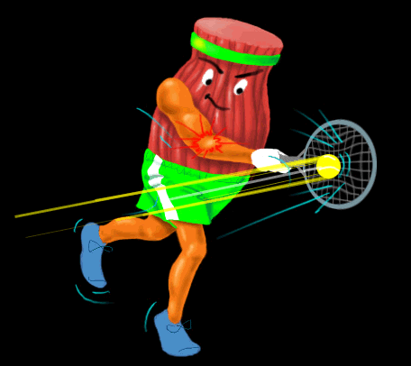
TENNIS ELBOW

Slide 6
What is Tennis Elbow?
Tennis elbow is an injury to the muscles and tendons on the outside (lateral aspect) of the elbow that results from overuse or repetitive stress.
The narrowing of the muscle bellies of the forearm as they merge into the tendons create highly focused stress where they insert into the bone of the elbow.

Slide 7
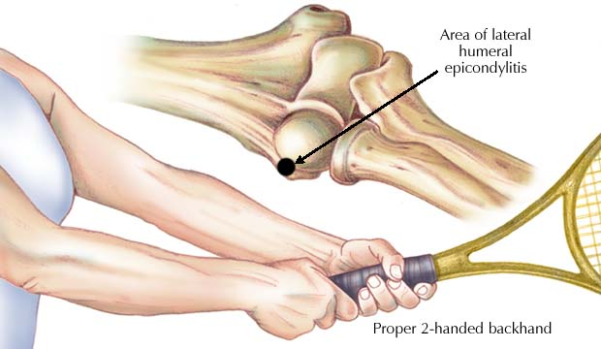
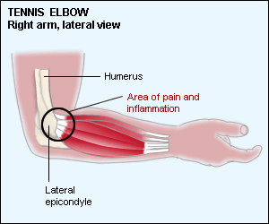
TENNISE Elbow Anatomy
Lateral epicondyle- located on lateral side of distal end above capitulum. Anconeus and supinator attach.

Slide 8
The tendon usually involved in tennis elbow is called the Extensor Carpi Radialis Brevis (ECRB).

Slide 9
Lateral Epicondylitis Symptoms
Pain about 1-2 cm down from bony area at the outside of the elbow (lateral epicondyle).
Pain on the outside of the elbow when the hand is bent back (extended) at the wrist against resistance.
Pain on the outside of the elbow when trying to straighten the fingers against resistance.
Pain when pressing (palpating) just below the lateral epicondyle on the outside of the elbow
Weakness in the wrist with difficulty doing simple tasks such as opening a door handle or shaking hands with someone

Slide 10
Causes of tennis elbow
Overuse or repetitive strain caused by repeated extension (bending back) of the wrist against resistance.
This may be from activities such as tennis, but also in day to day activities.
A poor backhand technique in tennis.
A racket grip that is too small.
Strings that are too tight.
Playing with wet, heavy balls.
Repetitive activities such as using a screwdriver, painting or typing

Slide 11
Physical Examination
Point of tenderness is examined
Muscle strength
Range of motion- Active and passive
Resisted isometric movements
Special test : Cozen's test, Mill's test
Neck- pain of elbow may be referred to the neck as well

Slide 12
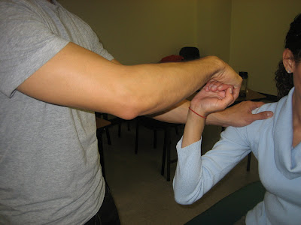
LATERAL EPICONDYLITIS TESTS/
A. COZEN'S TEST/Resistive Tennis Elbow Test
-PT SEATED
-INSTRUCT PT. TO PLACE THEIR ELBOW IN FLEXION & WRIST IN EXTENSION.
-PLACE ONE HAND ON PT'S SHOULDER (STABILIZE) & GRAB PT;S FIST WITH OTHER HAND.
-INSRUCT PT TO RESIST AS YOU PULL ON FIST.
-(+) PAIN IN LATERAL EPICONDYLE
-Dx: LATERAL EPICONDYLITIS / TENNIS ELBO

Slide 13
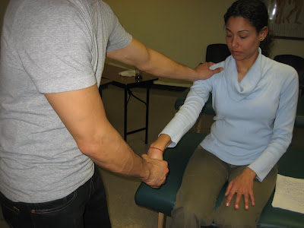
B. MILLS TEST
-PT SEATED
-INSTRUT PT. TO PLACE ELBOW IN EXTNESION & WRIST IN EXTENSION.
-PLACE ONE HAND ON PT'S SHOULDERS & OTHER HAND GRABS PT'S FIST.
-HAVE PT RESIST AS YOU PULL ON FIST.
-(+) PAIN IN LATERAL EPICONDYLE
-Dx: LATERAL EPICONDYLITIS (TENNIS ELBOW.)
Notes:
TVHWSSS

Slide 14
Chair lift test = Lifting the back of a chair with a three finger pinch (thumb, index long fingers) and the elbow fully extended
Maudsley’s test = Resisted third digit extention

Slide 15
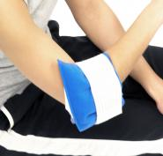
Physiotherapy Treatment
Phase 1
Tennis elbow is a soft tissue injury of the muscles and tendons around the elbow joint, and thereforer should be treated like any other soft tissue injury. Immediately following an injury, or at the onset of pain,the R.I.C.E regime should be employed. This involves
Rest
Ice
Compression
Elevation

Slide 16
Phase 2 : Rehabilitation
Gentle stretching exercises including wrist
flexion (bending the wrist down), extension (bending the wrist up). The elbow should be fully straightened.
stretchesshould be held for 20-30 seconds and repeated 5-10 times, at least twice a day.
Vigorous stretching should be avoided

Slide 17
Strengthening exercise
Strengthening
Strengthening exercises should begin as soon as pain allows. This will depend on how bad the injury is.
If it hurts during the exercise, after or makes it worse the next day then do not continue with strengthening exercises. Be patient.
Start with static exercises. When these can be done comfortably move onto concentric and then eccentric exercises.
It is important that strengthening exercises are done before trying to return to activity.
Apply cold therapy after strengthening exercises

Slide 18
Wrist Extension. Place 1 lb. weight in hand with palm facing downward (pronated); support forearm at the edge of a table or on your knee so that only your hand can move.
Raise wrist/hand up slowly (concentric contraction), and lower slowly (eccentric contraction).

Slide 19
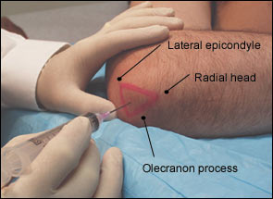
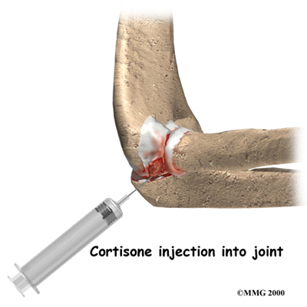

Slide 20
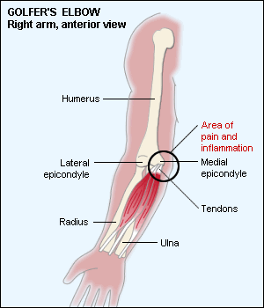
Golfers Elbow what is golfers elbow
Golfers elbow (medial epicondylitis) is a similar injury to tennis elbow only it affects the inside of the elbow instead. Golfers elbow is more common in throwers (throwers elbow) and golfers hence the nicknames

Slide 21
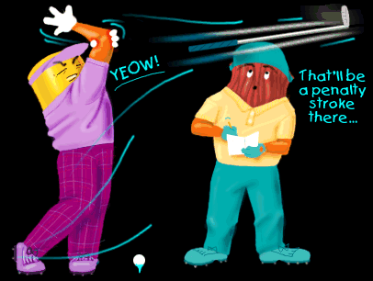
Medial Epicondylitis (Golfer’s Elbow)

Slide 22
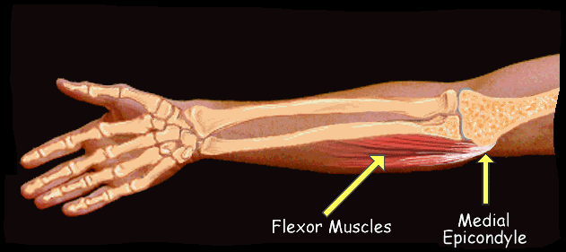
MEDIAL EPICONDYLITIS
Pronation, wrist flexion and elbow flexion.

Slide 23
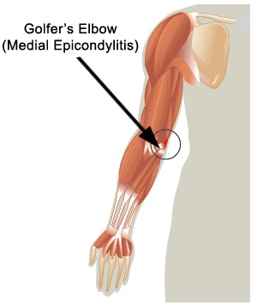
cause
Causes of Medial Epicondylitis
Medial epicondylitis is caused by repeated wrist flexion.
It can occur from sports including golf or throwing actions, as well as in occupations such as on production lines or manual jobs like carpentry. It tends to occur after a period of repeated wrist flexion, which the body is unaccustomed to.
The wrist flexor muscles, which are found on the palm side of the forearm, become painful and inflamed at their attachment point on the inner elbow.

Slide 24
Who can get
Golf players (especially those who continually take divots out of the ground)
Tennis players (especially those players who put a lot of top spin on the ball)
Squash players
Badminton players
water skiing
knitting
working at a computer
gymnastics
body building or weight lifting
carpentry
hammering
painting
chopping wood
bricklaying
repetitive use of a screwdriver
sewing

Slide 25
Symptoms of Golfers Elbow
Pain on the bony bit on the medial side of the elbow.
Weakness in the wrist.
Pain on the inside of the elbow when you grip something hard.
Pain when wrist flexion (bending the wrist palm downwards) is resisted.
Pain on resisted wrist pronation - rotating inwards (thumb downwards). . Sometimes fully straightening the elbow is difficult because of pain.
There may be tingling sensation, or numbness on the inside of the forearm and the last 2 fingers, and is usually worse with or after activities.

Slide 26
MEDIAL EPICONDYLITIS TEST
-PT SEATED -INSTRUCT PT TO EXTEND ELBOW & FLEX WRIST.
-PLACE 1 HAND ON PT'S SHOULDER & GRAB PT'S FIST WITH OTHER HAND.
-HAVE PT RESIST AS YOU PULL ON FIST.
-(+) PAIN IN MEDIAL EPICONDYLITIS. -Dx: MEDIAL EPICONDYLITIS aka GOLFER'S ELBOW.

Slide 27
Treatments for Golfer’s elbow
;
RICE(Ice the injury for two days (15 mins at a time up to six times a day).
Rest
Deep transverse frictional massage.
Taping or brasing
Ultrasound treatment.
Shortwave diathermy.
Specific stretching and mobilisation.
Strengthening exercises.
Give a steroid injection
Acupuncture.
anti-inflammatory medication
Manipulation.

Slide 28
Static Exercises
It is important these exercises are done without any pain.
If you feel pain, stop and wait until such time as they can be performed without pain.
Repeat the exercises daily.
Assess any effect on the elbow immediately after as well as the next day.
Method
Static wrist flextion
Rest the forearm on a flat surface such as a table or bench with the palm facing up.
Start with the wrist in an extended position (fingers pinting down).
Use the other hand to resist as you attempt to flex the wrist.
There shouldn't be any movement at the wrist.
Start at around 30% of your maximum force.
Hold this contraction for 5-10 seconds and then rest. Repeat 5-10 times.
Gradually increase the duration of the static contraction until you can manage 10 contractions of 10 seconds without pain.

Slide 29
Dynamic Exercises
Wrist flextion
Rest the arm on a flat surface, with the forearm and palm facing downwards.
Start in a fully flexed position (hand pointing down).
Extend the wrist as shown.
Start with 3 sets of 10 repetitions daily and build up gradually up to 3 sets of 30 reps.
Wrist extention
Turn the arm over so the palm is facing upwards.
Start in a fully extended position (hand pointing down).
Flex the wrist as shown.
Start with 3 sets of 10 repetitions daily and build up gradually up to 3 sets of 30.

Slide 30
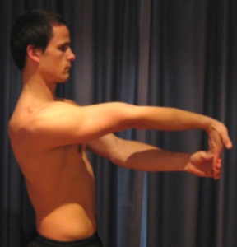
Golfers Elbow Stretch
Begin this exercise with your elbow straight (figure 2). Take your wrist backwards using your other hand until you feel a mild to moderate stretch pain-free. Hold for 15 seconds and repeat 4 times.

Slide 31
Tennis Ball Squeeze
Begin this exercise holding a tennis ball (figure 3). Squeeze the tennis ball as hard as possible and comfortable without pain. Hold for 5 seconds and repeat 10 times.

Slide 32
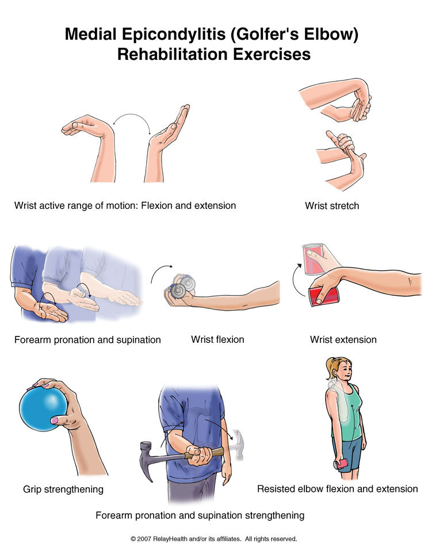

Slide 33
Wrist active range of motion: Flexion and extension: Bend your wrist forward and backward as far as you can. Do 3 sets of 10.
Wrist stretch: With one hand, help to bend the opposite wrist down by pressing the back of your hand and holding it down for 15 to 30 seconds. Next, stretch the hand back by pressing the fingers in a backward direction and holding it for 15 to 30 seconds. Keep your elbow straight during this exercise. Do 3 sets on each hand.
Forearm pronation and supination: With your elbow bent 90°, turn your palm upward and hold for 5 seconds. Slowly turn your palm downward and hold for 5 seconds. Make sure you keep your elbow at your side and bent 90° throughout this exercise. Do 3 sets of 10.

Slide 34
Strengthening exercises
Wrist flexion: Hold a can or hammer handle in your hand with your palm facing up. Bend your wrist upward. Slowly lower the weight and return to the starting position. Do 3 sets of 10. Gradually increase the weight of the can or weight you are holding.
Wrist extension: Hold a soup can or hammer handle in your hand with your palm facing down. Slowly bend your wrist upward. Slowly lower the weight down into the starting position. Do 3 sets of 10. Gradually increase the weight of the object you are holding.
Grip strengthening: Squeeze a rubber ball and hold for 5 seconds. Do 3 sets of 10.
Forearm pronation and supination strengthening: Hold a soup can or hammer handle in your hand and bend your elbow 90°. Slowly rotate your hand with your palm upward and then palm down. Do 3 sets of 10.
Resisted elbow flexion and extension: Hold a can of soup with your palm face up. Slowly bend your elbow so that your hand is approaching your shoulder. Then lower it slowly so your elbow is completely straight. Do 3 sets of 10. Slowly increase the weight you are using.

Slide 35
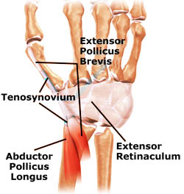
De Quervain's Tendinitis (De Quervain's Tendinosis
What is De Quervain's Tenosynovitis
inflammation of the synovium of the abductor pollicis longus and extensor pollicis longus tendons as they pass through the wrist (on the thumb side of the wrist).

Slide 36
ANATOMY
Two of the main tendons to the thumb pass through a tunnel (or series of pulleys) located on the thumb side of the wrist.
Tendons are rope-like structures that attach muscle to bone. Tendons are covered by a slippery thin soft-tissue layer, called synovium.
This layer allows the tendons to slide easily through the tunnel. Any swelling of the tendons located near these nerves can put pressure on the nerves.
This can cause wrist pain or numbness in the fingers.
De Quervain tenosynovitis of the first extensor compartment.

Slide 37
Causes
The most common cause of deQuervain's Tenosynovitis involves repetitive thumb movements . (grasping, pinching, squeezing, or wringing)
When we "overdo" these movements, the APL and EPB become inflamed, and this leads to swelling. This swelling hampers the smooth gliding action of these tendons within the tunnel, thus producing pain. Other causes may include:
trauma to the APL and EPB, such as straining these tendons due to a fall.
arthritic diseases, such as rheumatoid arthritis.
scar tissue from surgery or an injury can make it difficult for the tendons to slide easily through the tunnel.

Slide 38
Symptoms of De Quervain's Tenosynovitis
:
Tenderness and swelling on the thumb side of the wrist where the tendons pass.
Crepitus may be felt (a creaking of the tendon as it moves).
Finkelstein's test may be positive.

Slide 39
Special test
The Finkelstein test
conducted by making a fist with the fingers closed over the thumb and the wrist is bent toward the little finger

Slide 40
Treatment
Rest
Ice or cold therapy to reduce pain and inflammation.
Ultrasound therapy.
Stretching and strengthening
Soft tissue massage.
Thumb bracing or splinting(splinting if necessary.)
Thumb taping
Joint mobilization
Ice or heat treatment
Exercises to improve flexibility and strength
education
Training and activity modification advice
Technique correction
Anti-inflammatory advice
devising an appropriate return to activity plan( Using an extra thick pen may help as this reduces the stretch on the tendons when writing).
A cortisone injection may be given.
In rare cases surgery may be indicated.

Slide 41
Thumb lift
1. Place your hand on a flat surface, with your palm up.
2. Lift your thumb away from your palm to make a "C" shape.
3. Hold for about 6 seconds.
4. Repeat 8 to 12 times.

Slide 42
Passive thumb MP flexion
1. Hold your hand in front of you, and turn your hand so your little finger faces down and your
thumb faces up. (Your hand should be in the position used for shaking someone's hand.) You
may also rest your hand on a flat surface.
2. Use the fingers on your other hand to bend your thumb down at the point where your thumb
connects to your palm.
3. Hold for at least 15 to 30 seconds.
4. Repeat 2 to 4 times.

Slide 43
Finkelstein stretch
1. Hold your arms out in front of you. (Your hand should be in the position used for shaking
someone's hand.)
2. Bend your thumb toward your palm.
3. Use your other hand to gently stretch your thumb and wrist downward until you feel the stretch
on the thumb side of your wrist
4. Hold for at least 15 to 30 seconds.
5. Repeat 2 to 4 times

Slide 45
Stretching and strengthening
You may do all of these exercises when the initial pain is gone.
Opposition stretch: Rest your hand on a table, palm up. Touch the tip of your thumb to the tip of your little finger. Hold this position for 6 seconds. Repeat 10 times.
Wrist stretch: With one hand, help to bend the opposite wrist down by pressing the back of your hand and holding it down for 15 to 30 seconds. Next, stretch the hand back by pressing the fingers in a backward direction and holding it for 15 to 30 seconds. Keep your elbow straight during this exercise. Do 3 sets on each hand.
Wrist flexion: Hold a can or hammer handle in your hand with your palm facing up. Bend your wrist upward. Slowly lower the weight and return to the starting position. Do 3 sets of 10. Gradually increase the weight of the can or weight you are holding.
Wrist radial deviation strengthening: Put your wrist in the sideways position with your thumb up. Hold a can of soup or a hammer handle and gently bend your wrist up, with the thumb reaching toward the ceiling. Slowly lower to the starting position. Do not move your forearm throughout this exercise. Do 3 sets of 10.
Wrist extension: Hold a soup can or hammer handle in your hand with your palm facing down. Slowly bend your wrist upward. Slowly lower the weight down into the starting position. Do 3 sets of 10. Gradually increase the weight of the object you are holding.
Grip strengthening: Squeeze a rubber ball and hold for 5 seconds. Do 3 sets of 10.
Finger spring: Place a large rubber band around the outside of your thumb and the rest of your fingers. Open your fingers to stretch the rubber band. Do 3 sets of 10.

Slide 46
Notes:
F:\Prevention of Tennis Elbow.mht

