Slide 1
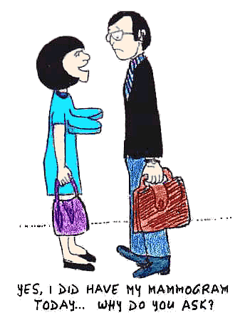
Surgical Conditions of the Breast
Dr. S. Nishan Silva
(MBBS)

Slide 2
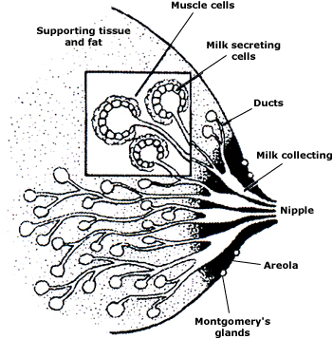
Breast Anatomy
Ruan, W, Kleinberg, DL. Endocrinology 1999; 140:5075. Copyright © 1999 The Endocrine Society.

Slide 3
Evaluation: History
History:
Change in general appearance of breast (size, symmetry)
New or persistent skin changes
New nipple inversion
Breast pain (cyclic vs. noncyclic, duration, location in breast)
Breast mass (how it was discovered, duration, change in size, location)
Relationship of mass to menstrual cycles
Nipple discharge (unilateral vs. bilateral, color)
Medications (e.g. hormones)
Risk factors for breast cancer

Slide 4
Evaluation: History
Risk Factors vs. Protective Factors
Risk Factors | Protective factors
BRCA1 and BRCA2 | Breastfeeding
1˚ relative with breast or ovarian cancer | Parity
Personal history of breast disease | Recreational exercise
Age > 70 yrs | Postmenopause BMI < 23
Age at menarche < 12 yrs | Oophorectomy at < 35 yrs
Nulliparous or age at first birth > 30 yrs | Aspirin
Never breastfed
Age at menopause > 55 yrs
Use of OCP’s
HRT (estrogen + progestin)
Radiation exposure to chest
EtOH

Slide 5
BRCA1 and BRCA2 genes: 60% to 80% of all inherited breast cancers
BRCA1
Autosomal dominant disease
Tumor suppressor gene on chromosome 17
Lifetime risk of breast cancer: 50-80%
Often early age of onset
Second primary breast cancer 40-60%
Ovarian Ca risk 15-45%
Possible increased risk of other cancers

Slide 6
BRCA2
Tumor suppressor gene on chromosome 13, also autosomal dominant
Life time risk breast cancer 50-85%
Male breast cancer 6%
Ovarian cancer 10-20%
Increased risk of prostate cancer, melanoma, pancreatic cancer

Slide 7
Evaluation: Physical Exam
Clinical Breast Exam:
Inspect (relaxed, arms raised, hands on hips)
Breast symmetry
Skin changes (dimpling, retraction, edema, ulceration)
Nipples (symmetry, inversion/retraction, discharge)
Palapation (breasts, axillae, entire chest wall)
Pain
Masses
Regional lymph nodes (Axillary and Supraclavicular)
Documentation
“Clock” system
Location of concern and abnormality
Distance from areola
Size of mass

Slide 8
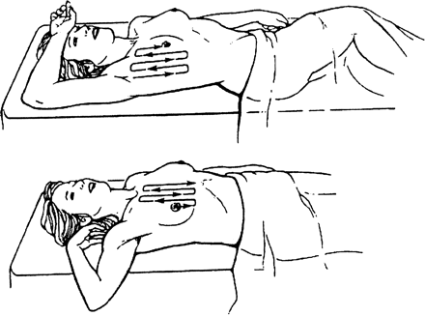
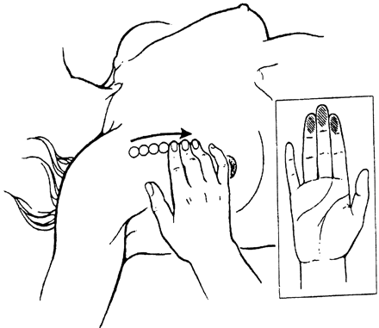
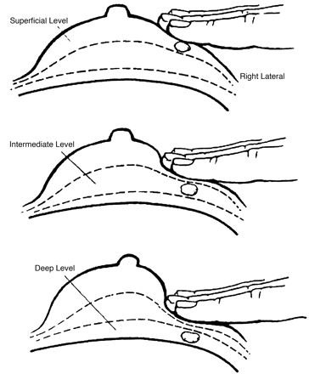
Evaluation: Physical Exam
Clinical Breast Exam:
Position the patient in the direction of palpation for the CBE.
Use pads of the index, third, and fourth fingers (inset) make small circular motions
Make three circles with the finger pads, increasing the level of pressure (subcutaneous, mid-level, and down to the chest wall) with each circle
Sanslow, D, et. al. Clinical breast examination” practical recommendations for optimizing performance and reporting. CA Cancer J Clin. 2004 Nov-Dec; 54(6): 327-44

Slide 9
Benign vs. Malignant
Chief Complaint | Benign Characteristics | Malignant Characteristics
Breast mass | Multiple lesions | Single lesion
 | “Rubbery” | Hard
 | Mobile | Immovable
 | Well circumscribed border | Irregular borders
Nipple discharge | Bilateral | Unilateral
 | Multiductal | Uniductal
 | Milky | Bloody, Clear, or Colored
 |  | Spontaneous
 |  | Persistent
Skin changes |  | Retraction
 |  | Dimpling
 |  | Thickening

Slide 10
Breast Disease
Benign
Nonproliferative
Fibrocystic changes
Simple cysts
Lactational adenoma
Fibroadenoma
Hyperplasia without atypia
Epithelial hyperplasia
Sclerosing adenosis
Intraductal papillomas
Hyperplasia with atypia
LCIS
DCIS
Malignant
Ductal carcinoma
Lobular carcinoma
Tubular carcinoma
Mucinous carcinoma
Micropapillary carcinoma
Metaplastic carcinoma
Inflammatory carcinoma

Slide 11
Mastalgia: Incidence
Approximately 45% of women have mild breast pain, and 21% have severe breast pain in their lifetime
Breast cancer is found in 1.2 – 6.7% of women presenting with breast pain

Slide 12
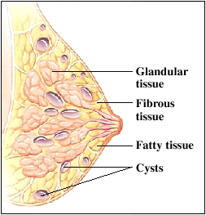
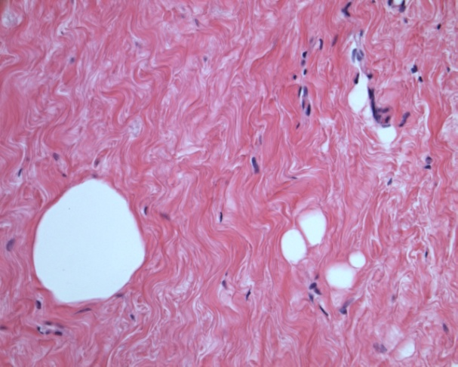
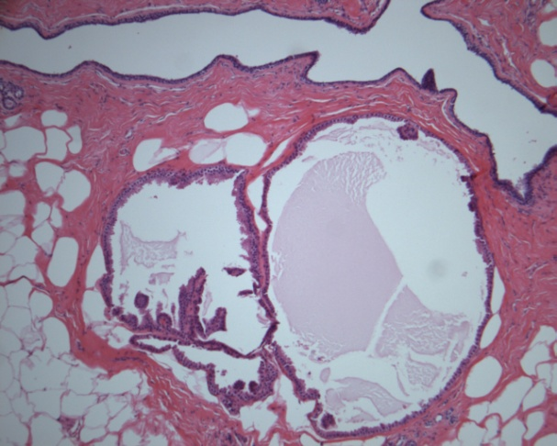
Mastalgia: Fibrocystic Disease
Fibrocystic disease
Premenopausal women
Premenstrual breast swelling/tenderness
Nodules/masses/lumps related to dense breast tissue or cysts
Fibrous tissue
Cystically dilated ducts
+ Calcifications
+ Ductal hyperplasia

Slide 13
Mastalgia: Management
Treatment:
Lifestyle
Eliminate caffeine
Low fat diet
Symptomatic
Support garments (well-fitting, supportive bra, sports bra)
Compresses
Medication
NSAID’s
OCP’s, Progestogens
Danazol
Bromocriptine
GnRH agonists
Tamoxifen - IF severe mastalgia

Slide 14
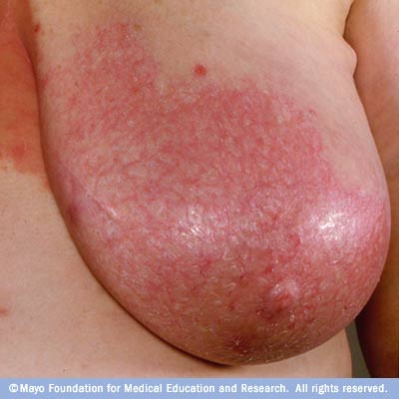
Mastalgia: Mastitis
Presentation
Usually seen in breastfeeding mothers
Unilateral, swollen, wedge-shaped area of breast
Pain, redness, induration (hardening)
Systemic symptoms (high fever, malaise, chills)
Treatment
Rest, fluids
Dicloxicllin 500mg QID x 10-14d
Continue frequent breast feeding

Slide 15
Breast Abscess

Slide 16
Breast Abscess

Slide 17
Incision and Drainage

Slide 19
Breast Mass: Etiology
More than 90% of palpable breast masses in women in their 20’s to early 50’s are benign
Differential Diagnosis:
Fibrocystic changes
Fibroadenoma
Fat necrosis
Phyllodes tumor
Intraductal papilloma
Breast cancer

Slide 20
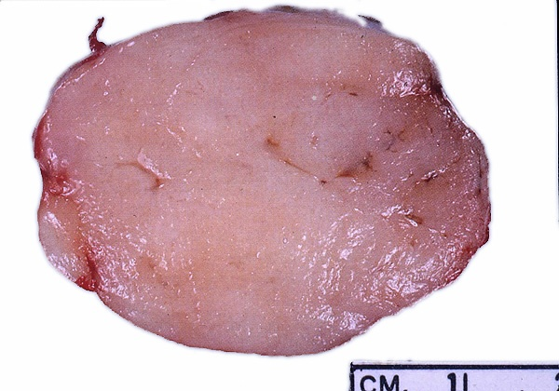
Breast Mass: Fibroadenoma
Fibroadenoma
Solitary, firm, rubbery, mobile mass
Women < 30 yrs
Slow growing (? hormonally mediated)
Fibroadenoma gross specimen
Firm, tan, lobulated
Well circumscribed mass
Variable size

Slide 21
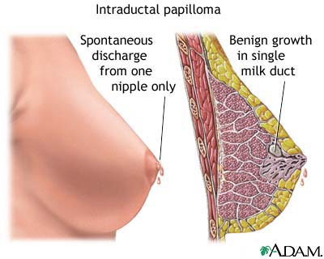
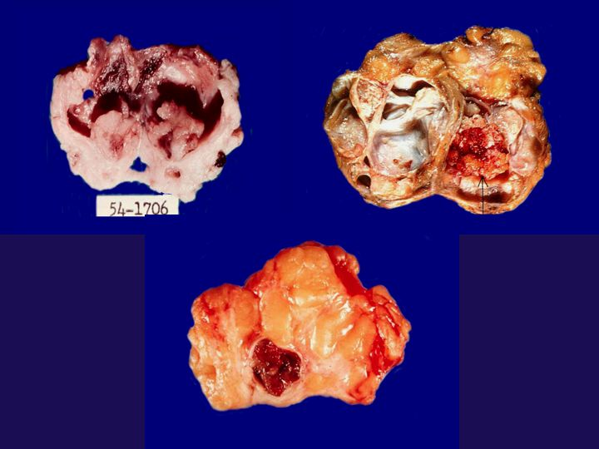
Breast Mass: Intraductal Papilloma
Intraductal papilloma
Unilateral bloody nipple discharge
Sub-areolar intraductal mass
Duct excision
Intraductal papillary neoplasm with fibrovascular cores lined by benign ductal and myoepithelial cells

Slide 22
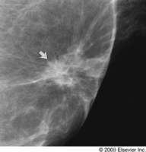
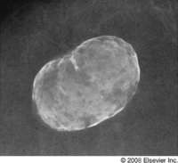
Breast Mass: Fat Necrosis
Fat Necrosis
Caused by trauma
Tender, firm mass with indistinct borders
May appear suspicious on physical exam
Benign breast calcification seen on mammography
Fat necrosis manifesting as a spiculated mass
Densely calcified 3-cm area of fat necrosis 2 years after blunt trauma to the breast.

Slide 23
Breast Mass: Evaluation
Initial evaluation
< 35 yr – Diagnostic ultrasound + Diagnostic mammogram
> 35 yr – Diagnostic mammogram
Further evaluation
Simple cyst
Symptomatic – Aspirate
Asymptomatic – Observe for 2-4 months
Complicated cyst – Ultrasound-guided aspiration
Solid mass – Core needle biopsy (CNB) or Excision
No specific findings – Re-examine after two cycles

Slide 24
Ultrasound Scan of Breast

Slide 25
Breast Ultrasound

Slide 26
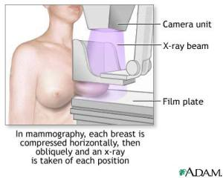

Slide 27
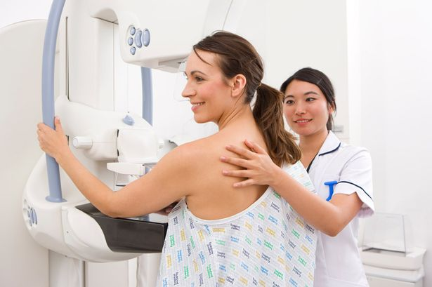

Slide 28
Mammogram
Breast Cancer
Fibroadenoma

Slide 29
Nipple Discharge: Etiology
Etiology
Lactation
Physiologic nipple discharge
Hyperprolactinemia
Hypothyroidism
Medication related
Neurogenic stimulation
Pathologic
Intraductal papilloma
Ductal ectasia
DCIS

Slide 30
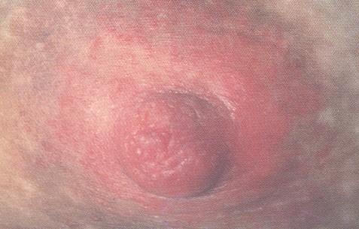
Inverted nipple
Sore nipple
NF-
Notes:
30

Slide 31
Serous Discharge

Slide 32
Blood stained Discharge

Slide 33
Nipple Discharge: Management
Management
Physiologic nipple discharge
Directed at underlying cause
Pathologic nipple discharge
Refer to surgeon
Terminal duct excision
Central (total) terminal duct excision
Resection of intraductal papilloma

Slide 34
Malignant Breast Disease
Pathologic finding on CNB or excision biopsy
DCIS/LCIS
Invasive carcinoma
Refer to surgical oncologist
Treatment modalities:
Radiation
Chemotherapy
Lumpectomy
Mastectomy
Hormonal therapy

Slide 35
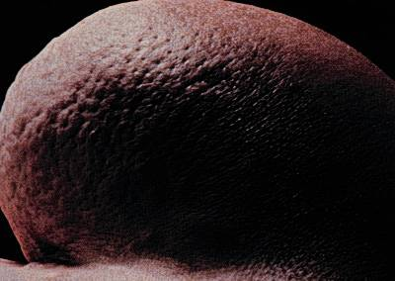
Mastalgia: Inflammatory Breast Cancer
Inflammatory breast cancer
Peau d’orange-dimpling of involved skin due to retraction caused by lymphatic involvement and obstruction
Associated erythema
Cellulitis may mimic inflammatory carcinoma

Slide 36
Skin Dimpling

Slide 37
Peau d‘orange

Slide 38
Ulcerated lesion

Slide 39
Triple Assessment
Triple assessment- gold standard
Clinical, Radiology, Pathology
Describe

Slide 40
FNAC Breast

Slide 41
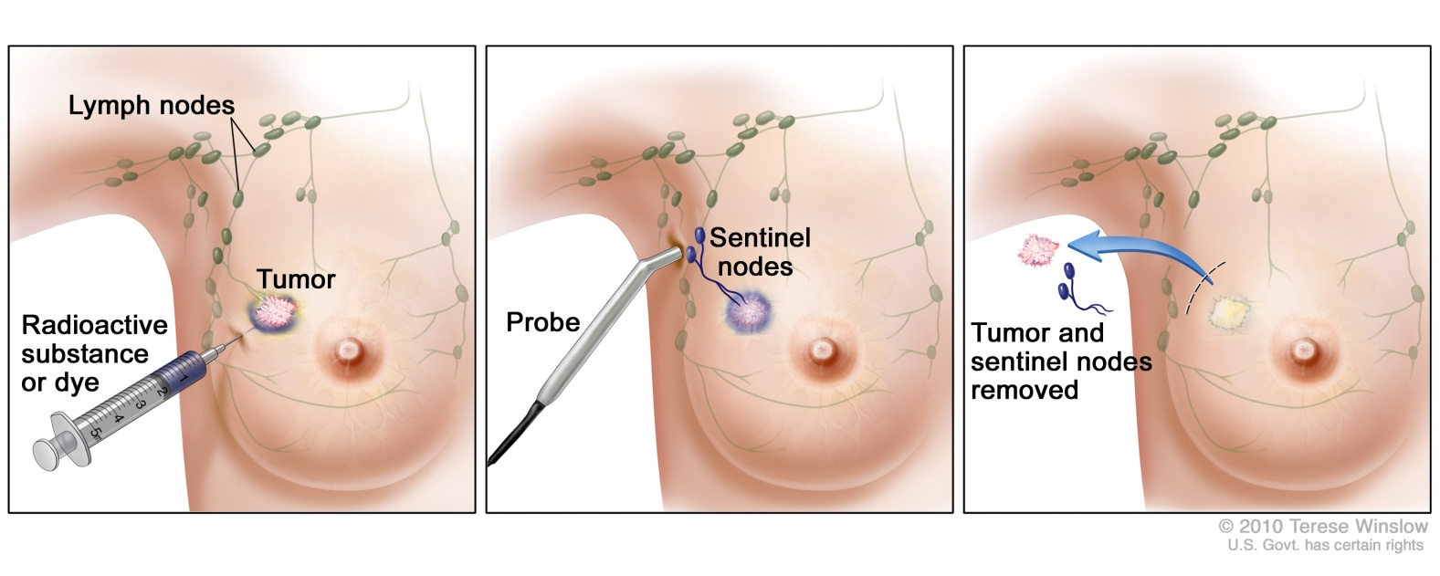
Sentinel node biopsy

Slide 42
Staging and Prognosis
Primary Tumor
T1 = Tumor < 2 cm. in greatest dimension
T2 = Tumor > 2 cm. but < 5 cm.
T3 = Tumor > 5 cm. in greatest dimension
T4 = Tumor of any size with direct extension to chest wall or skin
Regional Lymph Nodes
N0 = No palpable axillary nodes
N1 = Metastases to movable axillary nodes
N2 = Metastases to fixed, matted axillary nodes
Distant Metastases
M0 = No distant metastases
M1 = Distant metastases including ipsilateral supraclavicular nodes
Clinical Staging and prognosis
Clinical Stage I T1 N0 M0 Stage Prognosis (5 year surv. Rate)
Clinical Stage IIA T1 N1 M0 I 93%
T2 N0 M0 II 72%
Clinical Stage IIB T2 N1 M0 III 41%
T3 N0 M0 IV 18%
Clinical Stage IIIA T1 N2 M0
T2 N2 M0
T3 N1 M0
T3 N2 M0
Clinical Stage IIIB T4 any N M0
Clinical Stage IV any T any N M1

Slide 43
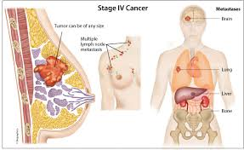

Slide 44
Liver Metastases

Slide 45
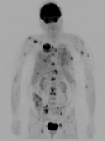
Metastatic Disease/ PET SCAN

Slide 46
Neglected Breast Cancer

Slide 47
Mastectomy
No physical handicap
The degree of emotional handicap depends on the patient

Slide 48
Breast conservation surgery
Breast contour is preserved
Requires radiotherapy
Generally less depression and better body image

Slide 49
Breast conservation surgery
Occasionally may cause a lot of distortion if the lump is large or too close to the nipple
In such cases, may require plastic surgery or a mastectomy is necessary

Slide 50
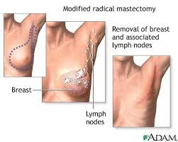

Slide 51
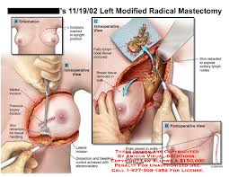

Slide 52
BREAST RECONSTRUCTION

Slide 53
Why?
“I have a long life to live and I want to live it whole.”
“I wanted to once again put on a beautiful nightgown and fill it all out.”
“”I was gardening one day when I bent over and my prosthesis fell out. Crying I picked it out of the muddy water. The next day I called a Plastic Surgeon.”

Slide 58
Permanent Expander
1Step
Corrects skin deficiency
Multiple office visits

Slide 60
Pre-op

Slide 61
Fully Expanded

Slide 62
Implant in Place

Slide 63
Nipple Areola Reconstruction

Slide 64
Autogenous Tissue
Corrects skin deficiency
Normal subcutaneous tissue
No foreign material
Longer operative time
Higher morbidity

Slide 65
Latissimus Dorsi

Slide 66
Latissimus Dorsi

Slide 67
Latissimus Flap Planning

Slide 74
Pre-op

Slide 75
Single Pedicle TRAM

Slide 76
Post-op

Slide 77
Pre-op

Slide 78
Intra-op

Slide 79
Post-op

Slide 80
Pre-op

Slide 81
Intra-op

Slide 82
Microsurgery

Slide 83
Post-op

Slide 84
Nipple Reconstruction

Slide 85
Areola Reconstruction

Slide 86
NAC Reconstruction

Slide 87
Post Radical and Radiation

Slide 88
TRAM

Slide 89
Lymphedema

Slide 90
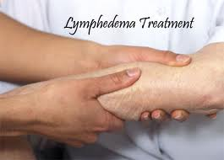

Slide 91
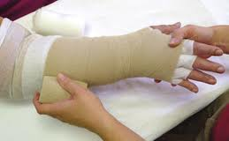

Slide 92
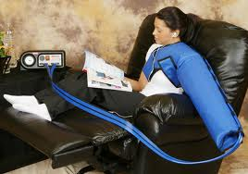

Slide 93
BREAST CANCER PREVENTION
Screening
Breast self-exam
Clinical Breast Exam
Mammography
Risk Assessment
Genetic Testing BRCA1/BRCA 2

Slide 94
Breast Clinical Exam

Slide 95
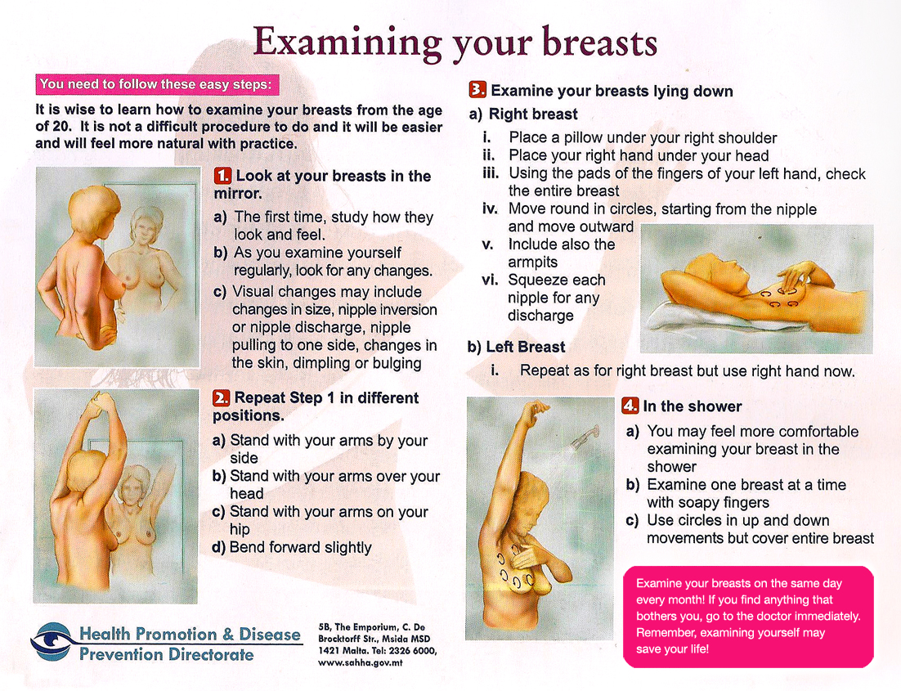

Slide 96
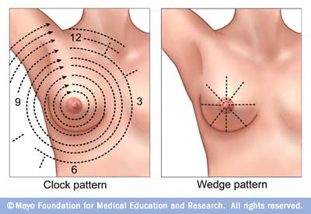
BREAST SELF-EXAM

Slide 97
Gynecomastia

Slide 98
The Male Breast
Gynecomastia
Prepubertal gynecomastia
Rare, adrenal carcinoma and testicular tumor can cause this.
Pubertal gynecomastia
Occurs in 60-70% of pubertal boys.
Senescent gynecomastia
40% of aging men have this to some degree.
Drugs, such as steroids, digitalis, hormones, spironolactone, and antidepressants can cause this.
Male breast carcinoma
0.7% of all breast cancers
<1% of male cancers
Average age of diagnosis is 63.6 years old
Painless unilateral mass that is usually subareolar with skin fixation, chest wall fixation,, and ulceration.
Mostly ductal carcinoma
Males generally present at later stage than woman
Overall survival worse in men, however when compared stage for stage the survival rates are similar.

