Slide 1
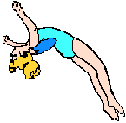
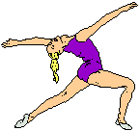
Stretching and Flexibility

Slide 2
Factors that influence flexibility
1- Joint structure
The type of joint determine the degree of ROM. For example; a ball-and-socket joint, like shoulder has greater ROM than a hinge joint like wrist.
2- Age
With age, muscles go through a shortening process due to lack of physical activities and a loss of elasticity in the connective tissues surrounding the muscles.
3- The Elasticity
The elasticity of the skin, tendons and ligaments.
4-Gender
Females tend to be more flexible than males of similar age throughout life.

Slide 3
Factors that influence flexibility
5-Exercise
Participation in regular exercise involving full ROM generally enhances flexibility, while a sedentary lifestyle often results in diminished flexibility.
6-Muscle mass
muscle mass can be a factor (for example, large hamstrings limits the ability to fully bend the knees). Excess fatty tissue imposes a similar restriction.

Slide 4
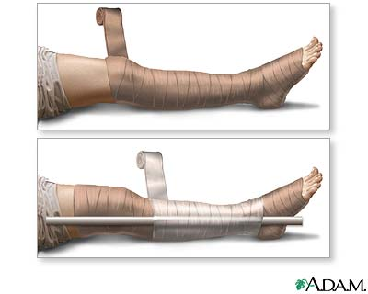
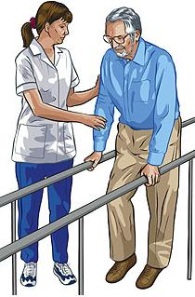
Causes of soft tissue shortening
1- Prolonged immobilization :
as patient in splint or plaster cast after fracture or surgery.
2- Restricted mobility:
patient rest in bed or wheel chair for long time leading to long term static and faulty position of the joints and soft tissues.
3- Neuromuscular diseases:
like paralysis, spasticity, weakness, muscle imbalance and pain.

Slide 5
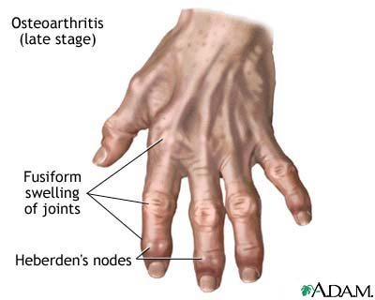
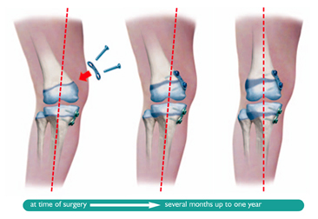
Causes of soft tissue shortening
4- Connective tissue diseases: like dermatomyositis, polymyositis, joint disease as rheumatoid arthritis and osteoarthritis which cause pain , inflammation and alter the structure of soft tissues.
5- Trauma and tissue pathology: like oedema, hemorrhage, surgical incision and burn.
6- Congenital and acquired bony deformities.

Slide 6
Types of Stretching
1- Ballistic stretching.
2- Dynamic stretching.
3- Active stretching.
4- Passive stretching.
5- Self stretching.

Slide 7
1- Ballistic stretching
is a form of passive stretching or dynamic stretching in a bouncing motion. It involves fast, "jerky" movements where a double bounce is performed at the end range of movement.

Slide 8
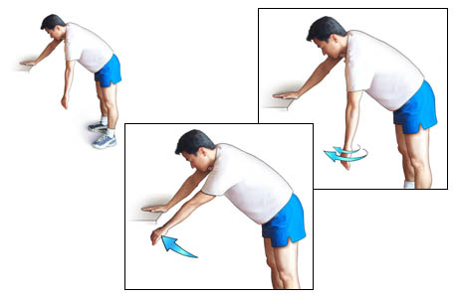
2- Dynamic stretching
Is controlled, swings, and moving gently part of your body to the limits of your range of motion. Dynamic stretching exercises should be performed in sets of 8-12 repetitions.

Slide 9
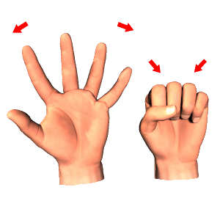
3- Active Stretching( inhibition)
Is a technique used to increase joint mobility by inhibiting and lengthening elastic muscle tissues or skin.
This type of stretching is only done with normally innervated muscle and under voluntary control.
It can not be used in patient with severe muscle weakness, spasticity, or paralysis from neuromuscular dysfunction.

Slide 10
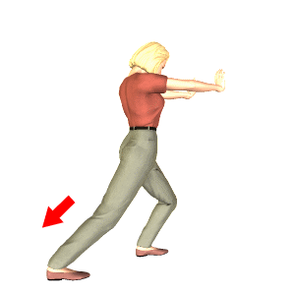
There are 3 variations of active inhibition technique:
Hold- relax
Hold- relax –contract
Agonist contraction

Slide 11
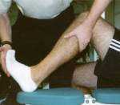
4- Passive Stretching
An external force applied either manually or mechanically while the patient is relaxed. This type can be classified into:

Slide 12
a- Manual Passive Stretch
The patient must be relaxed as possible during passive stretching.
The stretch force is usually applied for at least 30 seconds and repeated 3 times in an exercise session.
The therapist applies an external force and controls the direction, speed, intensity and duration of stretch to shorten soft tissues. The tissues are elongated beyond their resting length.
This technique should not be confused with passive range of motion exercises. Passive stretching takes the structures beyond the free range of motion. Passive range of motion is applied only within the unrestricted available range.

Slide 13
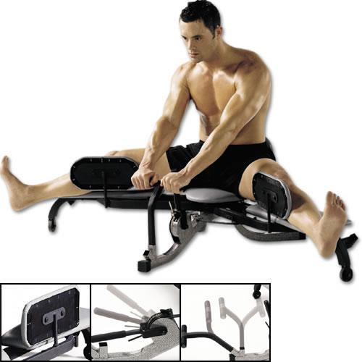
b- Prolonged Mechanical Passive Stretch
A low intensity external force (5-15 lb) is applied over a prolonged period of time with mechanical equipment.
The stretch force is applied with the patient as relaxed as possible.
The stretch may be maintained for 15-30 minutes or as long as several dayes or weeks, depending on the type of apparatus used.
The stretch can be applied through positioning of the patient, with weighted traction and pulley systems, or with serial splints or casts.

Slide 14
5- Self Stretching
Self stretching is a type of flexibility exercise that the patient carries out himself. It may involve relaxation of muscle and a passive stretch applied through the weight of the body.
Self stretching can also be carried out actively by the patient first inhibiting and then lengthening the tight muscle.

Slide 15
Goals of Stretching
1- The main goal is to regain normal range of motion of joints and mobility of soft tissue that surrounding that joint.
2- Prevent irreversible contractures.
3- Increase the general flexibility of muscle and soft tissues before vigorous strengthening exercises.
4- Minimize and prevent the risk of musculo-tendinous injuries related to specific physical activities and sports.

Slide 16
Procedure of Stretching
1-move the extremity slowly through the free range to the point of restriction.
2-grasp proximal and distal to the joint during the motion.
3-firmly stabilize the proximal segmentand move the distal p art.
4-very gentle traction to the moving joint prior to stretch.
5-the stretching force is slow, gentle and sustaind.
6-hold the patient in the stretched position at least 30 seconds.
7-gradually release the stretch force.
8-allow the patient to take rest then repeat the procedure.

Slide 17
Indications of Stretching
1- Limited range of motion due to contractures, adhesions and scar tissue formation leading to shortening of muscles, ligaments, connective tissue and skin.
2- When there are structural (skeletal) deformities as a result of limitation.
3- Whenever contracture interfere with activities of daily living.
4- When there is muscle imbalance (muscle weakness and opposing tissue tightness). Tight muscle must be stretched first before strength of weak muscle.

Slide 18
Contra-indications of Stretching
1- Presence of bony block that limits joint motion.
2- Recent fracture.
3- Cases of acute inflammation or infection (presence of heat and swelling around the joint).
4- Presence of acute sharp pain with joint movement or muscle elongation.

Slide 19
Contra-indications of Stretching
5- When a hematoma or other tissue trauma are observed.
6- When contracture or shortening of soft tissues are providing increase joint stability or increased functional abilities as in case of paralysis or sever muscle weakness.

Slide 20
Precautions of Stretching
1-Don’t force the joint beyond its normal range of motion (remember ROM varies in normal subjects).
2-Newly united fractures should be protected by stabilization between the fracture site and the joint where the movement takes place.
3-Patient known or suspected osteoporosis as, prolonged bed rest, old age, and prolonged use of steroids.

Slide 21
4-Avoid vigorous stretching of muscles and connective tissues that have been immobilized for long time (connective tissues as tendons and ligaments lose their tensile stretching after prolonged immobilization)
5-If there is joint pain or muscle soreness lasting for more than 24 hours, it is preferable to take rest and if you start to make stretch take care don’t use too much force during stretch.
6-Avoid stretching edematous tissues because it is more susceptible to injury.
7-Avoid overstretch the weak muscles because it may lead to more pain and edema.
8-Elderly patients due to age-related change in flexibility.

Slide 22
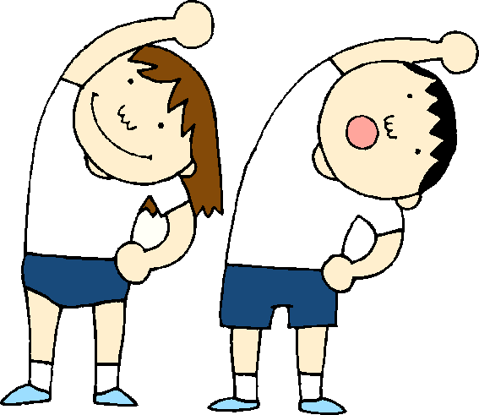
Definition of terms related to shortening
Stretching:
Therapeutic technique used to elongate (lengthen) shorten tissues and increase range of motion.
Passive stretching:
application of an external force (manual or mechanical) to a relaxed patient to lengthen his shortened soft tissues.
Active stretching:
the patient uses his own muscles to inhibit tight muscle and elongate it actively.

Slide 23
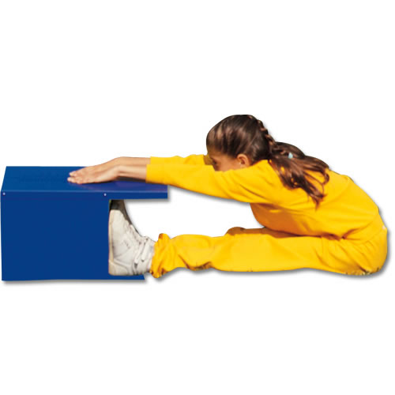
Definition of terms related to shortening
Flexibility
It is like stretching exercises used to increase range of motion. It is the ability of a muscle to relax and yield to a
stretch force.

Slide 24
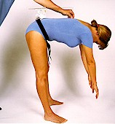
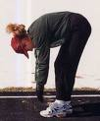
Definition of terms related to shortening
Tightness
It is a mild decrease in length of soft tissues. Tightness occurs in muscle or soft tissues before full range of motion can occur.
The subject is able to achieve all range but the outer range is limits.
Notes:
24

Slide 25
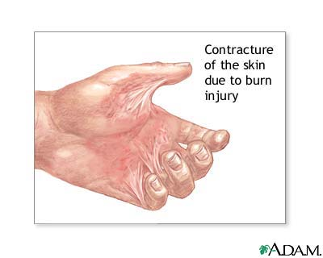
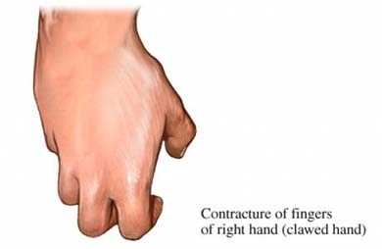
Definition of terms related to shortening
Contracture
It is a marked decrease in soft tissue length leading to significant loss of range of motion. The mechanical elasticity of the muscle is greatly compromised.
Contracture is described by identifying the shorten muscle; e.g., contracture of the elbow flexors will lead to reduce elbow extension range and we call it elbow flexion contracture.
The term contracture and contraction are not synonymous because contraction means physiological shortening of muscle.

Slide 26
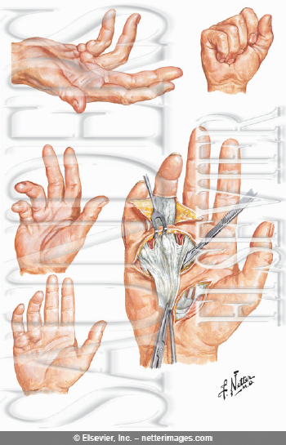
Definition of terms related to shortening
Irreversible Contracture
Irreversible contracture is a permanent loss of flexibility of soft tissue that cannot elongate or released by non surgical methods. The elastic tissues are replaced by non elastic tissues as bone, fibrosis and scar tissues.
Overstretch
Stretch beyond the normal range of motion of a joint and the surrounding soft tissues.
Overstretch may be necessary for certain healthy individuals with normal strength and stability participating in sports such as gymnastics.

Slide 27
Definition of terms related to shortening
Selective stretch is the use of stretching technique selectively to limit the range motion in specific joints.
For example: in patient with spinal cord injury, stability of the trunk is necessary for independence in sitting. With thoracic and cervical lesions, the patient will not have active control of back extensors. If moderate tightness is allowed to develop in the extensors of the low back, the patient will be able to lean into the slightly tight structures and will have some trunk stability in sitting.

Slide 28
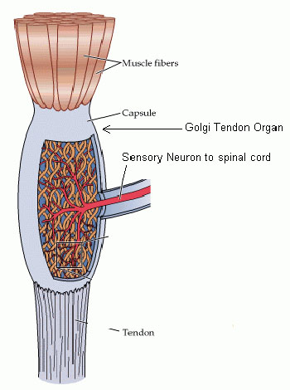
Golgi Tendon Organ(GTO),
Wraps around the ends of an extrafusal fibers and is sensitive to tension in muscle caused either by passive stretch or active muscle contraction.
The GTO is a protective mechanism that inhibits contraction of the muscle in which it lies. It fires easily (low threshold) after an active muscle contraction and has a high threshold for firing with passive stretch.

Slide 29
The GTO may be the neurophysiologic basis for the inhibition of muscle that occurs with passive stretching. When passive stretch is applied, tension will increase in the muscle and cause firing of GTO and subsequent inhibition (relaxation) of the muscle.

Slide 30
Stretching of Connective Tissues
Connective tissues around joints and within muscle must be also lengthened to increase range of motion. Although connective tissue does not have the contractile and relaxation properties of muscle, it is somewhat supple (plastic) and can be lengthened.

Slide 31
Stretching of Connective Tissues
If connective tissue is immobilized in shorten position it will tend to shorten as muscle tissues.
If the immobilization takes a long period of time, a dense form of fibrous tissues that does not yield to stretch will replace the normal connective tissues.
To elongate or stretch connective tissues you must use passive stretching.
Connective tissues yield best to a prolonged, sustained stretch applied for at least 20 to 30 minutes.

Slide 32
Stretching of Connective Tissues
It is preferable to use any source of heat to increase connective tissue temperature because it increases tissue extensibility but use of cold is not increase extensibility.
If the body part is allowed to cool in the lengthened position, more permanent changes in the length of connective tissue can be achieved.

