Slide 1
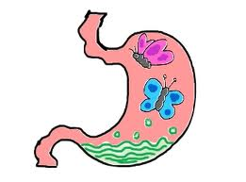
Stomach related Surgical issues
Dr. Nishan Silva
(MBBS)

Slide 2
Acute UGI Bleeding
Presentation
  Hematemesis
    Vomiting BRB or coffee ground material
  Melena
    Black tarry stool
  Hematochezia
    Bright red or maroon rectal discharge
    11% are UGI Bleeding
  NG Lavage
    Positive result
      Blood or coffee ground material
    Negative Result
      Bile with no blood
      Bleeding stopped
      Bleeding beyond closed pylorus

Slide 3
Acute UGI Bleeding
Hemodynamic Instability
  Shock
  Orthostatic hypotension
  Profuse active bleeding
  Decrease in HCT ≥ 10%
  Anticipated transfusion > 2 units RBC’s

Slide 4
Acute UGI Bleeding
Resuscitation
  Large bore I.V.
  NSS
  Blood Transfusions
  Correct coagulopathy INR > 1.5
    FFP
    Vitamin K
  Correct thrombocytopenia < 50,000
  NG Lavage to remove blood & clots
  Protect airway if necessary with elective intubation
  PPI
  Octreotide
  GI and Surgical Consults

Slide 5
Acute UGI Bleeding
Diagnostic Studies
  Endoscopy
  Tagged red cell bleeding scan
  Angiography

Slide 6
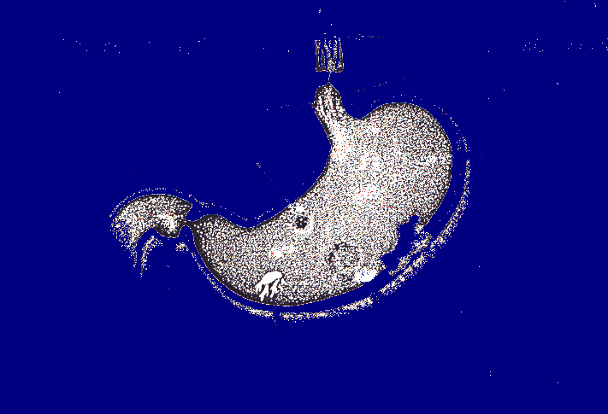
Causes of Esophago-Gastro-Duodenal Bleeding
Varices
Mallory Weiss
Esophagitis
Gastric Ulcer
NSAID’s/
Aspirin
Neoplasm
Duodenal Ulcer
Acute Gastritis
Arterio-Venous
Malformation

Slide 7
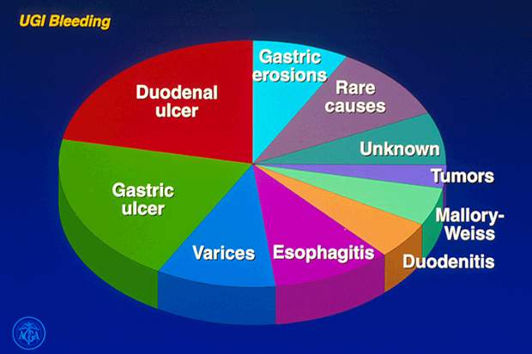
Upper Gastrointestinal Bleeding

Slide 8
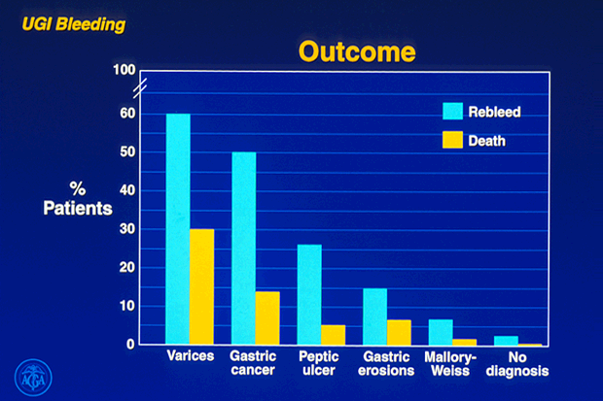
Influence of Diagnosis on Outcome

Slide 9
Acute UGI Bleeding
Endoscopy
  Gold standard for Dx
  Most sensitive study
  Therapeutic potential is major asset
  Decrease re-bleeding
  Fewer blood transfusions
  Decreases LOS
  Reduces mortality
  Reduces surgical procedure
  Pre-Endoscopy Emycin

Slide 10
Acute UGI Bleeding
Risks of Endoscopy
  Aspiration
  Hypoventilation
  Perforation
  Co-Morbid Events
    AMI
    COPD

Slide 11
Acute UGI Bleeding
Endoscopic treatment of PUD
  Epinephrine injection – initial Rx only
  Heater probe
  Bipolar electro-coagulation
  Endo clips – 15-20% of ulcers cannot be clipped
  Use double channel scope
  Re-bleeding occurs 15-20% of non-variceal lesions
  Re-bleeding usually occurs in 24-48 hrs.
  Re-scope successful 50%

Slide 12
Acute UGI Bleeding
PPI Treatment
  Decreases re-bleeding in PUD
  Decreases blood transfusions and LOS
  High risk ulcers; use PPI infusion
    80 mg IV bolus
    8 mg 1 hr. infusion
  Switch to PPI BID orally in 72 hrs.
  Positive H. pylori; treat as outpatient

Slide 13
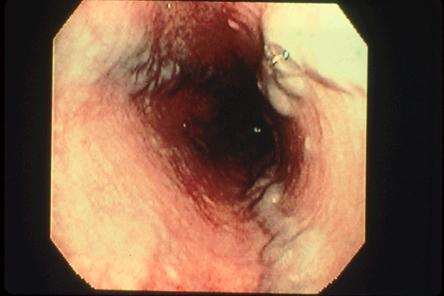
Endoscopic View of Oesophageal Varices

Slide 14
Variceal Bleeding
Prediction of patients at risk
Prophylaxis against first bleed
Treatment of active bleeding
Prevention of re-bleeding

Slide 15
Variceal Bleeding
30-40% mortality
Directly related to portal hypertension
70% risk of re-bleeding in 1 year
Occurs in 25-40% of patients with cirrhosis most common etiology
Portal pressure flow X resistance
Normal portal pressure 5mm Hg

Slide 16
Variceal Bleeding
Treatment of Active Bleeding
  Current Options
    Octreotide
    Endoscopy
    Surgery
    TIPS

Slide 17
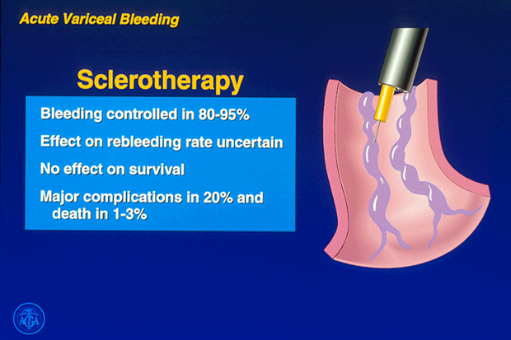
Oesophageal Varices - Sclerotherapy

Slide 18
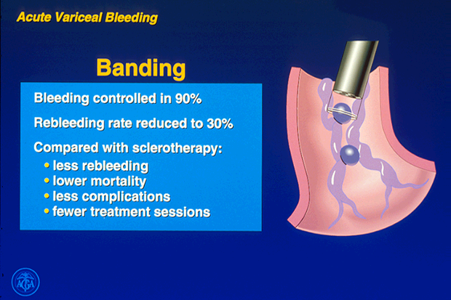
Oesophageal Varices - Banding

Slide 19
Transjugular Intrahepatic Porto Systemic Shunts
Functions similar to surgical shunts
No surgery, done transjugular
Re-bleed rate 20% in first year
Major drawback is hepatic encephrlopathy
Shunt stenosis common
Very expensive
Best used as salvage procedure

Slide 20
Gastric and duodenal ulcer disease

Slide 21
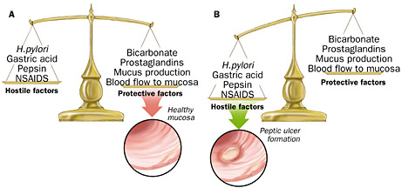
Peptic Ulcer Disease
Pathogenesis :
Protective factors vs. hostile factors

Slide 22
Peptic ulcer
Pathogenesis:
For both Duodenal & Gastric Ulcers:
  Infection w/ H. pylori:
    Decreases resistance of mucus layer from acid permeation (hydrophobicity)
    Increase acid secretion
    Slow duodenal emptying
    Reduced both duodenal and gastric bicarbonate secretion

Slide 23
Clinical Manifestation
Abdominal pain:
  Due to irritation of afferent nerves w/in the ulcer by the acid or due to peristaltic waves passing through the ulcer
    Duodenal: colicky or burning pain relieved w/ food intake
    Gastric: gnawing or burning usually during or after eating.
N/V
Weight loss
Epigastric tenderness

Slide 24
Peptic ulcer
Pathogenesis:
  Effects of NSAIDs
    Decreases Prostagladin
    Prostaglandin – inhibits acid secretion, stimulates mucus and HCO3 secretion and mucosal blood flow
  Zollinger-Ellison Syndrome (1%):
    Massive secretion of HCL due to ectopic gastrin production from non-beta islet cell tumor (gastrinoma)
    Associated w/ type I (MEN) PPP
    20% multiple, 2/3 malignant, w/ slow growing
    Parietal cell mass is increased
    > gastrin 3-6 x the normal

Slide 25
Symptoms of gastric ulcer disease:
  epigastric pain after meal or during meal
  upper dyspeptic syndrome – loss of appetite, nauzea, vomiting, flatulence
  vomiting brings relief
  reduced nutrition
  loss of weight

Slide 26
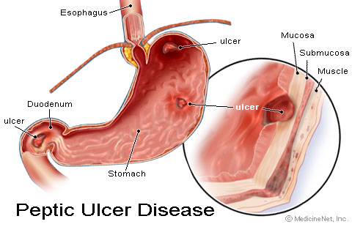
Comparing Duodenal and Gastric Ulcers

Slide 27
Symptoms of duodenal ulcer disease:
  epigastric pain 2 hours after meal or on a empty stomach or during night
  pyrosis
  good nutrition
  obstipation
  seasonal dependence (spring, autumn)

Slide 28
Diagnosis:
UGIS (double contrast)
Endoscopy

Slide 29
Therapy:
  Conservative
    regular lifestyle
    prohibition of the smoking and alcohol
    diet (proteins, milk and milky products)
    pharmacology (antagonists of H2 receptors, antacids, anticholinergics
  Surgical
    BI, BII resection
    proximal selective vagotomy
    vagotomy with pyloroplastic
    suture of perforated or haemorrhagic ulcer

Slide 30
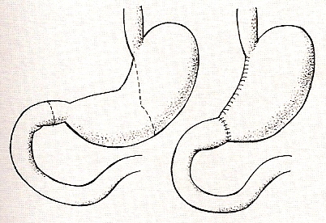
Zeman, M. et al., Speciální chirurgie, ISBN 80-7262-260-9, 2004
Billroth I

Slide 31
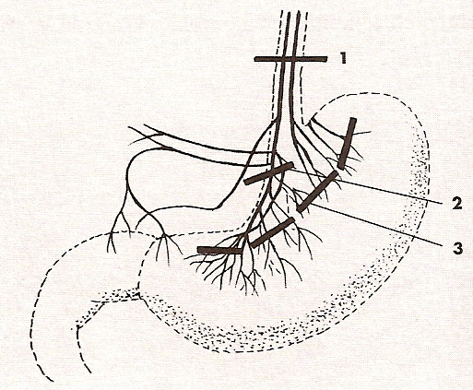
Zeman, M. et al., Speciální chirurgie, ISBN 80-7262-260-9, 2004
Vagotomy

Slide 32

Treatment
Primarily medical
  PPI or H2 blocker
  Triple combination (double antibiotic and PPI=amoxicillin, clarithromycin, pantoprazole for 7-14 days)
Surgical indications
  Intractibility (after medical therapy)
  Hemorrhage
  Obstruction
  Perforation
  Relative: continuous requirement of steroid therapy/NSAIDs
Notes:
H pylori therapy fails in as many as 20% of patients

Slide 33
Treatment:
Mechanism of Pharmacologic Therapy:
For eradication of H. pylori:
  Bismuth based triple therapy
    Bismuth + Tetracycline + Metronidazole
  Proton pump inhibitor
    Omeprazole + Amoxicillin/Clarithromycin
    + metronidazole

Slide 34
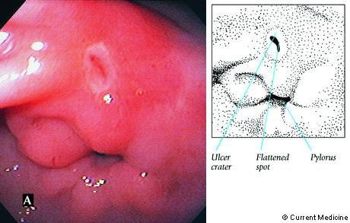
GI Bleeding

Slide 35
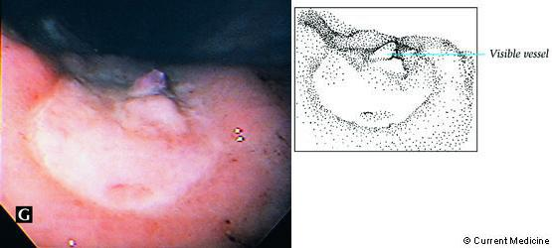
Ulcer with recent bleed

Slide 36
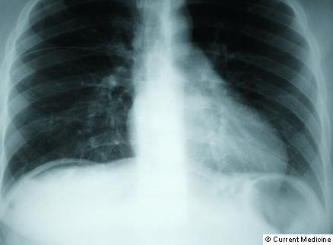
Ulcer Perforation

Slide 37
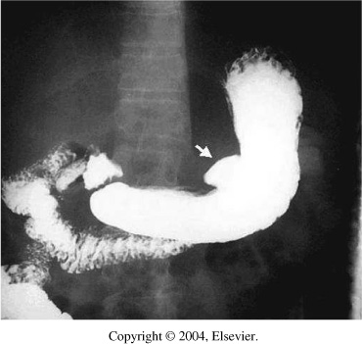

Slide 38
Gastric Cancer
Gastric cancers can occur anywhere in the stomach. However, most frequently, they occur on the lesser curvature (next slide).
The tumor infiltrates the surrounding mucosa, penetrating the wall of the stomach and adjacent organs and structures.
At the time of diagnosis, the liver, pancreas, esophagus, and duodenum are often affected.

Slide 39
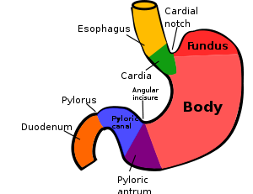
Clinical manifestations
Pain relieved by antacids.
Dyspepsia (indigestion), early satiety , weight loss, abdominal pain above the umbilicus.
Loss of appetite and nausea and vomiting.

Slide 40
Assessment and diagnostic findings
The physical examination may not be helpful in detecting the cancer because most early gastric tumors are not palpable. In advanced cases, a gastric mass may be palpable.
Ascites and hepatomegaly may be apparent if metastasis occurs.
Palpable nodules around the umbilicus (slide 6).
Esophagogastroduodenoscopy for biposy and cytologic washings is the diagnostic study of choice.
CT completes the diagnostic studies to assess for surgical resectability of the tumor before surgery is scheduled.
CT of the chest, abdomen, and pelvis is important in staging of gastric cancer.

Slide 41
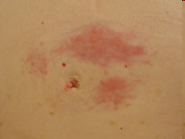
Sister Mary Joseph's nodule of the umbilicus

Slide 42
Medical management
Successful treatment of gastric cancer is through tumor removal.
Cure could be achieved if the tumor has been removed while it is still localised to the stomach. Otherwise, cure is less likely.
Unresectable tumor in a patient with advanced disease, chemotherapy using single agent chemotherapeutic medications including 5-fluorouracil (5-FU), cisplatin, doxorubicin, and mitomycin.
It is now more common to administer combination therapy, primarily 5-FU-based therapy with other agents.

Slide 43
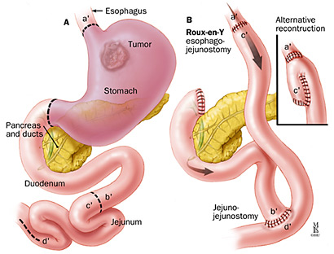
Total gastrectomy may be performed for a resectable cancer. The entire stomach, the duodenum, the lower portion of the esophagus, supporting mesentry, and lymph nodes are removed. Esophagojejunostomy is performed to reconstruct the GI tract.

Slide 44
Nursing diagnoses, planning and goals
Based on assessment data, nursing diagnoses may include:
  Anxiety related to the disease and anticipated treatment.
  Imbalanced nutrition related to early satiety or anorexia.
  Pain related to tumor mass.
  Anticipatory grieving related to diagnosis of cancer.
  Deficient knowledge regarding self-care activities.
The major goals for the patient may include:
  reduced anxiety
  optimal nutrition
  pain relief
  adjustment to diagnosis and anticipated life style changes

Slide 45
Question
Treatment of ulcers which are positive for H. pylori need?
A) only a longer coarse of PPI
B) addition of antibiotics
C) need an inpatient coarse of
treatment
D) can be treated the same as ulcers
that are negative for H. pylori

Slide 46
Clinical Scenario
67 yo M with history of HTN and osteoarthritis who presents to the ED with 3 episodes of coffee –ground emesis today.
No abdominal pain, melena or hematochezia. No history of liver disease or coagulopathy, +occasional ETOH use.
Medications include HCTZ, Lisinopril, and Ibuprofen PRN for joint pain
VS on arrival: T 37, HR 102, BP 108/72, similar BP standing , Pox 99% RA
Examination: . No scleral icterus. Abdomen soft, non-tender, no HSM. Rectal with dark brown stool
Labs: Hgb 9.8, Plt 245, INR 1, LFTs nl, BUN 28/Cr 1.4.

Slide 47
Clinical Scenario Conclusion
67yo M on NSAIDS with 3 episodes of coffee –ground emesis, anemia, and tachycardia
  What is the likely etiology of the bleeding?
  What is the appropriate acute management?

Slide 48


Slide 49


