Slide 1
Common Skin Lumps in Surgery
Dr. S. Nishan Silva
(MBBS)

Slide 2
Solitary neurofibroma
Soft, flaccid, pinkish white, 2-20 mm
Invaginates on pressure, “buttonholing”
Solitary or multiple
Distinctive histopathologic findings, fibrils, cellular proliferation, and degenerative changes
Sx excision

Slide 3
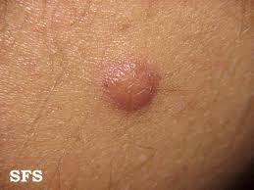

Slide 4
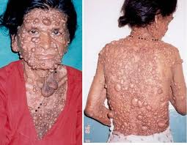

Slide 5
lipomas
Subcutaneous tumors composed of fat tissue
Most commonly found on the trunk
Also neck, forearms and axillae
Soft, single or multiple, lobulated and compressible
Growth to size and remain stationary
again be careful of sacrococcygeal lipomas
Lesion may be left untreated or excised

Slide 6
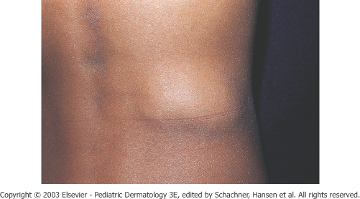
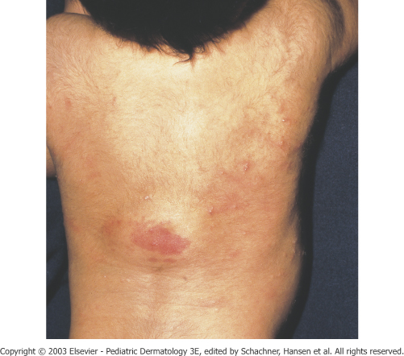

Slide 7
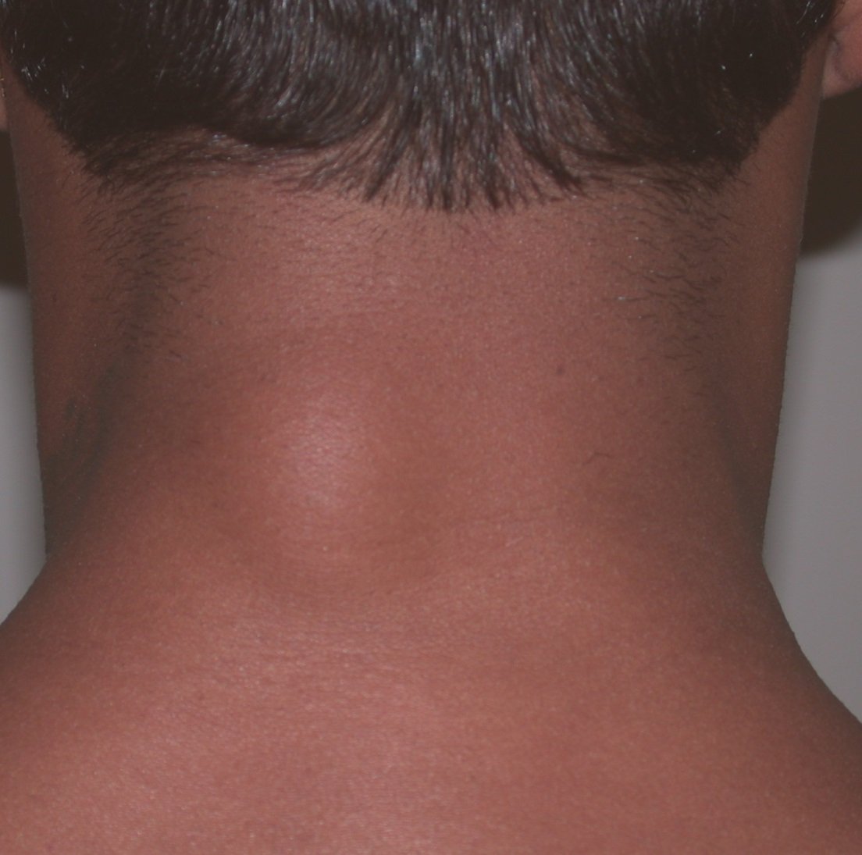

Slide 8
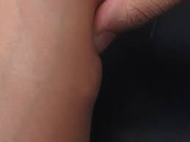
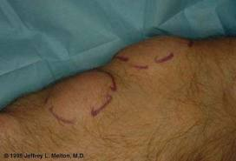

Slide 9
Solitary lesions reaching greater than 10 cm should be investigated for malignancy
Multiple lesion may be painful if growing rapidly
Madelung’s disease, benign symmetric lipomatosis
Dercum’s disease, assoc with weakness and psychiatric disturbances

Slide 10
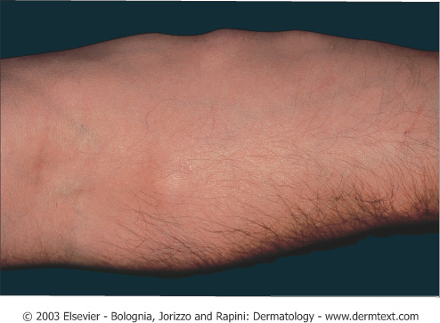

Slide 11
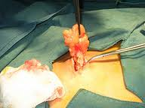

Slide 12
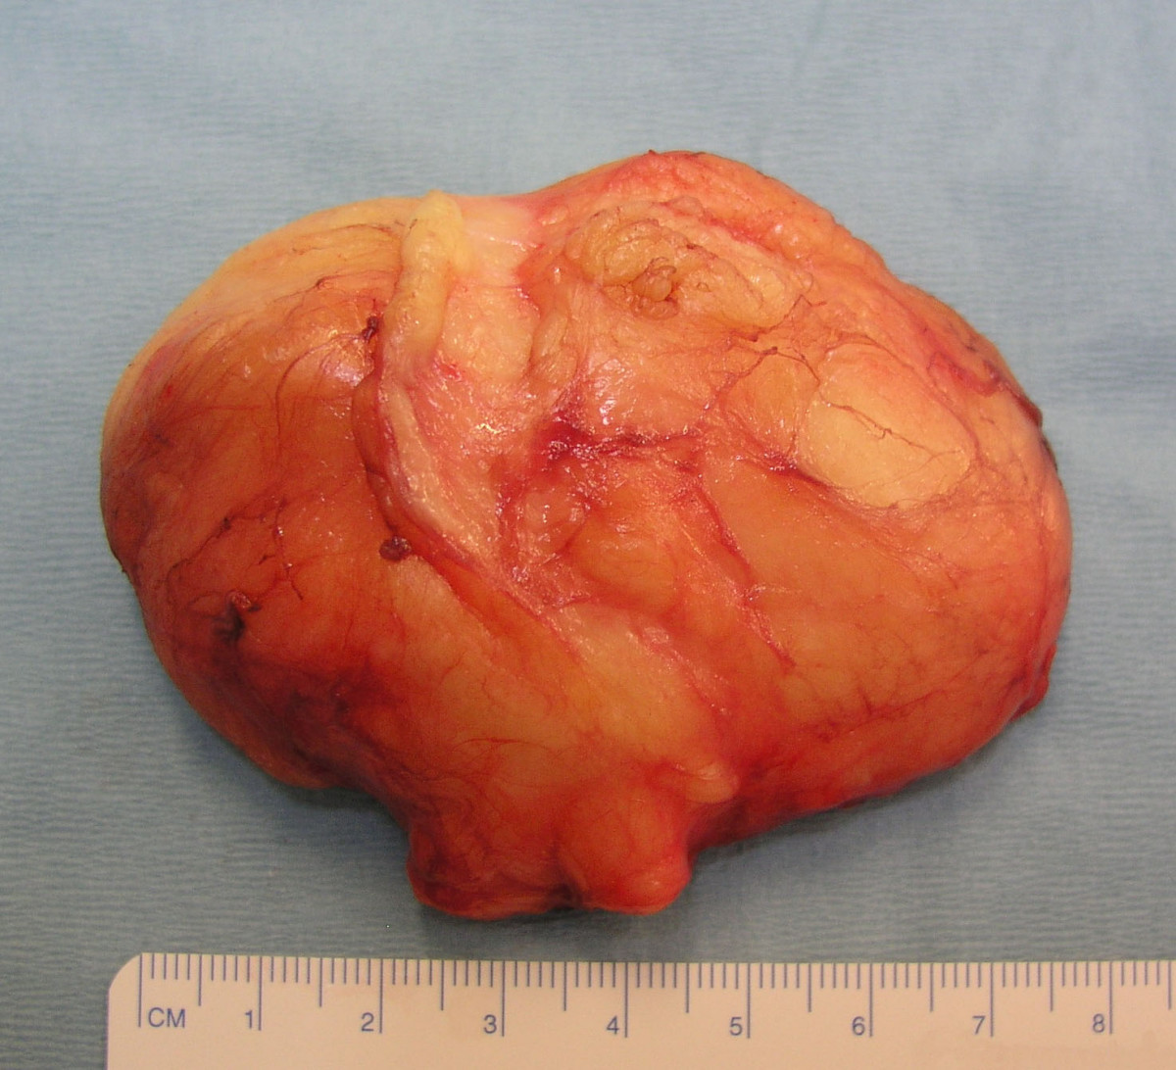

Slide 13
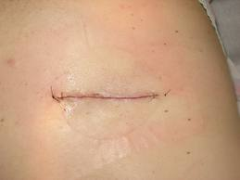

Slide 14
Sebaceous cyst

Slide 15
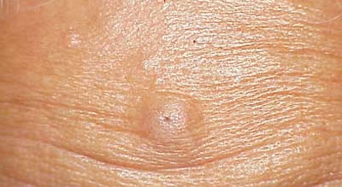

Slide 16
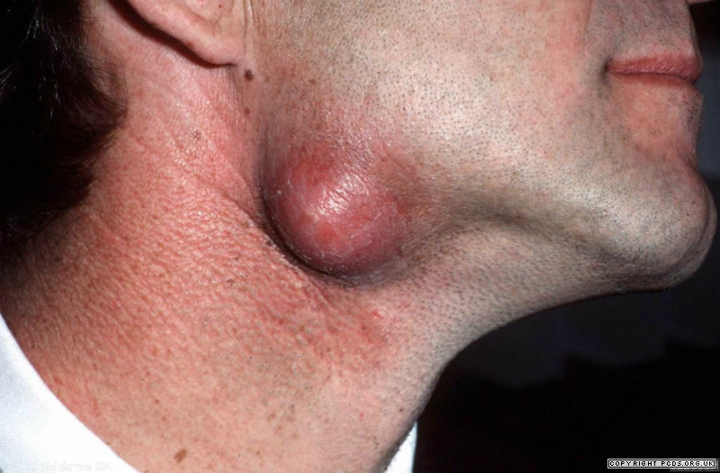

Slide 17
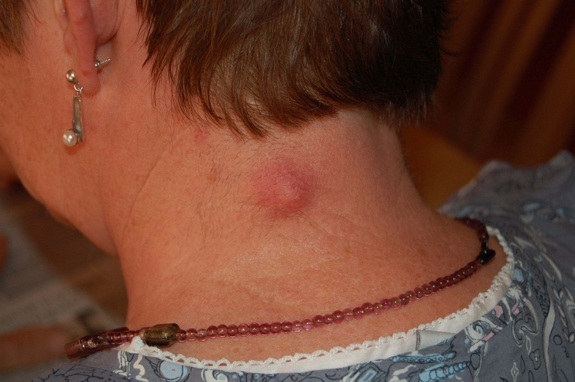

Slide 18
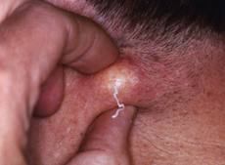

Slide 19
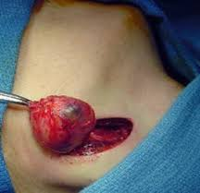

Slide 20
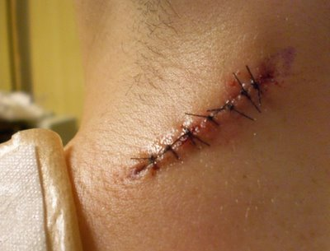

Slide 21
Carbuncle

Slide 22
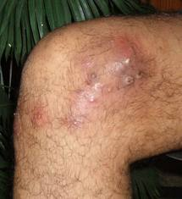
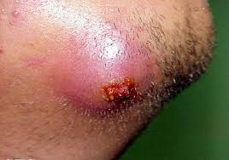

Slide 23
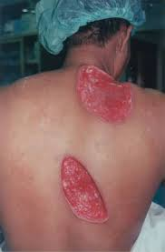

Slide 24
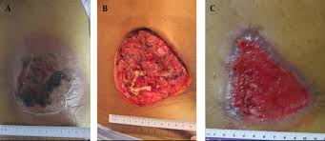

Slide 25
Ganglion

Slide 26
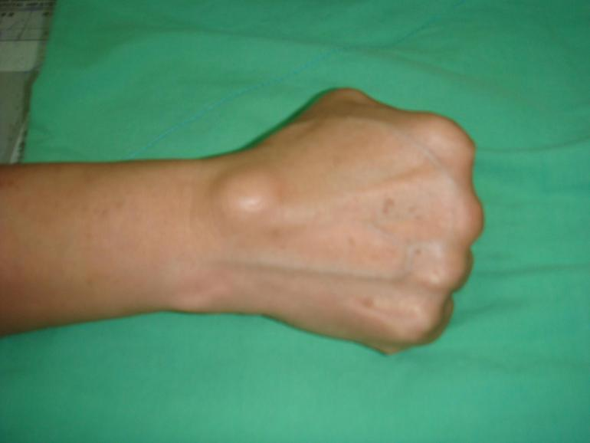

Slide 27
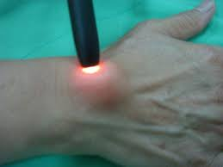

Slide 28
