Slide 1
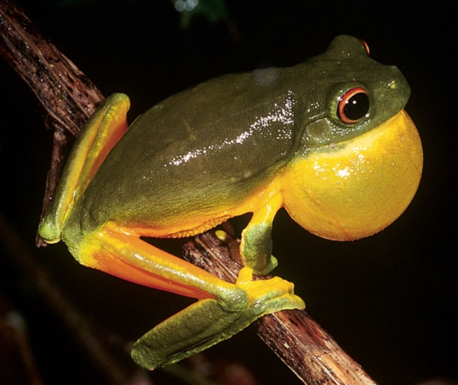
Neck and Thyroid Surgeries
Dr. S. Nishan Silva
(MBBS)

Slide 2
NECK SURGERY
LUMPS IN THE NECK
WOUNDS OF THE NECK
SURGICAL INFECTIONS IN THE NECK

Slide 3
LUMPS IN THE NECK HISTORY AND EXAMINATION
HISTORY:- rate of growth of the lump, - symptoms:pain, discharge
EXAMINATION- characteristics of the lump- site, shape, size, surface, tenderness, fixation, consistency, fluctuence, pulsatility, associated lymph- adenopathy
Clinical diagnosis- benign or malignant
-cystic or solid lump

Slide 4
LUMPS IN THE NECK CAUSES
1. Lymph node enlargement:
-lymphomas,
-lymph node metastases,
-inflammatory lymphadenopathy from acute or chronic infections in the neck,
-AIDS related lymphadenopathy
2. Congenital cysts: thyroglossal, branchial, cystic hygroma
3. Lumps in the skin: lipoma, epidermal cyst
4. Rare tumors: carotid body tumors
5. Thyroid and parathyroid nodules

Slide 5
LYMPH NODE ENLARGEMENT
CERVICAL TUBERCULOSIS
Synonims: tuberculous cervical adenitis
:cervical tuberculous lymphadenopathy
:mycobacterial lymphadenitis
:extrapulmonary tuberculosis

Slide 6
LUMPS IN THE NECK CAUSES
1.LYMPH NODE ENLARGEMENT:
c. ACUTE INFECTIONS d. CHRONIC INFECTIONS

Slide 7
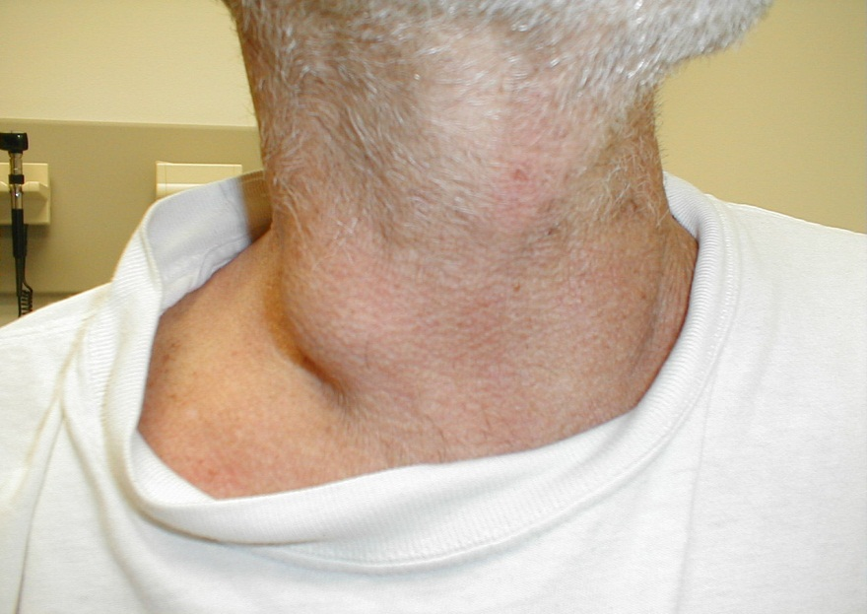
LUMPS IN THE NECK CAUSES
1.LYMPH NODE ENLARGEMENT:
a. PRIMARY TUMORS b. SECONDARY TUMORS
-lymphomas- -lymph node metastases-

Slide 8
LUMPS IN THE NECK CAUSES
2. CONGENITAL CYST:
c. CYSTIC HYGROMA

Slide 9
LUMPS IN THE NECK CAUSES
2. CONGENITAL CYST:
a. THYROGLOSSAL CYSTS

Slide 11
Thyroglossal fistula
Thyroglossal fistula is never congenital.
It follows infection or inadequate removal of thyroglossal cyst.

Slide 12
Characteristic indrawing of the external opening of a thyroglossal fistula on protrusion of the tongue.

Slide 13
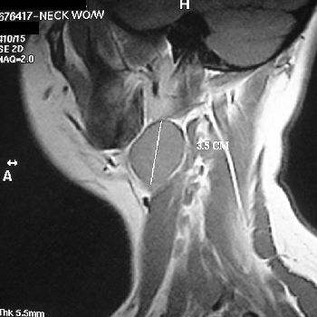
LUMPS IN THE NECK CAUSES
2. CONGENITAL CYST:
b. BRANCHIAL CYST

Slide 14
LUMPS IN THE NECK CAUSES
3.LUMPS IN THE SKIN:
a. LIPOMA

Slide 15
LUMPS IN THE NECK CAUSES
3.LUMPS IN THE SKIN:
b. EPIDERMAL CYST

Slide 16
Lingual Thyroid
Whole or part of the gland containing as a swelling at the tongue base.
May cause dysphagia, impairment of speech, respiratory obstruction.

Slide 17
Ectopic Thyroid
? Ectopic

Slide 18
LUMPS IN THE NECK CAUSES
4.RARE TUMORS:
CAROTID BODY TUMORS

Slide 19
Thyroid Problems

Slide 20
History
History elements suggestive of malignancy:
Progressive enlargement
Hoarseness
Dysphagia
Dyspnea
High-risk (fam hx, radiation)
Not very sensitive / specific

Slide 21
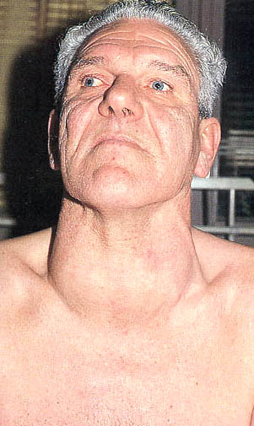
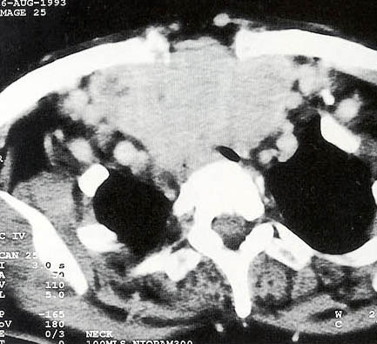
Physical Exam

Slide 22
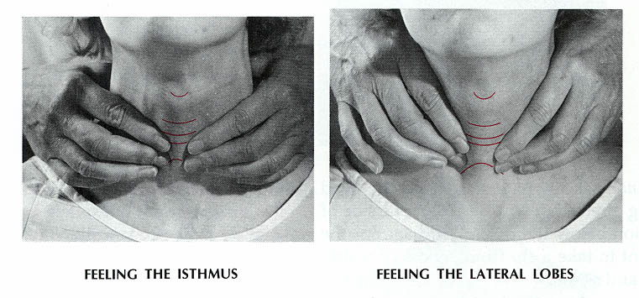
Physical
Thyroid exam generally best from behind
Check for movement with swallowing

Slide 23
Hyperthyroidism Symptoms
Hyperactivity/ irritability/ dysphoria
Heat intolerance and sweating
Palpitations
Fatigue and weakness
Weight loss with increase of appetite
Diarrhoea
Polyuria
Oligomenorrhoea, loss of libido

Slide 24
Hyperthyroidism Signs
Tachycardia (AF)
Tremor
Goiter
Warm moist skin
Proximal muscle weakness
Lid retraction or lag
Gynecomastia

Slide 25
Causes of Hyperthyroidism
Most common causes
Graves disease
Toxic multinodular goiter
Autonomously functioning nodule
Rarer causes
Thyroiditis or other causes of destruction
Thyrotoxicosis factitia
Iodine excess (Jod-Basedow phenomenon)
Struma ovarii
Secondary causes (TSH or ßHCG)

Slide 26
Graves Disease
Autoimmune disorder
Ab^{s} directed against TSH receptor with intrinsic activity. Thyroid and fibroblasts
Responsible for 60-80% of Thyrotoxicosis
More common in women

Slide 27
Graves Disease Eye Signs
N - no signs or symptoms
O – only signs (lid retraction or lag) no symptoms
S – soft tissue involvement (peri-orbital oedema)
P – proptosis (>22 mm)(Hertl’s test)
E – extra ocular muscle involvement (diplopia)
C – corneal involvement (keratitis)
S – sight loss (compression of the optic nerve)

Slide 28
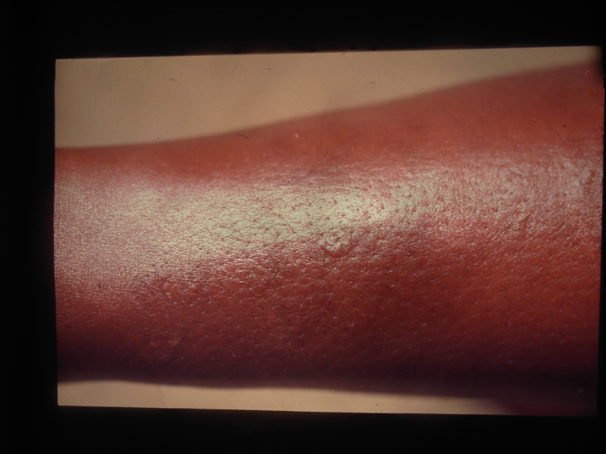
Graves Disease Other Manifestations
Pretibial mixoedema
Thyroid acropachy
Onycholysis
Thyroid enlargement with a bruit frequently audible over the thyroid

Slide 29
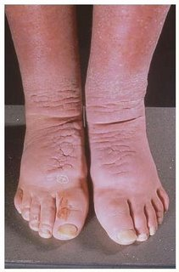
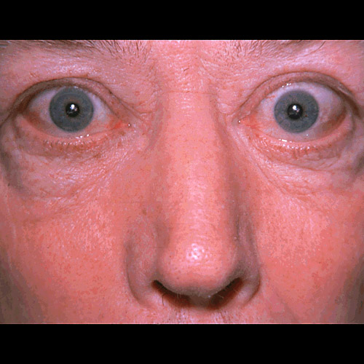
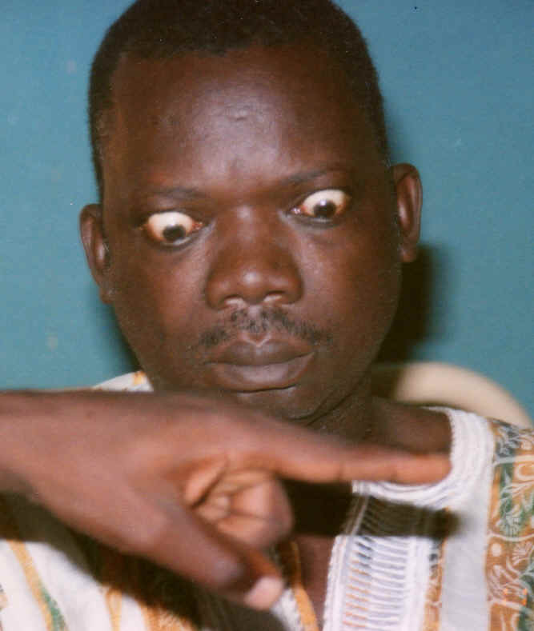
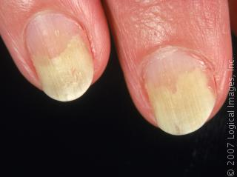
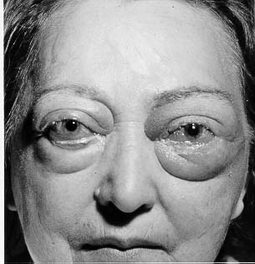
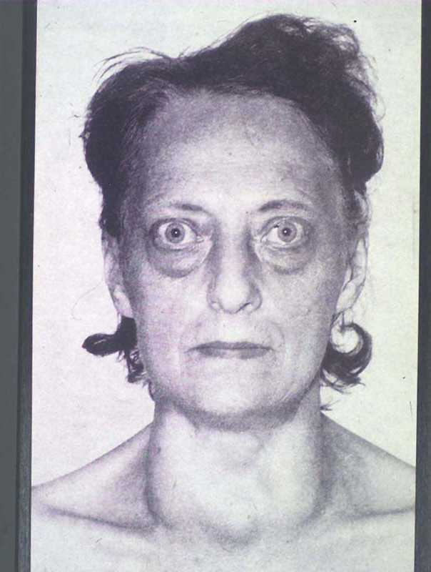
Graves disease

Slide 30
Hypothyroidism Symptoms
Tiredness and weakness
Dry skin
Feeling cold
Hair loss
Difficulty in concentrating and poor memory
Constipation
Weight gain with poor appetite
Hoarse voice
Menorrhagia, later oligo and amenorrhoea
Paresthesias
Impaired hearing

Slide 31
Hypothyroidism Signs
Dry skin, cool extremities
Puffy face, hands and feet
Delayed tendon reflex relaxation
Carpal tunnel syndrome
Bradycardia
Diffuse alopecia
Serous cavity effusions

Slide 32
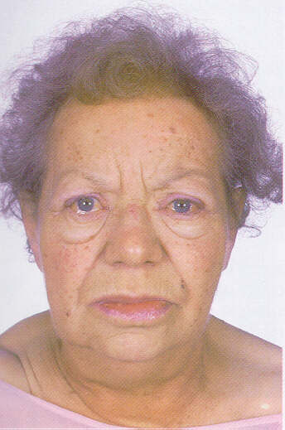
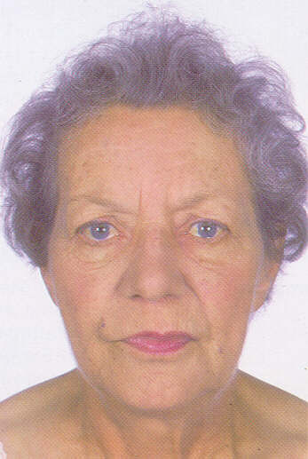
Hypothyroidism
Before
after

Slide 33
Causes of Hypothyroidism
Autoimmune hypothyroidism (Hashimoto’s, atrophic thyroiditis)
Iatrogenic (I₁₂₃treatment, thyroidectomy, external irradiation of the neck)
Drugs: iodine excess, lithium, antithyroid drugs, etc
Iodine deficiency
Infiltrative disorders of the thyroid: amyloidosis, sarcoidosis,haemochromatosis, scleroderma

Slide 34
Chronic Thyroiditis
Hashimoto’s
Autoimmune
Initially goiter later very little thyroid tissue
Rarely associated with pain
Insidious onset and progression
Most common cause of hypothyroidism
TPO ab^{s} present (90 – 95%)

Slide 35
LUMPS IN THE NECK CAUSES
Multinodular goitre

Slide 36
Thyroid carcinomas
Papillary carcinoma
Follicular carcinoma
Medullary carcinoma
Anaplastic carcinoma

Slide 37
Papillary Carcinoma
Most common (80%)
Women 3 times more common
30-40 years of age
Familial also (FAP)
Radiation exposure as a child
Patients with Hashimoto’s thyroiditis
Slow growing, TSH sensitive, take up iodine, TSH stimulation produces thryroglobulin response.

Slide 38
Follicular Carcinoma
Second most common (10%)
Iodine deficient areas
3 times more in women
Present more advanced in stage than papillary
Late 40’s
Also TSH sensitive, takes up iodine, produces thryroglobulin.

Slide 39
Medullary Carcinoma
5%, female preponderance
75% sporadically, 25% familial. Familial cases are usually all over the gland, sporadic usually not multifocal.
MEN 2A, MEN2B syndromes.

Slide 40
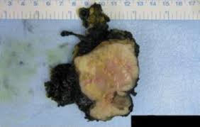
Anaplastic Thyroid Carcinoma
Bad.

Slide 41
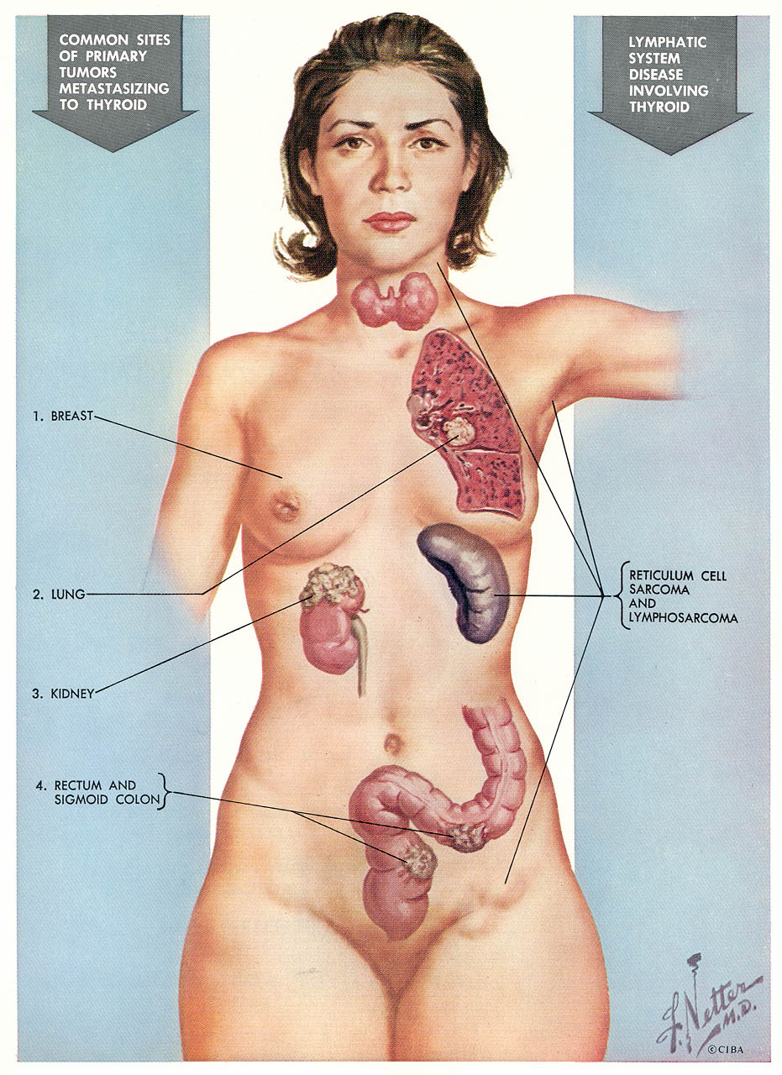
Thyroid Mets
Breast
Lung
Renal
GI
Melanoma

Slide 42
Thyroid Evaluation
TRH
TSH
Total T₃, T₄
Free T₃, T₄
RAIU
Thyroglobulin
Antibodies: Anti-TPO, Anti-TSHr

Slide 43
Thyroid Evaluation

Slide 44
X- rays
Plain radiograph
chest & thoracic inlet
….to detect retrosternal thyroid extension ,thyroid calcification ,bony or mediastinal LN & lung metastases
CT scan…
…For detecting regional &distant metasasis from thyroid cancr
MRI
….diagnosis of cervical LN metastasis

Slide 45
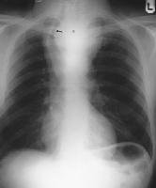
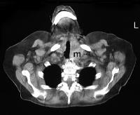
CT scan
AP CXR with large retrosternal
Goitere

Slide 46
Ultrasound
Used to establish the size & shape of the gland .
May indicate if nodules are single or multiple.
It will distinguish between cystic & solid lesions. (intrathyroid lesion)

Slide 47
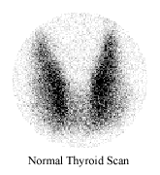
Radioisotpe scan
Single or multiple nodules .
Over functioning (hot nodules) or non-functioning (cold nodules)
20% of cold nodules are malignant
Hot nodules ….rarely malignant
Cold n
Hot n

Slide 48
How??
An injected or inhaled or ingested compound labelled with a suitable radionuclide is concentrated in the organ under review .
The emitted radiation is detected by the gamma camera.
Examples of radionuclides… Technetium 99m (99mTc)
iodine 131(131I)
Krypton (81mKr)
Gallium67 (67Ga)

Slide 49
FNA
Should be performed in the investigation of all thyroid nodules.
Distinguish between a solid lesion & a cyst
If the lesion is solid….cells are sent for cytological examination
If the lesion is a cyst ….then the fluid can be removed

Slide 50
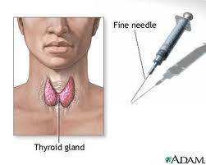

Slide 51
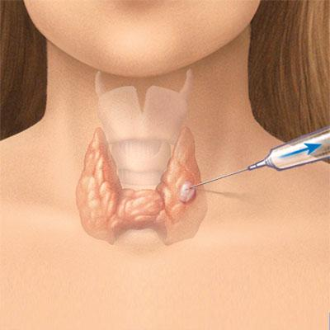
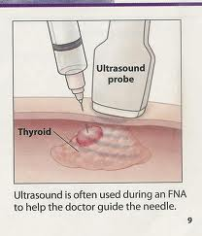

Slide 52
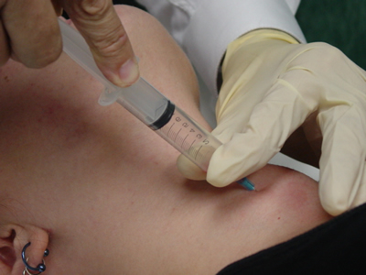

Slide 53
How??
A 21 G needle attached to a syringe ,flushed with saline.
is passed several times through the nodule while suction is maintained on the syringe.
The aspirated cells are then smeared onto slide & wet &/or dry fixed.
Results of cytology show benign cells, suspicious cells , malignant cells or the specimen is inadequate & consists of red cells only.

Slide 54
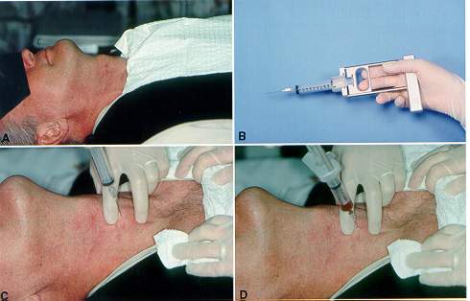
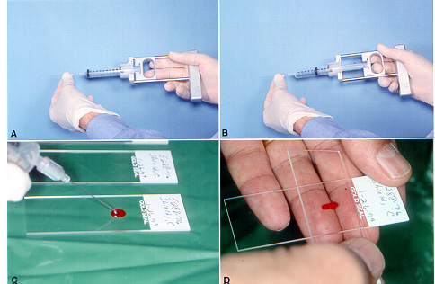

Slide 55
Frozen sections

Slide 56
Treatment…
FNA
benign
suspicious
malignant
inadequate
Observe
Repeat FNA
After 6-12months
surgery
surgery
Repeat FNA
Thyroid lobectomy

Slide 57
Types of thyroidectomies

Slide 60
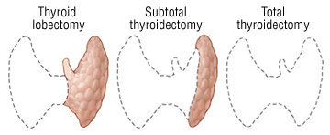

Slide 61
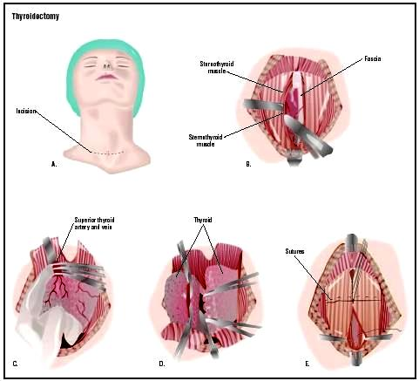

Slide 63
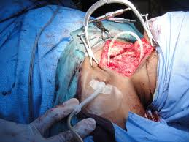

Slide 64
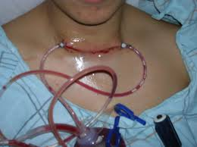

Slide 65
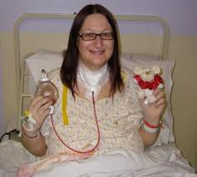
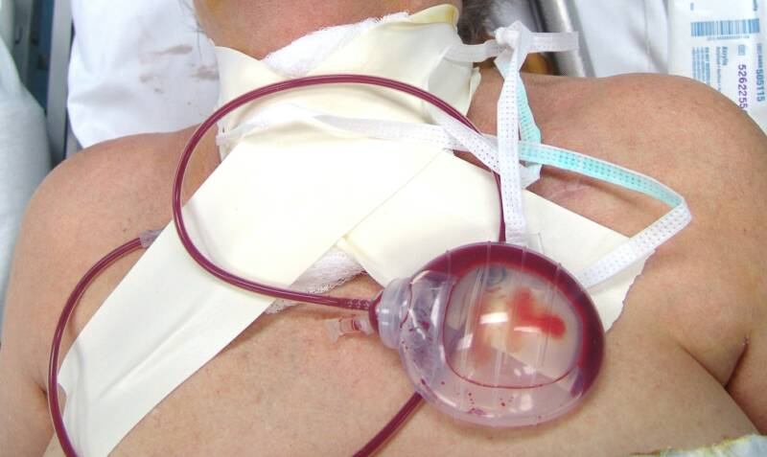

Slide 66
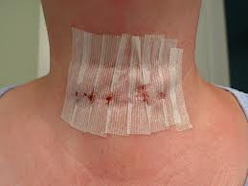
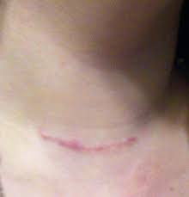

Slide 67
Complication of thyroid surgery
Damage to recurrent laryngeal nerve ….. leading to palsy & causing hoarseness.
Damage to external branch of superior laryngeal nerve … leading to palsy & hoarseness
Hypocalcaemia …caused by damage to parathyroids
Haemorrhage…causing laryngeal oedema & respiratory compromise.

Slide 68
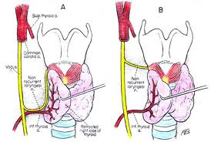
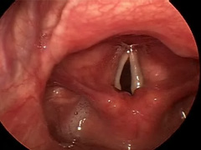

Slide 69
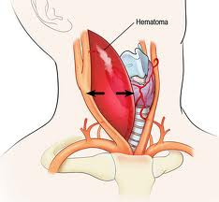

Slide 70
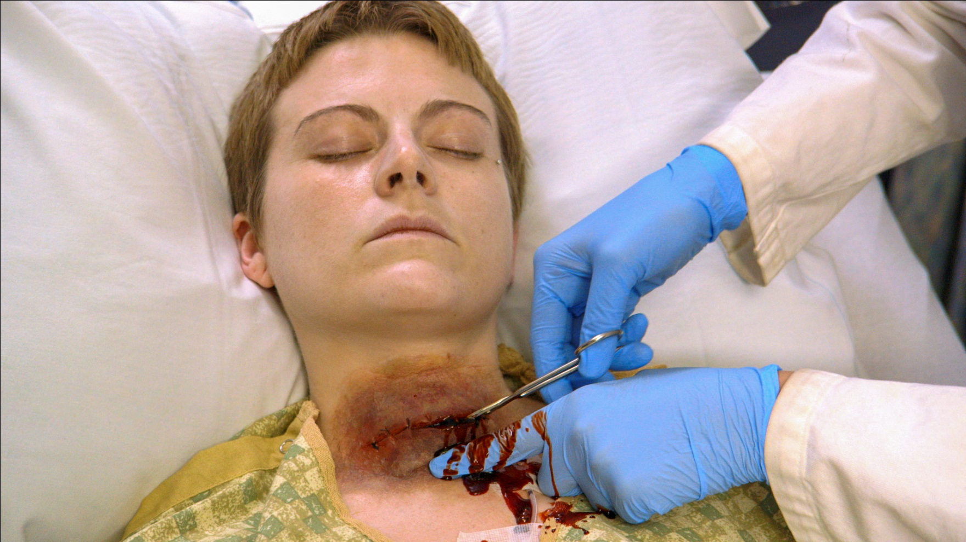

Slide 71
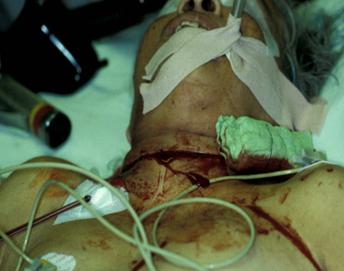

Slide 72
Thyrotoxic crisis (thyroid storm)
Severe thyrotoxicosis
High mortality
Need high index of suspicion
Prompt recognition needed
In those past/family hx of thyroid disorder

