Slide 1
Cardiothoracic surgery
Part II

Slide 2
Lobectomy
Lobectomy means surgical excision of a lobe.
A lobectomy of the lung is performed in early stage non-small cell lung cancer patients. It is not performed on patients that have lung cancer that has spread to other parts of the body.

Slide 3
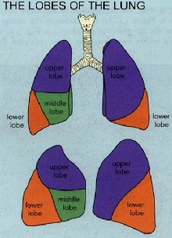

Slide 4
Pneumonectomy
A pneumonectomy (or pneumectomy) is a surgical procedure to remove a lung.
The most common reason for a pneumonectomy is to remove tumours tissue arising from lung cancer. In the days prior to the use of antibiotics in tuberculosis treatment, tuberculosis was sometimes treated surgically by pneumonectomy.

Slide 5
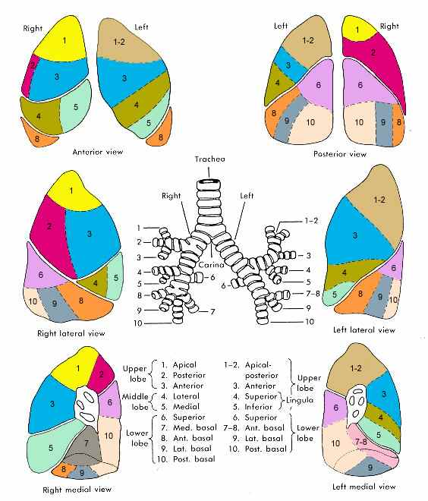
Segmentectomy
Excision of a lung segment.
This operation is usually performed for early stage lung cancer or for patients who may not be healthy enough for a lobectomy.

Slide 6
Pleuropneumonectomy
Surgical resection of an entire lung along with the parietal pleura; formerly used mainly for destroyed lung due to tuberculosis; currently, a method of treating malignant mesothelioma.

Slide 7
Thoracoplasty
Thoracoplasty was at 1st invented for the treatment of pulmonary tuberculosis during the days when no effective chemotherapeutic drugs for tuberculosis were available. Removal of some portions of the ribs by thoracoplasty deforms the chest wall and compresses tuberculous cavities.

Slide 8
Thoracoplasty
Currently, thoracoplasty is mainly applied to reduction of the volume of the pleural space in the treatment of post-resectional space problems and in the treatment of thoracic empyema.

Slide 9
Decortication
The procedure is usually performed when the lung is covered by a thick, inelastic pleural peel restricting lung expansion.

Slide 10
Endotracheal Intubation

Slide 11
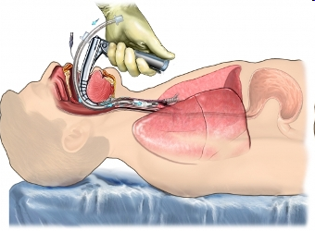
What is ENDOTRACHEAL INTUBATION?
Endotracheal intubation is a procedure by which a tube is inserted through the mouth down into the trachea
The endotracheal tube serves as an open passage through the upper airway

Slide 12
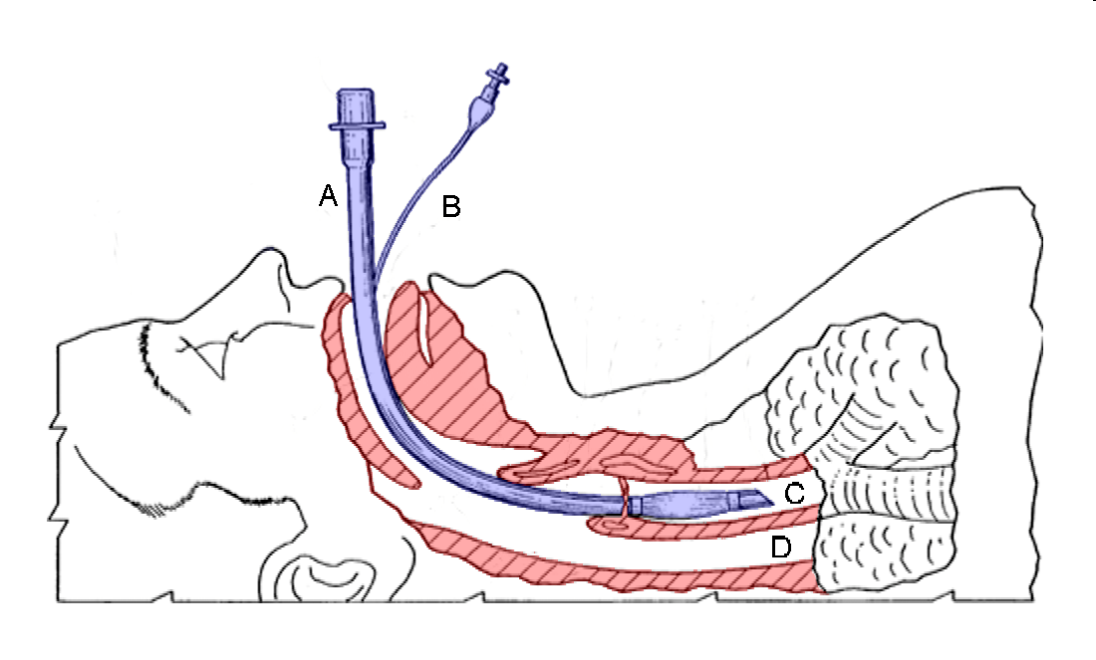

Slide 13
Indications for ETI
Routine
To provide anaesthesia
Emergency
Airway obstruction
Respiratory distress
Mental status alteration (GCS<8/15)
Flail chest/Pulmonary contusion
Cardio pulmonary resuscitation

Slide 14
Complications
Pneumothorax
Airway obstruction
Corneal abrasion
Trauma to lips, teeth, tongue and nose
Noxious autonomic reflexes
Laryngospasm
Bronchospasm
Laryngeal trauma

Slide 15
Airway perforation
Nasal, retropharyngeal, pharyngeal,
uvular, laryngeal, tracheal, oesophageal
and bronchial trauma
Oesophageal intubation
Bronchial intubation

Slide 16
Tracheostomy

Slide 17
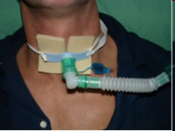
What is TRACHEOSTOMY
Tracheostomy is an operative procedure that creates a surgical airway in the trachea

Slide 18
Indications for tracheostomy
Indicated to bypass an airway obstruction
In congenital anomalies such as laryngeal hypoplasia
Due to a foreign body that cannot be dislodged
Neck trauma that results in severe injury
Facial fractures that may lead to upper airway obstruction

Slide 19
Edema of upper airway due to burn, trauma, infection and anaphylaxis
To provide a long-term route for mechanical ventilation in cases of respiratory failure
To provide pulmonary toilet
In aspiration and the inability to handle secretions

Slide 20
Complications
Infection,
Hemorrhage
Pneumothorax
Tracheo-aesophageal fistula
Tracheal dilatation and stricture

Slide 21
Read on
Tracheostomy care

