Slide 1
Lumbar Spondylosis

Slide 2
CONTENT…
Anatomy of the vertebral column
Anatomy of the vertebrae
What is spondylosis?
Causes and Risk Factors
Signs and symptoms
Diagnosis
Special tests
Management
Advices to the patient

Slide 3
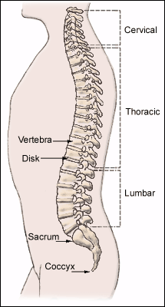
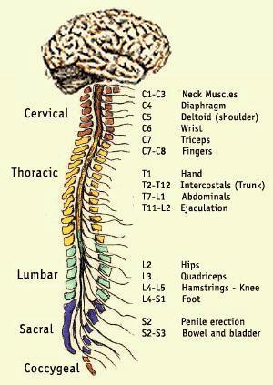
Anatomy of the vertebral column…

Slide 4
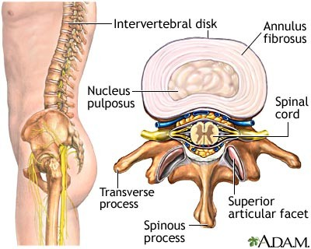
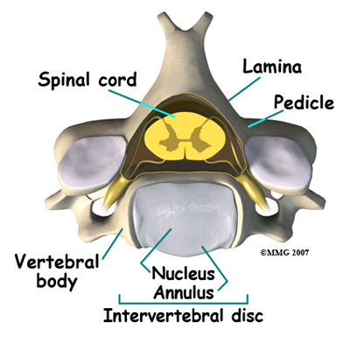
Anatomy of the vertebrae…

Slide 5
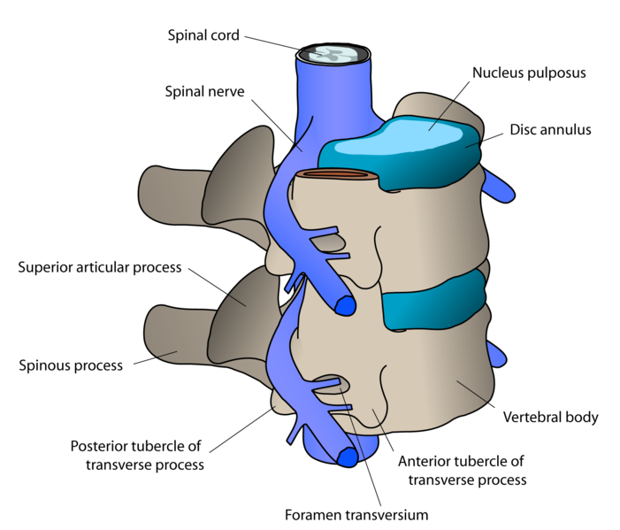

Slide 6
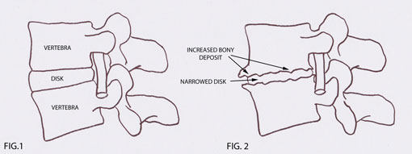
What is spondylosis?
Spondylosis refers to degenerative changes in the spine such as bone spurs and degenerating intervertebral discs
Spondylosis changes in the spine are frequently referred to as osteoarthritis

Slide 7
Spondylosis (spine arthritis) is one of the most common causes of spine pain and stiffness once you are aged over fifty
Spondylosis is further categorised depending on the region of the spine that it is present
Cervical Spondylosis (Neck Arthritis)
Thoracic Spondylosis (Mid Back Arthritis)
Lumbar Spondylosis (Low Back Arthritis)

Slide 8
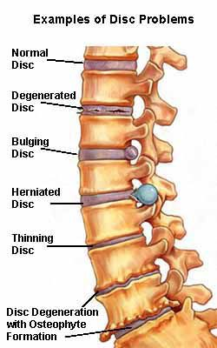

Slide 9
Causes and Risk Factors…
Spondylosis is an aging phenomenon
With age, the bones and ligaments in the spine wear, leading to bone spurs (osteoarthritis)
Also, the intervertebral discs degenerate and weaken, which can lead to disc herniation and bulging discs

Slide 10
Spondylosis is common
Symptoms are often first reported between the ages of 20 and 50
Over 80% of people over the age of 40 have evidence of spondylosis on X-ray studies
The rate at which spondylosis occurs is partly related to genetic predisposition as well as injury history

Slide 11
Signs and symptoms…
Many people do not have any symptoms(27%-37%)
Spinal stiffness, particularly early morning
Back pain due to nerve compression
Regional tenderness
Muscle spasm
Trigger points
Sciatica
Numbness
Weakness

Slide 12
Diagnosis…
X-rays
MRI
CT scans

Slide 13
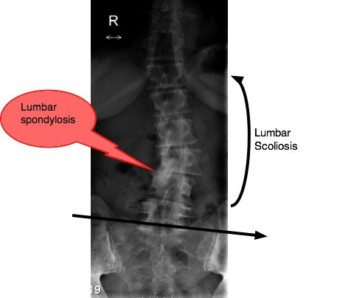
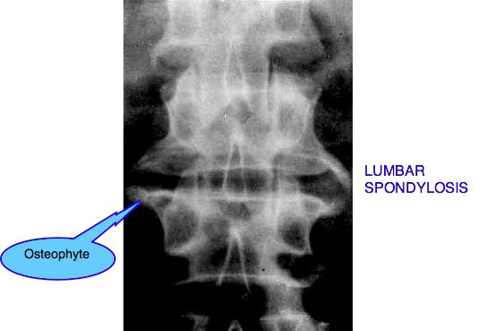

Slide 14
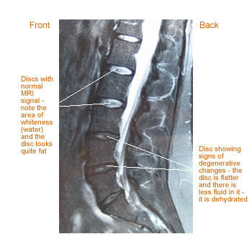

Slide 15
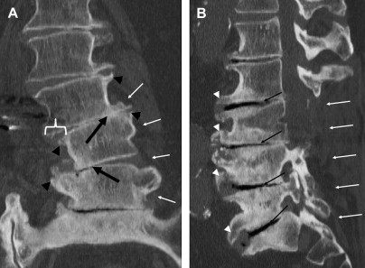

Slide 16
Special tests
Sacroiliac joint stress test
Patient position – Supine
The therapist crosses their arms placing the palms of the hands on the patient’s ASIS
The therapist applies a downward and a lateral force to the pelvis
Positive test – Indicated by unilateral pain in the sacroiliac joint or gluteal region and may be indicative of Sacroiliac joint dysfunction

Slide 17
Sitting flexion test
Patient position – Sitting with the knees flexed to 90 degrees and feet on the floor
The patient’s hip should be abducted to allow the patient bend forward
The therapist place his/her thumb on the inferior margin of the PSIS’s and monitors the movement of the bony structures as the patient bends forward and reaches towards the floor

Slide 18
Positive test – Indicated by one PSIS moving further in a cranial direction and may be indicative of an articular restriction

Slide 19
Standing flexion test
Patient position – standing with the feet 12 inches apart
The therapist places his/her thumbs on the inferior margin of the PSIS’s and monitors the movement of the bony structures as the patient bends forward with the knees extended
Positive test – Indicated by one PSIS moving further in a cranial direction and may be indicative of an articular restriction

Slide 21
Straight leg raising test
Patient position – Supine
The therapist lifts the patient's symptomatic leg by the posterior ankle while keeping the knee in a fully extended position
The therapist continues to lift the patient's leg by flexing at the hip until pain is illicited or end range is reached

Slide 22
Neurologic pain which is reproduced in the leg and low back between 30-70 degrees of hip flexion is a positive result of lumbar disc herniation at the L4-S1 nerve roots
In order to make this test more specific, the ankle can be dorsiflexed and the cervical spine flexed
This increases the stretching of the nerve root and dura

Slide 23
Pain at less than 30 degrees of hip flexion might indicate acute spondyloithesis, gluteal abscess, disc protrusion or extrusion, tumor of the buttock, an acute dural inflammation, a malingering patient, or the sign of the buttock
Pain at greater than 70 degrees of hip flexion might indicate tightness of the hamstrings, gluteus maximus, hip capsule or a pathology of the hip or sacroiliac joints

Slide 24
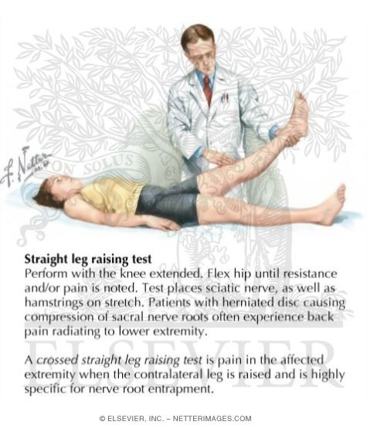
A highly specific test that can aid in the diagnosis of a herniated nucleus pulposus is the crossed straight leg raise test

Slide 25
Management…
Management
Medical
Physiotherapy

Slide 26
Medical management
No medication has been proven to reverse the degenerative process of spondylosis
Anti-inflammatory medications (NSAID’s)
Analgesics
Muscle relaxants

Slide 27
Surgery is rarely necessary in patients with acute back pain, unless progressive neurologic problems develop
This is because most patients improve dramatically after treatment with medications and physical therapy, and most patients improve within days to weeks after back pain starts

Slide 28
Surgery is sometimes performed for acute sciatica, if nerve problems such as weakness and numbness are severe and worsen rather than improve, and cauda equina syndrome, a syndrome where the nerves at the bottom of the spinal cord are compressed by an intervertebral disc or a mass, causing neurologic problems

Slide 29
Physiotherapy management
In many cases of lumbar spondylosis, rest coupled with physical therapy is ordered
And in 75 percent of the cases, physical therapy and rest take care of the problem
Physical therapy can ease back stiffness
Exercises such as crunches and abdominal workouts can strengthen and rehabilitate muscles and joints near the spine and stomach, helping ease pressure and pain on the spine

Slide 30
Physical therapists also use electronic stimulation and heat to reduce pain and muscle spasms linked to spondylosis
Exercises involving pulleys and weights are often used to strengthen a patient's neck and back muscles
A physical therapist can also provide strategies to limit the risk of future back problems and whether any restrictions in work or recreational activities are required

Slide 31
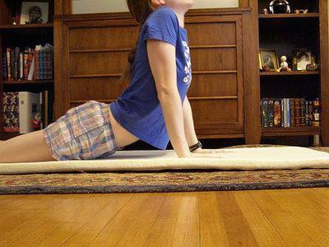
Possible physical therapy exercises include yoga-like exercises and other exercises to increase flexibility and strength
Stretching exercises are also common forms of treatment

Slide 32
Exercises for spondylosis
Back exercise 1
Lie on your back on the floor, bend your left knee, and put your left foot on the floor
Tighten your buttock and abdominal muscles
Maintain your neutral position
Raise your right leg off the floor 12 inches, keeping your knee straight
Hold this position and count to three
Lower your leg

Slide 33
Repeat 10 times
Do the exercise 10 times with your left leg raised
Vary the exercise by making squares and circles with the raised leg

Slide 34
Back exercise 2
Get into a kneeling position on the floor
Tighten your buttock and abdominal muscles
Stay in your neutral position
Put your hands on your hips
Raise your right foot off the floor, and place it down in front of you
You should now be kneeling on your left knee
Lunge forward, moving from your hips

Slide 35
Hold this position and count to three
Go back to your original kneeling position
Repeat the exercise 10 times with your right leg
Then do the exercise 10 times on the other side

Slide 36
Single-leg lift
It is important to stretch your lower back and keep your spine in alignment
You can do this by doing single-leg lifts
Lie face-down on the floor
Place your two hands under your chin and lift your head up slightly so that it is in line with your spine
Slowly lift your left leg up about 6 to 8 inches and hold it for three seconds

Slide 37
Do not flex or point your foot
Put your leg down in the starting position
Now lift your right leg up for three seconds to a similar height
Do this 10 times with each leg to gently stretch your lower back

Slide 38
Arm curls on exercise ball
Sit on a medium-sized exercise ball, 12 to 16 inches in diameter, and find your balance point
Grasp hold of two 4-lb
weights and let your arms extend down to your sides
Alternately curl the weights up to shoulder height, holding the weight at the top of the lift for two seconds
Do 10 lifts with each arm, take a 30-second break and repeat the set

Slide 39
The weights are light enough so that you should not strain any muscles, but the action of doing the curls on the exercise ball will be beneficial for your lumbar area

Slide 40
Pelvic Tilt
The pelvic tilt exercise helps ease the compressive forces in your lower back by stretching your lower spine
Begin by lying down on your back with both knees bent and the soles of your feet flat on the floor
Use the muscles of your abdomen to push your lower back down until it is in contact with the floor
Hold this position for five to 10 seconds, then relax
Repeat 10 times

Slide 41
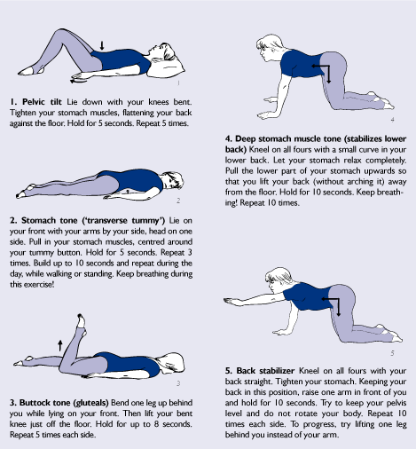

Slide 42
Double Knee to Chest
Like the pelvic tilt exercise, this exercise improves the range of motion in your lower back by decompressing your spine
Begin by lying down on your back with both legs extended and your arms by your sides
Bend both knees at the same time and lift your feet off the floor
Reach up with both arms and grab your legs around the shins

Slide 43
Use the muscles of your arms to pull both knees toward your chest
Hold this stretch for five to 10 seconds
Perform three sets of five to 10 repetitions daily

Slide 44
Pelvic Bridge
This exercise helps strengthen the muscles of your lower back
Begin by lying down on your back with your knees bent and the soles of your feet flat on the floor
Cross both of your arms across your chest while simultaneously tightening the muscles of your abdomen
Use a slow and controlled motion to lift your hips off the floor until there is a straight line between your knees, hips and shoulders

Slide 45
Hold this position for five to seven seconds, then return to the starting position using a slow and controlled motion
Repeat 10 times a day

Slide 46
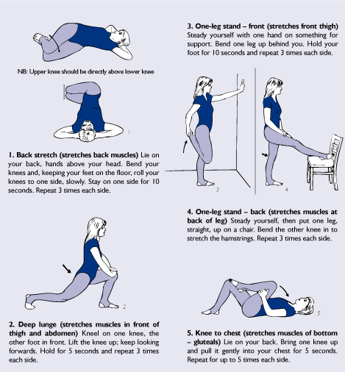

Slide 47
Advices to the patient…
Avoid long term sitting and standing
Avoid high heels
Reduction of weight (if the patient is obese)
Do not use a very soft or a spring metress
Use correct postures

Slide 48
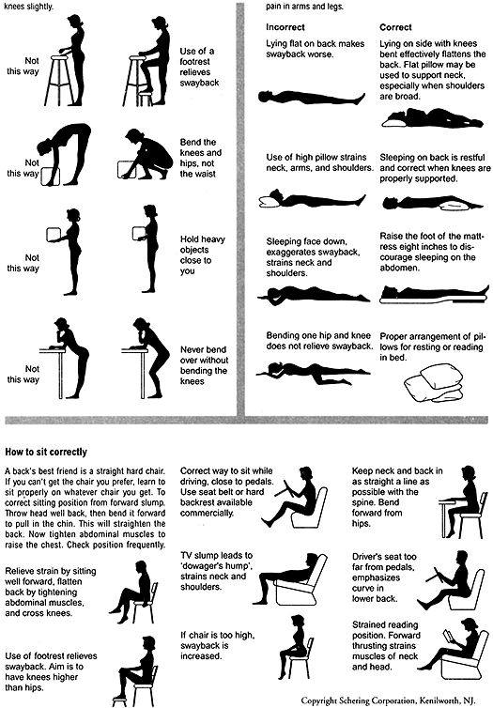

Slide 49
THANK YOU!!!

