Slide 1
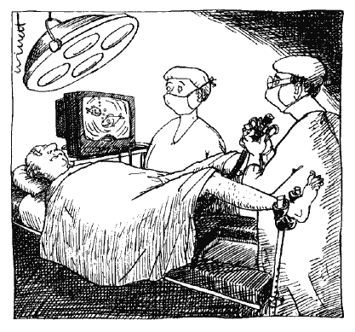
Laparoscopy
Dr. S. Nishan Silva
(MBBS)

Slide 2
SHORT HISTORY
1981 Semm performed first Laparoscopic
Appendectomy.
1987 Mouret performed first
Laparoscopic Cholecystectomy.
Prior to 1990, the only specialty performing laparoscopy on a widespread basis was gynecology, mostly for relatively short, simple procedures such as a diagnostic laparoscopy or tubal ligation.

Slide 3
LAPAROSCOPIC SURGERY
“KEYHOLE SURGERY”
MINIMALLY INVASIVE SURGERY
MINIMAL ACCESS SURGERY

Slide 4
DEFINITION
Minimal Access surgery :a combination of modern technology and surgical innovation that aims to accomplish surgical therapeutic goals with minimal somatic and psychological trauma.

Slide 5
This type of surgery offers a cost-effectiveness both to health services and to employers by shortening the operation time , shortening hospital stays and shorter recovery time

Slide 6
LAPROSCOPIC SURGERIES
Cholecystectomy, Appendectomy & Colectomy
Vagotomy
Hiatal, Inguinal & Diaphragmatic hernia repair
Urological- Nephrectomy, Adrenelectomy
& Prostatectomy.
OBG-Tubal surgeries,cystectomies,hystrectomies &
various ablations (endometriosis)
Thoracoscopies
Neurosurgeries
Lumbar discectomies
Diagnostic procedures

Slide 7
CONTRAINDICATIONS
1. Absolute - none
2. Relative
i) severe COAD
ii) recent MI
iii) ventriculoperitoneal shunts
iv) Increased ICT
v) extensive organomegaly vi) CHF

Slide 8
Broadly speaking, minimal access techniques can
be categorized as follows:
Laparoscopy
Thoracoscopy
Endoluminal endoscopy
Periviseral endoscopy
Arthroscopy and intra-articular joint surgery
Combined approach

Slide 9
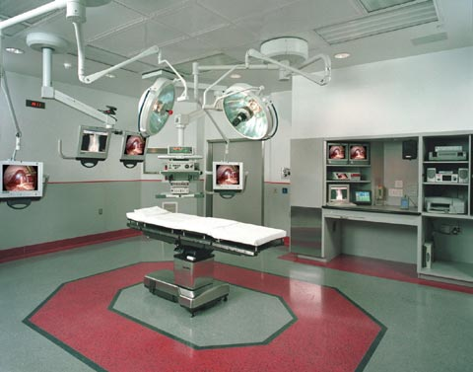
Minimally Invasive OR

Slide 10
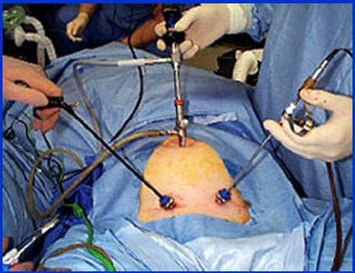

Slide 11
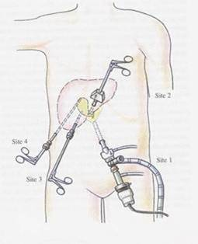
Fig. Demonstarting surgical incision
Sites in lap cholecystectomy

Slide 13
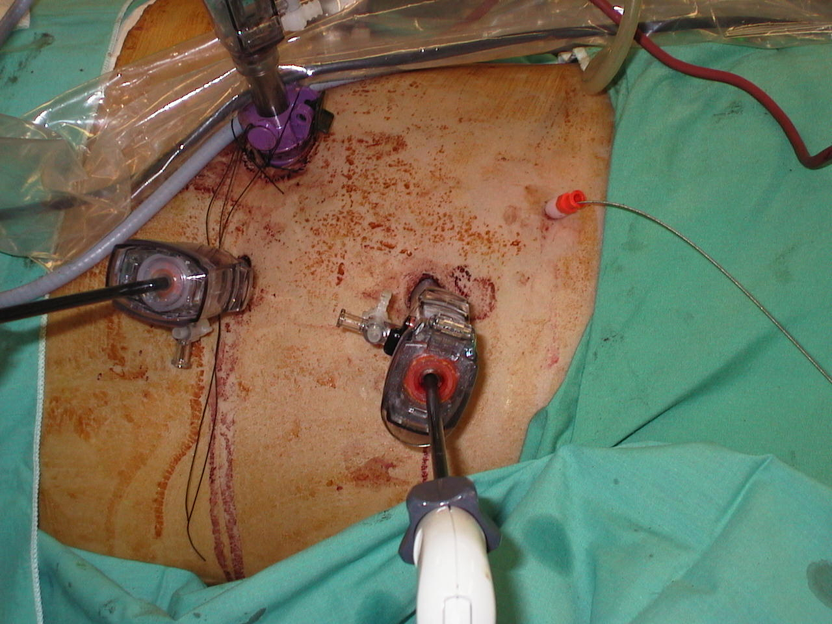

Slide 14
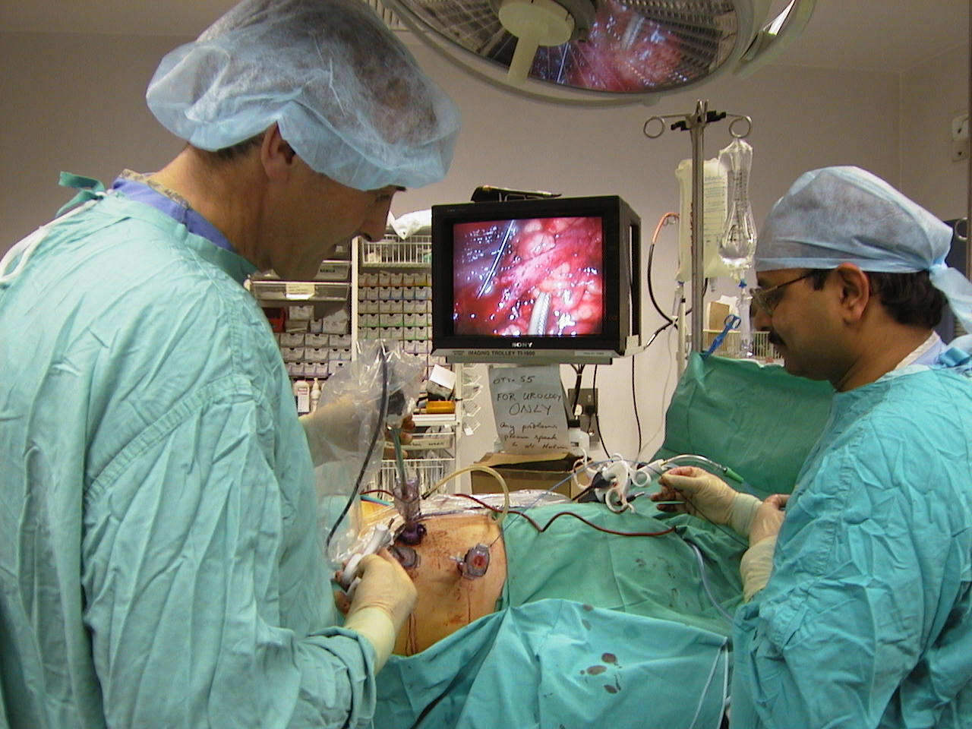

Slide 15
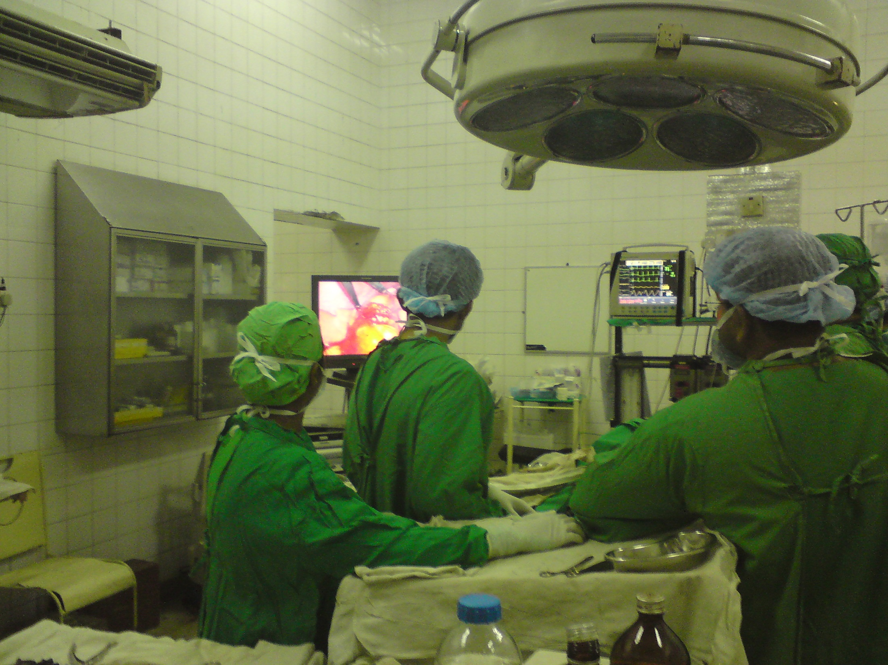

Slide 16
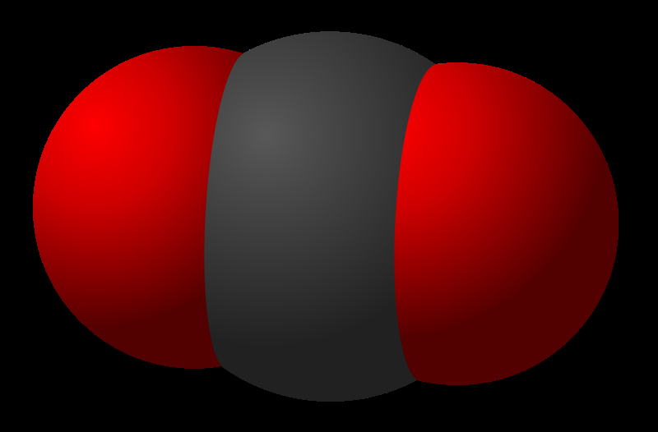
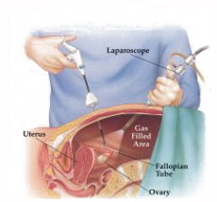
PHYSIOLOGICAL CHANGES
co2
position
Physiological
changes
pneumoperitoneum

Slide 17
Principle Differences between laparoscopic and open surgery
For the Surgeon
Magnified view often better than obtained via an incision allows precise dissection.
Altered (but not absent) tactile response
Two dimensional (flat screen) view.
Usually (but not always) longer operating time
Need to develop entirely different operating technique
Adaptation of principles of open surgery to laparoscopic surgery.

Slide 18
Instruments
Redesign of instruments for laparoscopic use.
Instruments for open surgery in general 6 – 10” in length built around a box joint.
Laparoscopic instruments in general 15 – 18” in length with an articulated connecting rod between handles and scissor blades, jaws etc.

Slide 19
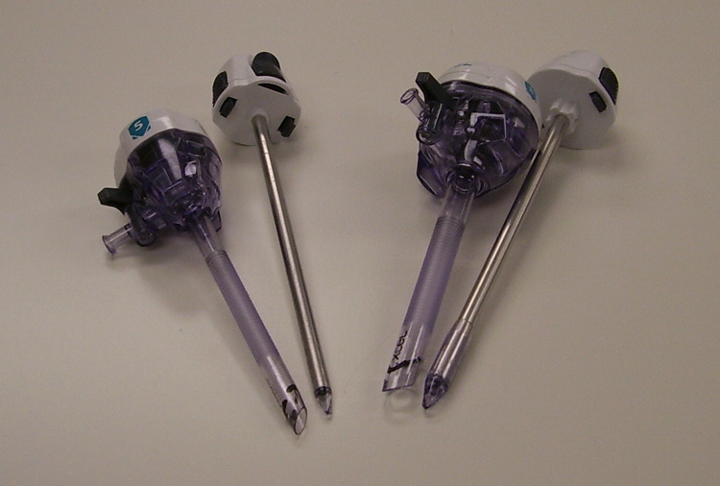
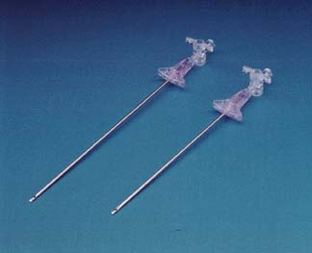
Access/Trocars/Pneumoperitoneum
Open technique (Hasson)
Veres Needle
Optical Trocar
CO2 insufflation

Slide 20
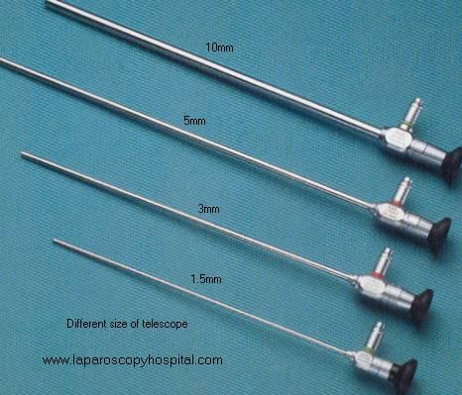
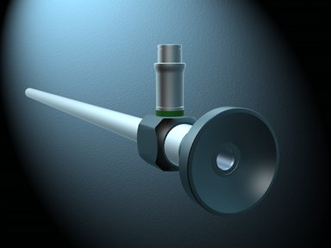
Laparoscopes
Size: 1.5mm, 3mm, 5mm, 10mm
Angle: 10, 30, 45 degree

Slide 21
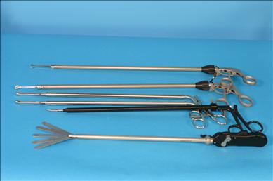
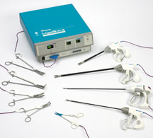
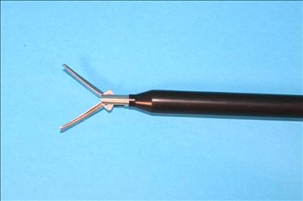
Instruments
Graspers
Sheers
Cautery
Harmonic (ultrasound)
Ligasure
Staplers
Suturing devices

Slide 22
Equipment Necessary for MAS
Camera
Light Source
Insufflator
TV Monitor
Telescopes
Light Guide Cable
Apart from the insufflator the system will work better if all the components are from the same company as one piece talks to another

Slide 23
CAMERA
These can be single chip or 3 chip.
CHIP: thois is also called a charged coupled device in short, CCD.
These are flat silicone wafers with a matrix, a grid of minute image sensors called pixels.
White balance and sometimes black balance
Sleeve it don’t soak it!!!

Slide 24
Light Source
Halogen or Xenon, cold light but beware can still burn holes in drapes esp. disposable and burn patient’s skin if left on the abdomen.
Brightest to darkest measured in units of decibels.
Automatic illumination, does it talk to the camera and are the necessary leads plugged in.
Lamp life meter, look at it. Is it nearly out? EBME keep the spares and they change it.
White balance by making sure white is correct then all the colours through the spectrum are correct.

Slide 25
Insufflator
CO2 because this has the same refractive index as air, so doesn’t distort the image and is non combustible.
Intraabdominal pressure run between 10 and 13 mmhg.
Use disposable filter and tubing for each patient.
High flow insufflators (35 litres) output determined by size of outlet.
Ensure you know how to change a cylinder and were they are stored.

Slide 26
TV Monitors
Usually a 20” screen.
If your monitor has MD in the spec. they are compliant with th lines.e hospital electrical safety systems for example Son 1343-MD.
You can use a standard TV but it must be run through an isolated transformer.
Horizontal resolution is the number of vertical lines.
Vertical resolution is the number of horizontal lines
More lines of resolution, better detail of picture.

Slide 27
Telescopes
Come in varying sizes, laparoscopes usually 5mm or 10mm.
Diagnostic 3mm scope available but not in general use in this hospital.
Made up of a rod and lens system.
Bundles of fibres, incoherent carry light and coherent carry image.
Wide range of angles available 0 and 30 degree are fairly standard.
All laparoscopes are autoclavable and can go thru steris, no ultrasonic bath.

Slide 28
Light guide Cables
Different diameters
Fibre light cable
Buy auroclavable
Don’t bend to acutely as will break fibres.
Check when you plug them in are all the fibres are okay.
Condensers

Slide 29
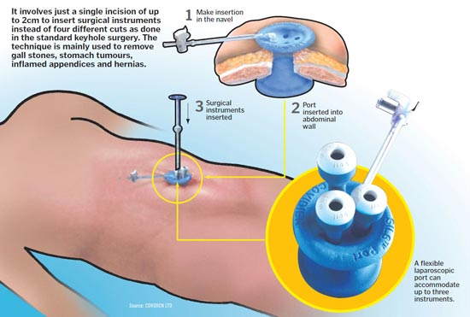
Single Port Access Surgery

Slide 30
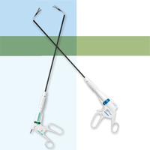
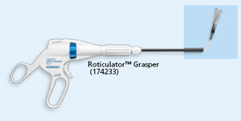
Single Port Access Surgery
Instruments:

Slide 31
Thoracoscopy
A rigid endoscope is introduced through an incision in the chest to gain access to the thoracic contents.
Usually there is no requirement for gas insufflation as the operating space is held open by the rigidity of the thoracic cavity.

Slide 32
Endoluminal endoscopy
Flexible or rigid endoscopes are introduced into hollow organs or systems, such as the urinary tract, upper or lower gastrointestinal tract, and respiratory and vascular systems

Slide 33
Perivisceral endoscopy
Body planes can be accessed even in the absence of a natural cavity. Examples are mediastinoscopy, retroperitoneoscopy and
retroperitoneal approaches to the kidney, aorta and lumbar sympathetic chain.
Extraperitoneal approaches to the retroperitoneal
organs, as well as hernia repair, are now becoming increasingly Common place, further decreasing morbidity associated with visceral peritoneal manipulation.
Other, more recent, examples include subfascial ligation of incompetent perforating veins in varicose vein surgery.

Slide 34
Arthroscopy and intra-articular joint surgery
Orthopedic surgeons have long used arthroscopic access to the knee and have now moved their attention to other joints, including the shoulder, wrist, elbow and hip.
Combined approach
The diseased organ is visualized and treated by an assortment of endoluminal and extraluminal endoscopes and other imaging devices.

Slide 35
Disadvantages of Open surgery
Large wound that is enough to give adequate exposure for safe manipulation.
This wound is often the cause of morbidity (infection, dehiscence, bleeding , herniation and nerve entrapment)
The wound pain by itself prolongs recovery time and by reducing mobility we increase the incidence of pulmonary atelectasis , chest infection and DVT.

Slide 36
Exposure of any body cavity to the atmosphere also causes morbidity through cooling and fluid loss by evaporation.
Increased risk for post-surgical adhesions
In handling intestinal loops, this will disturb the peristaltic activity of the gut and provoke adynamic ileus (paralytic ileus)

Slide 37
Advantages of Laparoscopic surgery
Decrease in wound size
Reduction in wound infection, dehiscence, bleeding,
herniation and nerve entrapment
Decrease in wound pain
Improved mobility
Decreased wound trauma
Decreased heat loss

Slide 38
COMPLICATIONS
INTRAOP
PNEUMOPERIT.
GAS
EXTRAVASATION
POSITIONING
Arrythmias
Hyper/hypotension
CVS
Hycercarbia
Gas embolism
RESPI.
s/c emphysema
Pneumothorax
pneumomediastinum
Nerve injury
Endobronchial intubation
Thermal injuries

Slide 39
Limitations of Minimal access surgery
To perform minimal access surgery with safety, the surgeon
must operate remote from the surgical field, using an imaging system that provides a two-dimensional representation of the operative site.
The instruments are longer and sometimes more complex to use than those commonly used in open surgery. This results in being faced with significant problems of hand–eye coordination.

Slide 40
continued
Usually (but not always) longer operating time
Sometimes , it is better for the patient and to the surgeon to convert a Laparoscopic surgery to an open surgery
if there is any intraoperative arterial bleeding maybe very difficult to achieve endoscopically because the blood obscure the field of vision
Loss of tactile feedback
Problem in extraction of large specimens and resected tissue

Slide 41
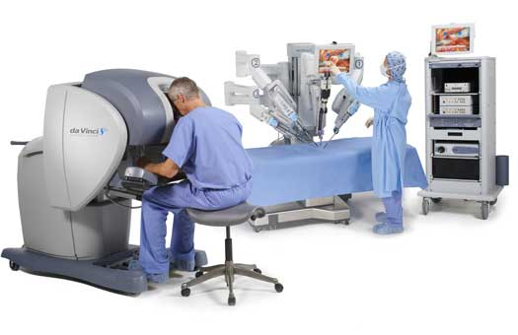
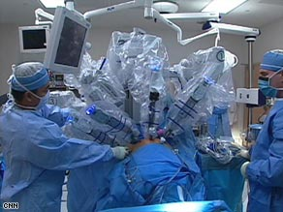
Robotic Surgery

Slide 42
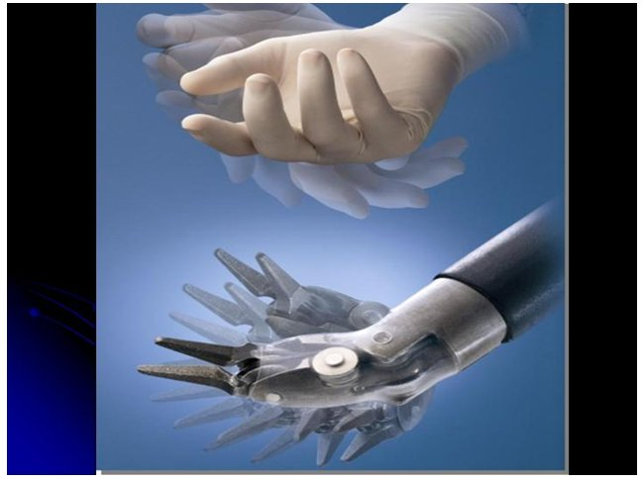
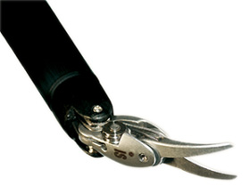
Robotic Surgery
Benefits:
-More Precise/range of motion
-3D Vision/magnified
-More comfortable for Surgeon
-Can be done remotely
Disadvantages:
-Lack of haptics
-Expensive $$$
-Long set up/procedure time
-No Judgement

Slide 43
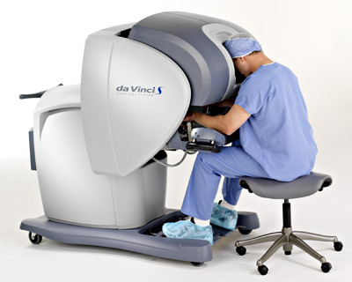
Robotic Surgery
Commonly used for:
-Urology (prostatectomy)
-Cardiac (heart surgery)
-Gynecology (hysterectomy)
-Less useful in general surgery

Slide 44
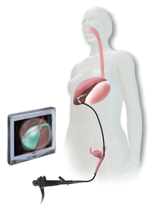
NOTES Surgery Natural Orifice Translumenal Endoscopic Surgery
Experimental
University Centers
Orifice can be:
-Mouth/stomach
-Vagina
-Rectum

Slide 45
NOTES Surgery
Benefits:
-Cosmetic (no scars! –Really!!)
-Less pain
-Faster Recovery
-Less risk of wound infections/hernias
Disadvantages:
-Learning Curve
-Takes Longer (much…)
-Problems with closing enterotomies

