Slide 1
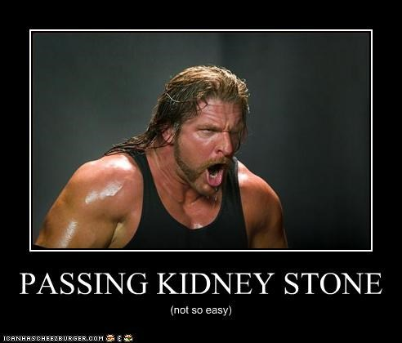
Urological Surgical Procedures
Dr. S. Nishan Silva
(MBBS)

Slide 2
Age and Hematuria
Age (yr) | Common | Uncommon
0 to 15 | Glomerulopathy (IgA, Alport’s syndrome, thin BM disease, APSGN) Hypercalciuria with stones Congenital obstructive anomalies UTIs Sickle cell disease Viral infection | Factitious Fever HUS Hemophilia HSP Schistosomiasis
15-50 | Calculi Menstrual contamination Exercise UTIs PKD Sickle cell disease Intercourse Papillary necrosis | AVMs or fistulae DIC Goodpasture’s syndrome Loin pain-hematuria syndrome Renal infarction Renal vein thrombosis Schistosomiasis Medullary sponge kidney
>50 | BPH Cancer (renal, ureteral, bladder, prostate) Overanticoagulation PKD Prostatitis | AVMs or fistulae Cyclic hematuria in women Endometriosis TTP Renal vein thrombosis Toxins (cantharidin, djenkol bean) LP-HS

Slide 3
Kidney, urinary tract and prostate - the important “tumours”
Kidney
nephroblastoma (Wilms’ tumour) – children
renal cell carcinoma - adults
Urinary tract
transitional cell (urothelial) tumour
squamous carcinoma of the bladder
Prostate
(prostatic hyperplasia)
prostatic carcinoma

Slide 4
Malignant tumours of the kidney
The only important ones are -
nephroblastoma (Wilms’ tumour)
renal cell carcinoma
transitional cell carcinoma of renal pelvis (essentially part of urinary tract)

Slide 5
Renal cell carcinoma (adenocarcinoma of the kidney)
commonest (~90%) renal malignancy in adults, but < 3% all malignancies in countries where it is commonest (less common in Africa)
ages 50s+ and male:female 2:1
usually large bulging tumour at renal pole (upper > lower)
yellowish cut surface, often with cysts and haemorrhage
often apparently sharp margins, due to pseudocapsule

Slide 6
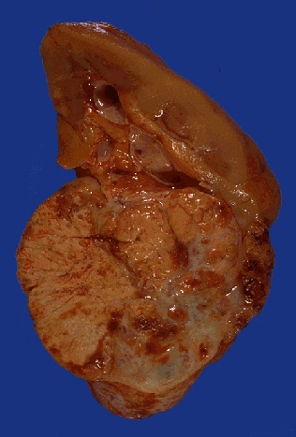

Slide 7
Spread of renal cell carcinoma
local, lymphatic and blood
may invade perinephric fat
can invade pelvi-calyceal system
lymphatic – first to para-aortic nodes
often invades renal vein………
blood spread most often to lungs (50%), bones (33%), adrenals and brain

Slide 8
Presentation of renal cell CA
usually late – so often CA has already spread
most often, haematuria
abdominal mass +/- loin pain
but, one of the great “mimickers”
metastasis (classically cannonball metastases in lungs)
fever of unknown origin/night sweats
weight loss, malaise
paraneoplastic phenomena -
- secretion of erythropoietin, renin, parathormone, corticosteroids, eosinophilia, amyloidosis etc

Slide 9
Prognosis of renal cell CA
5-yr survival rate overall ~ 50%
70 % if no metastases
15-20% if renal vein involved

Slide 10
Risk factors for renal cell CA
cigarette smoking is only definite association – e.g. 30-40% occur in smokers in UK, where <20% population smoke
(rarely, genetic factors – e.g. in the very rare von Hippel-Lindau disease)

Slide 11
URINARY TRACT TUMOURS
the only common intrinsic tumours of the urinary tract are those of transitional epithelium (urothelium)
variety of names -
transitional tumours
or transitional epithelial tumours
or transitional cell tumours
or urothelial tumours

Slide 12
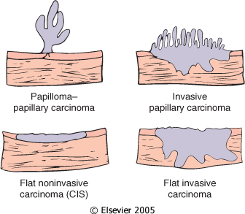
Downloaded from: Robbins & Cotran Pathologic Basis of Disease (on 14 July 2008 01:09 PM)
© 2007 Elsevier

Slide 13
Transitional tumours
presentation
- most often, haematuria
- but also urinary infection and/or obstruction
often prolonged natural history
carcinomas may present with metastases
spread – local, lymphatic & blood – details depend on site of primary
tumour cells exfoliate into urine, so cytological examination of urine can sometimes help in diagnosis

Slide 14
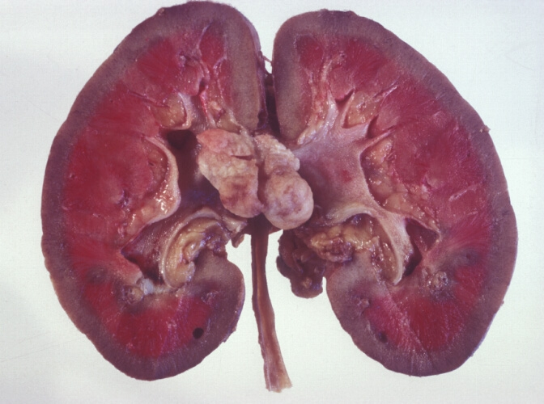

Slide 15
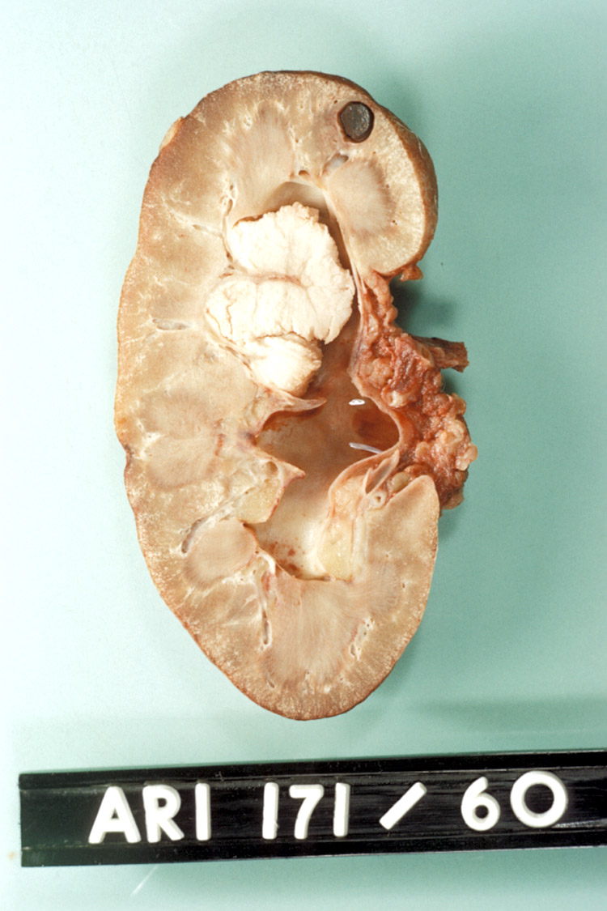

Slide 16
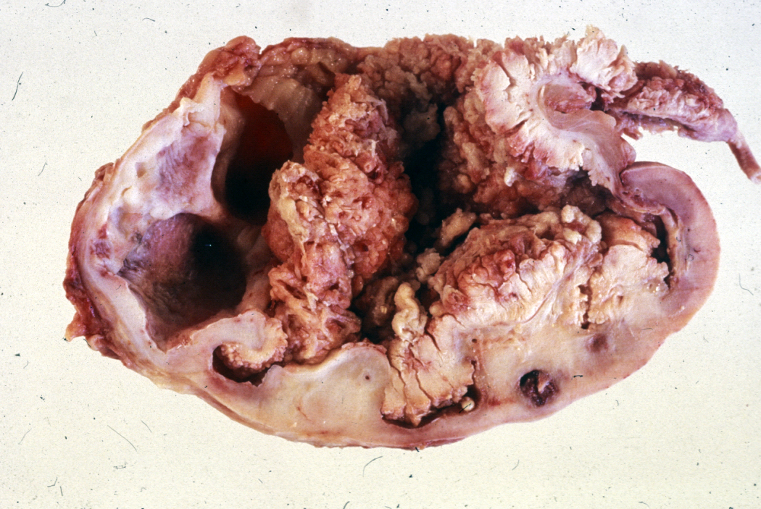

Slide 17
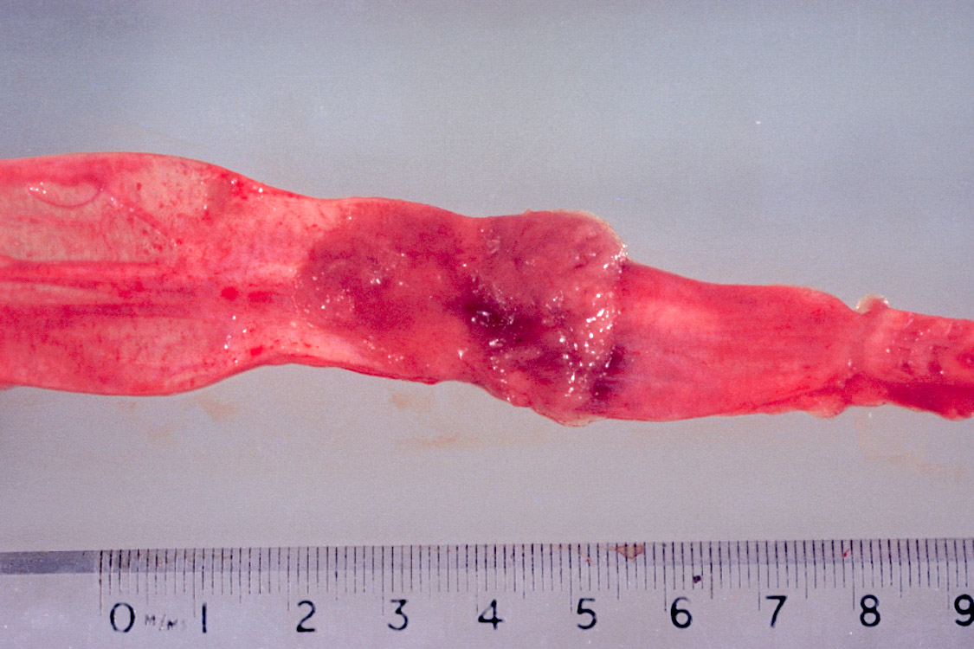

Slide 18
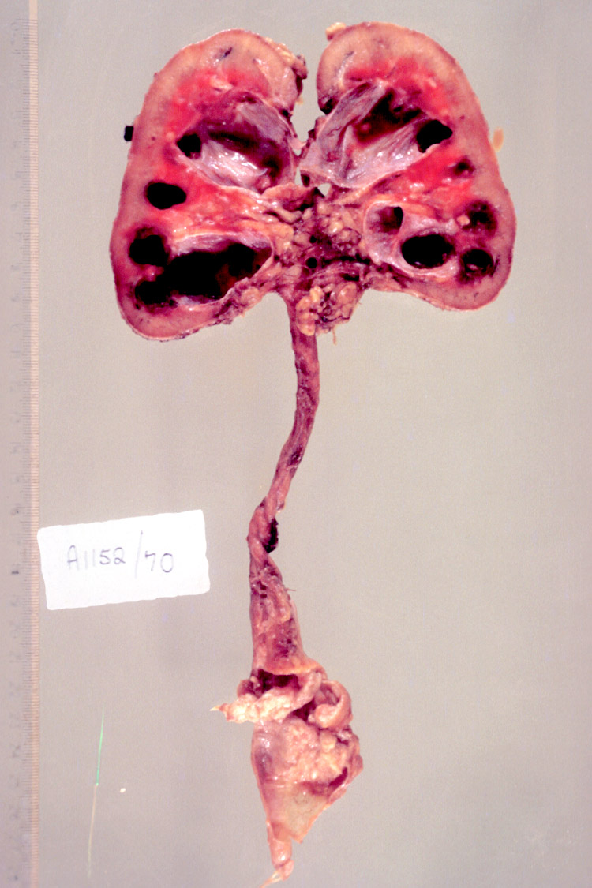

Slide 19
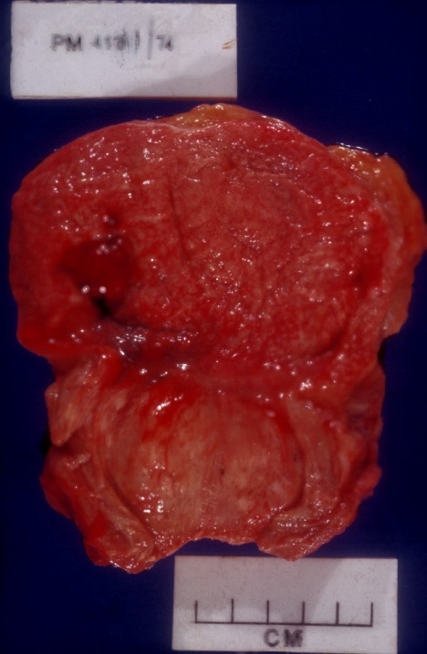

Slide 20
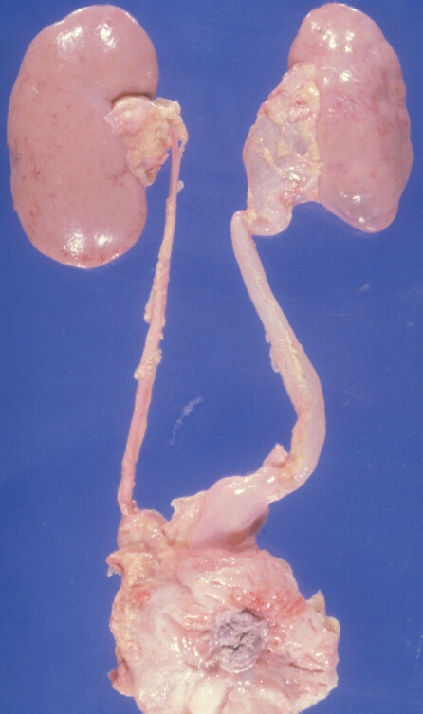

Slide 21
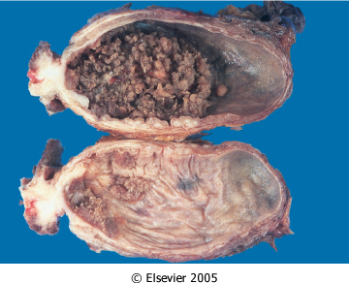
Downloaded from: Robbins & Cotran Pathologic Basis of Disease (on 14 July 2008 01:09 PM)
© 2007 Elsevier

Slide 22
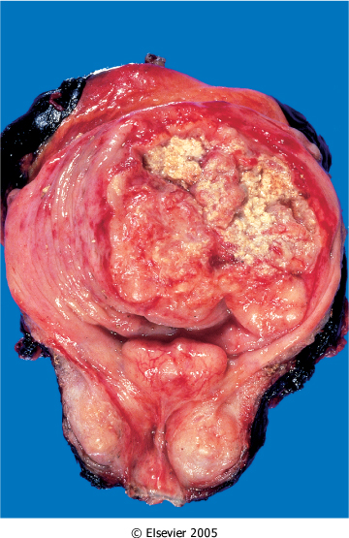
Downloaded from: Robbins & Cotran Pathologic Basis of Disease (on 14 July 2008 01:09 PM)
© 2007 Elsevier

Slide 23
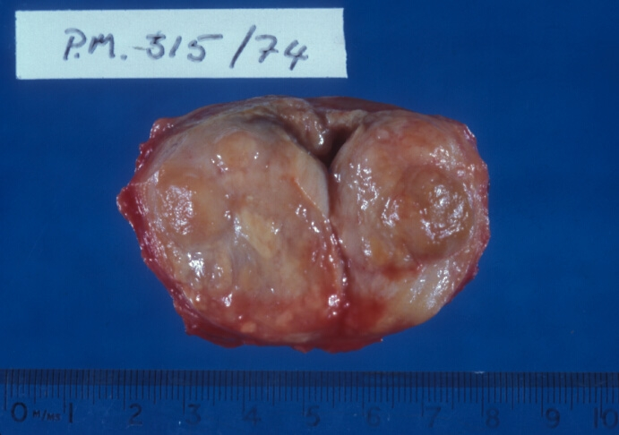

Slide 24
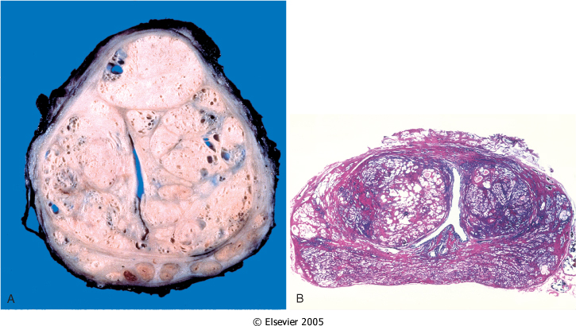
Downloaded from: Robbins & Cotran Pathologic Basis of Disease (on 14 July 2008 01:09 PM)
© 2007 Elsevier

Slide 25
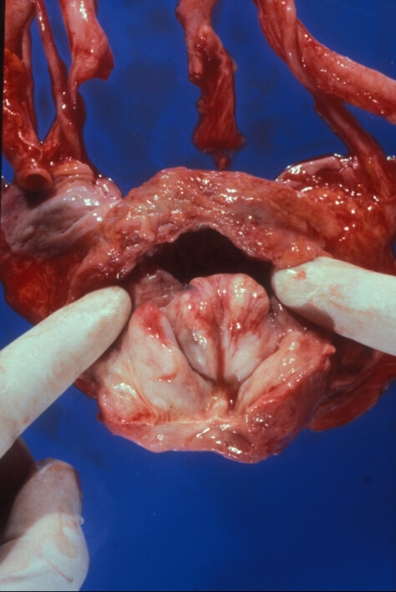

Slide 26
Carcinoma of the prostate
in Europe, N America (blacks>whites) and Australasia, commonest male CA
commoner than any female cancer
incidence increasing everywhere, but especially in Africa - ? higher than elsewhere?
family history raises risk ~ x 2 or 3
uncommon in orientals (but incidence increases if they move to regions with higher incidence)
age of incidence later than any other CA
old age (60s -80s)
younger in patients with family history

Slide 27
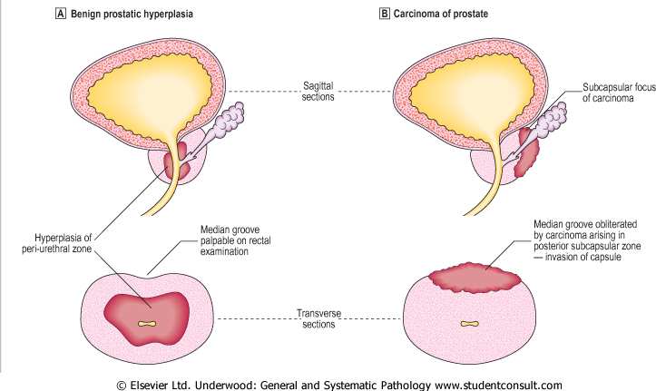

Slide 28
Effects of CA prostate
local = same as those of BNH (prostatism, obstruction, infection etc), but very often no local effects
distant, due to metastases - local, lymph and blood
often presents with metastasis – “occult carcinoma”

Slide 29
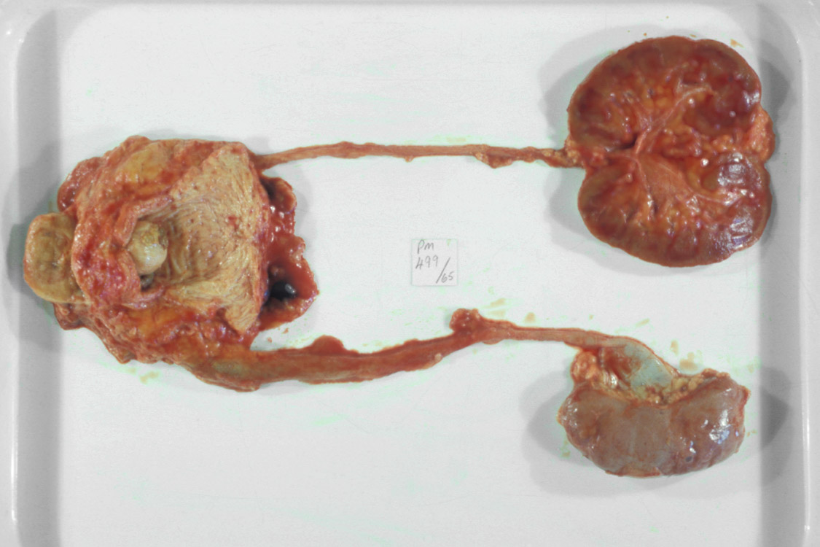

Slide 30
Spread of CA prostate
local – especially seminal vesicles and base of bladder
blood - chiefly to bones, particularly axial skeleton (lumbar spine, proximal femur, pelvis, thoracic spine) and ribs
bony metastases typically osteoblastic/osteosclerotic (in men, highly suggestive of CA prostate)
massive visceral dissemination unusual
lymphatic spread – common, often before blood spread
initially to the obturator nodes followed by pelvic, presacral, and para-aortic nodes

Slide 31
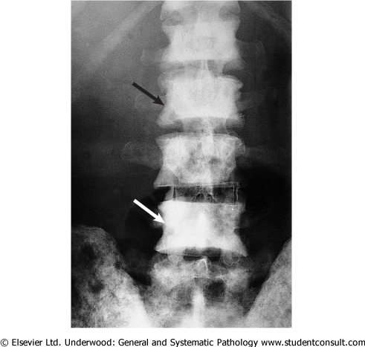
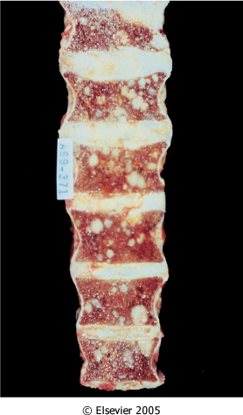

Slide 32
Aetiology
like BNH, androgens believed to play role in pathogenesis
orchidectomy protective
oestrogens sometimes used in treatment
genetic factors
1. increased incidence if family history
2. prostate cells with short repeats of CAG are highly sensitive to androgens
shortest CAG repeats are in African-Americans, while longest are in orientals
African-Americans have highest incidence of prostate cancer and orientals the lowest

Slide 33
Prognosis
as with most tumours, variable according to grade and stage of tumour
Gleason grading = histological grading of prostatic CA
“latent” CA prostate
discovered as incidental finding in prostates removed for BNH or at autopsy
very common in autopsies in very old men

Slide 34
Prostate specific antigen (PSA)
produced by prostatic epithelium
serine protease which liquefies semen coagulum which forms after ejaculation
normally tiny amounts in serum
elevated levels can occur in localised or metastatic prostate CA
but levels can increase in other conditions of the prostate and in ~ 20% CA cases PSA may be normal, so no value as screening test

Slide 35
UROLITHIASIS

Slide 36
Theories of Stone Formation
A. Nucleation Theory
B. Stone Matrix Theory
C. Inhibitor of Crystallization Theory
Most investigators acknowledge that these 3 theories describe the 3 basic factors influencing urinary stone formation. It is likely that more than one factor operates in causing stone disease. A generalized model of stone formation combining these 3 basic theories has been proposed.

Slide 37
RISK FACTORS
•Start of disease early in life: <25 years
•Stone containing brushite
•Only one functioning kidney
•Disease associated with stone formation:
- hyperparathyroidism
- renal tubular acidosis (partial/complete)
- jejunoileal bypass
- Crohn’s disease
- intestinal resection
- malabsorptive conditions
- sarcoidosis
- hyperthyroidism

Slide 38
RISK FACTORS
•Medication associated with stone formation:
- calcium supplements
- vitamin D supplements
- acetazolamide - ascorbic acid in megadoses ( > 4 g/day)
- sulphonamides - triamterene
- indinavir
•Anatomical abnormalities associated with stone formation:
- tubular ectasia (medullary sponge kidney)
- pelvo-ureteral junction obstruction
- calix diverticulum, calix cyst
- ureteral stricture
- vesico-ureteral reflux
- horseshoe kidney
- ureterocele

Slide 39
Renal Calculi
1 Coral calculus
2 Coral calculi fragment
3 Calculi, which are impregnated with blood pigments

Slide 40
Clinical Manifestations
Acute obstruction of the urinary tract may cause renal colic, a form of severe abdominal pain often accompanied by nausea and vomiting due to celiac ganglion stimulation. Onset is sudden, often during the night or in the early morning

Slide 41
Clinical Manifestations
Fever is rarely present except when a urinary tract infection accompanies obstruction.
Pulse rate and blood pressure, however, may be elevated as a result of the pain and agitation caused by the renal colic.
The patient's abdomen is generally flat and soft, with moderate deep tenderness on palpation where the calculus is lodged.
Some patients also have extensive hyperesthesia of the abdominal wall, either anteriorly or posteriorly.
The costo-vertebral area may be tender to percussion.

Slide 42
Laboratry Investigations
Stone analysis: In every patient one stone should
be analysed.
Blood analysis: Calcium Albumin Creatinine Urate
Urinalysis: Fasting morning spot urine sample
Dip-stick test: pH, Leucocytes/Bacteria
Cystine test, Ca, P, citrate, urate

Slide 43
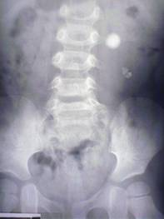
Diagnostic imaging
Routine examination involves a plain abdominal film of the kidneys, ureters and bladder (KUB) At least 90% of all renal stones are radiopaque and therefore readily visible on a plain film of the abdomen

Slide 44
Diagnostic imaging
Excretory pyelography must not be carried out in the following patients - those:
With an allergy to contrast media
With S-creatinine level > 200 µmol/L
On medication with metformin
With myelomatosis

Slide 45
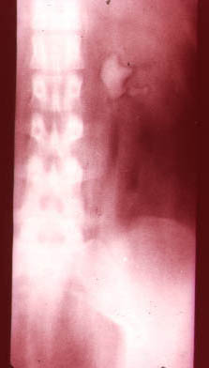
Diagnostic imaging
Special examinations that can be carried out include:
Retrograde or antegrade pyelography
Retrograde pneumo-pyelography or cystography
Spiral (helical) unenhanced computed tomography (CT)
Scintigraphy.

Slide 46
Diagnostic imaging
Ultrasonography-
In patients in whom it is not possible to obtain an intravenous urogram, ultrasonic evaluation of the kidneys may aid in the diagnosis of renal stones.
In pregnant women with flank pain in whom it is desirable to limit radiation exposure or in anuric patients or patients with chronic renal failure, the presence of hydronephrosis on acoustic shadowing may be diagnostic.

Slide 47
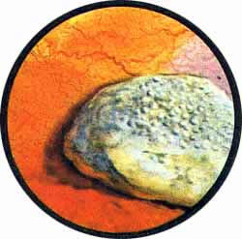
Diagnostic imaging
Cystoscopia shows swallowing of the ureter orifice in lower location of the stone, it may also partially project out to the orifice.

Slide 48
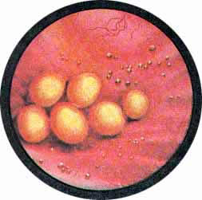
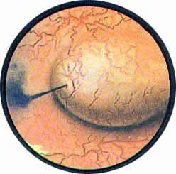
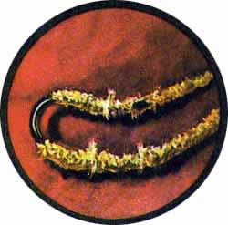
Cystoscopy

Slide 49
TREATMENT
Conservative
Instrumental
Surgical

Slide 50
Pain relief
Pain relief involves the administration by various routes of the following agents:
Diclofenac sodium
Indomethacin
Hydromorphone hydrochloride + atropine sulphate
Baralgin
No-spae + Analgine
Tramadol

Slide 51
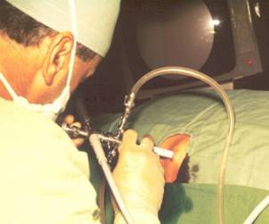
Pain relief
When pain relief cannot be obtained by medical means, drainage by stenting or percutaneous nephrostomy (PN) or stone removal should be carried out.

Slide 52
Stone removal
The size, site and shape of the stone at the initial presentation influence the decision to remove the stone. Also, the likelihood of spontaneous passage has to be evaluated. Spontaneous stone passage can be expected in up to 80% of patients with stones not larger than 4 mm in diameter. For stones with a diameter exceeding 7 mm the chance of spontaneous passage is very low.
The overall passage rate of ureteral stones is:
Proximal ureteral stones: 25%
Mid-ureteral stones: 45%
Distal ureteral stones: 70%

Slide 53
Indications for Active Stone removal
Stone removal is usually indicated for stones with a diameter exceeding 6-7 mm. Active stone removal is strongly recommended in patients fulfilling the following criteria:
Persistent pain despite adequate medication
Persistent obstruction with risk of impaired renal function
Stone with urinary tract infection
Risk of pyonephrosis or urosepsis
Bilateral obstruction.
Obstructing calculus in a solitary functioning kidney

Slide 54
Stone removal
In patients with coagulation disorders the following treatments are contra-indicated: extracorporeal shock wave lithotripsy (ESWL), percutaneous nephrolithotomy with or without lithotripsy (PNL), ureteroscopy (URS) and open surgery.
In pregnant women, ESWL, PNL and URS are contra-indicated. In expert hands URS has been successfully used to remove ureteral stones during pregnancy, but it must be emphasized that complications of this procedure might be difficult to manage.
In such women, the preferred treatment is drainage, either with a percutanous nephrostomy catheter, a double - J stent or a ureteral catheter .
For patients with a pacemaker it is wise to consult a cardiologist before undertaking an ESWL treatment.

Slide 55
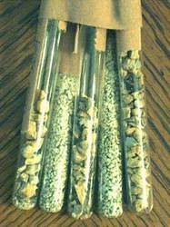
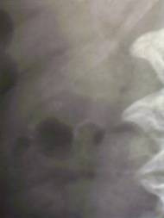
Percutaneous Procedures
Percutaneous nephrostomy. Because of this technique, urologists can now perform operative procedures within the kidney without using the standard large flank incisions and mobilization of the kidney.
This technique, along with refinements in endoscopic instruments and advances in fiberoptics, allows endoscopic manipulation in the upper urinary tract by the percutaneous approach.
Percutaneous nephrolithotomy with or without lithotripsy (PNL)

Slide 56
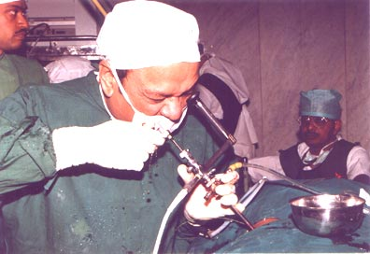
Closed Surgical Procedures
Cystoscopic technique [With the patient under anesthesia and with fluoroscopic control, stones in the distal ureter can sometimes be removed with a wire stone basket]
Ureteropyeloscopy [Manipulation of small ureteral stones under direct vision with a ureteroscope is a major advance in the management of ureteral calculi. With this technique, small stones can be easily trapped in a stone basket and safely extracted through the dilated ureter.

Slide 57
Extracorporeal Shock Wave Lithotripsy
An extracorporeal noninvasive technique that uses shock waves to disintegrate urinary calculi while the patient is immersed in a water bath has been tested extensively and is now in clinical use. With this technique, calculi in the upper urinary tract are reduced to fragments, which pass spontaneously from the collecting system and bladder in most patients.
Size, location, and consistency of stone determine the number of shocks needed for fragmentation. In general, between 500 and 2,000 shocks arc necessary to fragment and pulverize an intrarenal calculus sufficiently for complete passage.

Slide 58
Open Surgical Procedures
Pyelolithotomy: Simple pyelolithotomy is used for removal of calculi confined to the renal pelvis. Minimal dissection of the renal sinus is usually needed, and exposure of the entire kidney is not re­quired. This procedure is not indicated for the removal of entrapped caliceal stones or large, branched renal calculi.

Slide 59
Open Surgical Procedures
Ureterolithotomy. There are retroperitoneal, transperitoneal and combined surgical accesses. It depends on stone location. To remove stone from the superior ureter the Fedorov’s access is used, from medial ureter – Cuckulidze’s or Derev’yanko access is performed, the inferior ureter – Pyrogov’s access is needed, the pelvic portion of ureter may be accessed through the suprapubic arcuate incision.

Slide 60
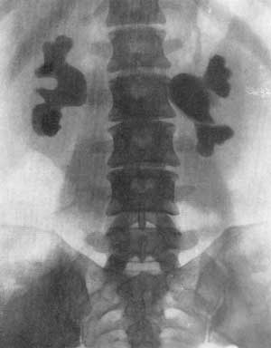
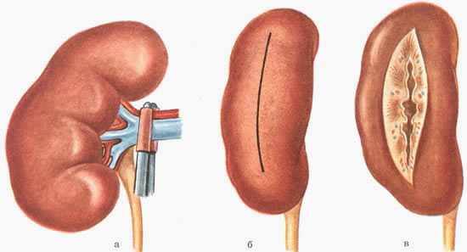
Open Surgical Procedures
Nephrectomy Nephrolithotomy Cystolithotomy

Slide 61
Lower Urinary Tract Symptoms
Storage symptoms
Frequency, Urgency, Nocturia
Incontinence
Suprapubic fullness and pain
Empty symptoms
Hesitancy, Intermittency, Small caliber,
Dysuria, Residual urine sensation

Slide 62
Urinary Incontinence
Stress incontinence
Urge incontinence
Total incontinence
Overflow incontinence
Giggle incontinence
Nocturnal enuresis

Slide 63
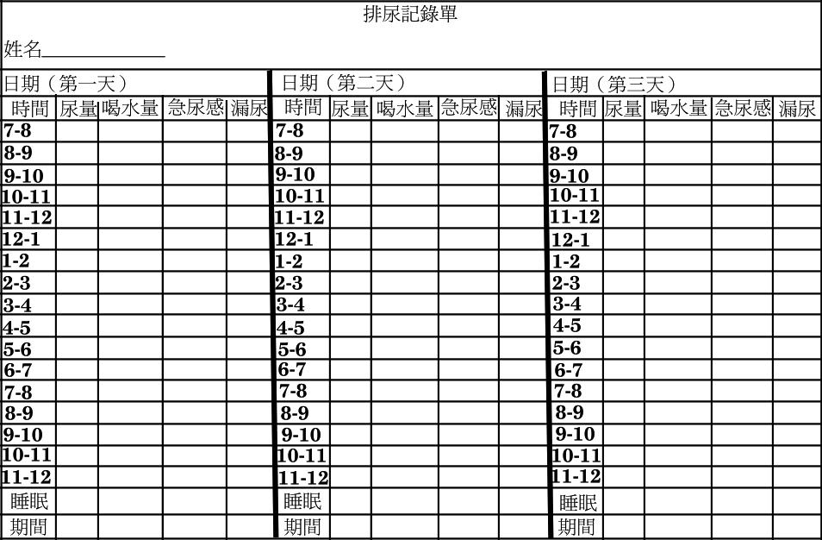
Voiding Diary

Slide 64
Physical Examination
Abdominal physical examination
Bladder, Operation scar
Perineal examination
Cystocele, Rectocele, Uterine prolapse
Urine leakage on cough, fistula
Vaginal mucosa, Vaginal tenderness
Neurological examination
B-C Reflex, PFM contractility, Anal tone

Slide 65
Prostatitis
Acute bacterial prostatitis
Chronic bacterial prostatitis
Abacterial prostatitis
Prostatodynia (perineal pain syndrome)
Using available symptom score or index to assess symptomatology

Slide 66
Ultrasound Examination in Male LUTS
Prostate enlargement is not indicator of BOO in men with LUTS
Transition zone index provides a better indicator for BOO
Bladder neck dysfunction
Trabeculated bladder
Low residual urine

Slide 67
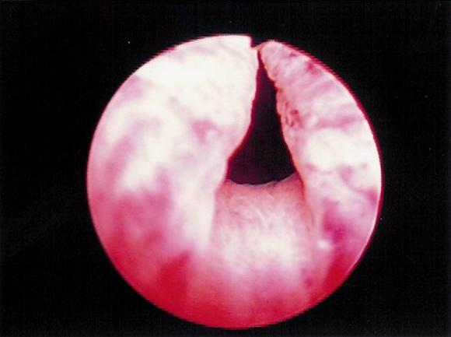
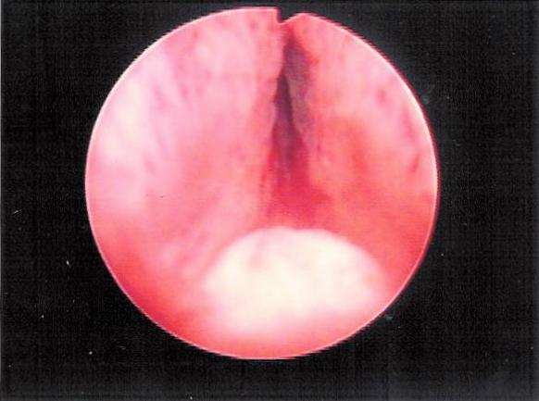
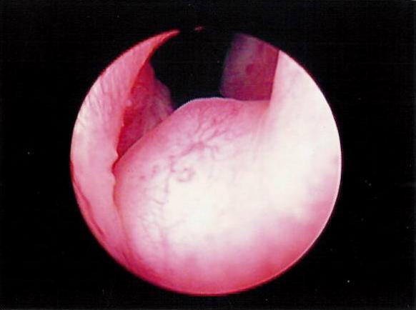
Prostatic enlargement
Benign prostatic enlargement
Prostatic cancer

Slide 68
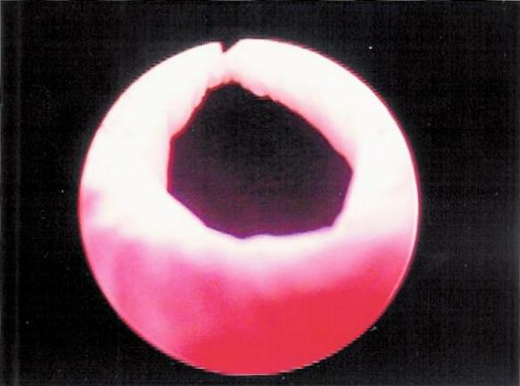
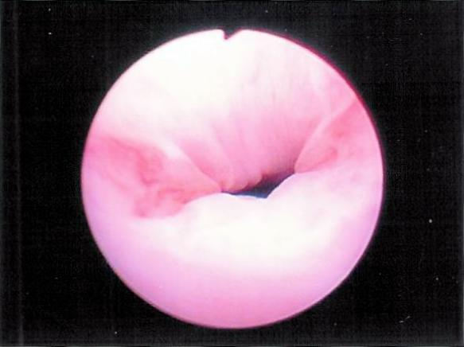
Female Urethral Incompetence
Bladder neck incompetence
Urethral incompetence

Slide 69
Assessing Pubococcygeus muscle function
Inspection
Perineum buldging downward
Vaginal introitus opens
Anus everted
Performing straining or coughing
Contraction of pubococcygeus m.

Slide 70
Cystocele and Prolapse

Slide 71
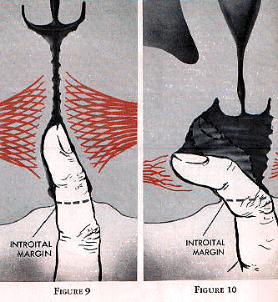

Slide 72
Laboratory examinations
Urinalysis & urine culture- evidence of pus cells and bacteria in urine
Blood chemistry, blood sugar- azotemia, diabetes may cause polyuria, detrusor underactivity
KUB- a lower ureteral stone cause storage symptoms and empty symptoms

Slide 73
Postvoid Residual Volume
Estimated immediately after voiding
Transabdominal ultrasound provides accurate volume estimation
Diuresis may falsely increase PVR
Patient might not void completely due to embarrassment
Do not forget PVR in clinical assessment of LUTS

Slide 74
Benign Prostatic Hyperplasia

Slide 75
BPH
n
The size of prostate enlarged microscopically since the age of 40.Half of all men over the age of 60 will develop an enlarged prostate
By the time men reach their 70’s and 80’s, 80% will experience urinary symptoms
But only 25% of men aged 80 will be receiving BPH treatment
n

Slide 76
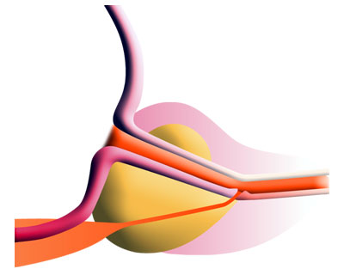
What is Benign Prostatic Hyperplasia?
Peripheral zone
Transition zone
Urethra

Slide 77
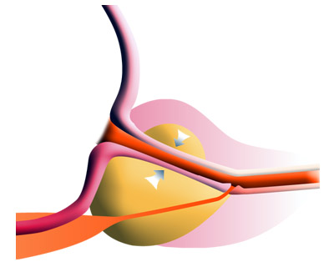
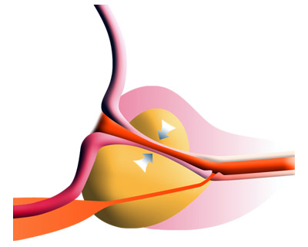
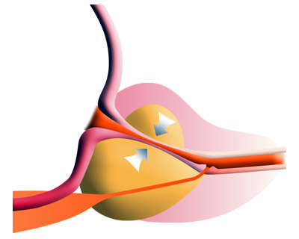
Peripheral zone
Transition zone
Urethra

Slide 78
What causes BPH?
BPH is part of the natural aging process, like getting gray hair or wearing glasses
BPH cannot be prevented
BPH can be treated
n
n
n

Slide 79
When should BPH be treated?
BPH needs to be treated ONLY IF:
Symptoms are severe enough to bother the patient and affect his quality of life
Complications related to BPH
n
n

Slide 80
Choosing the right treatment
Consider risks, benefits and effectiveness of each treatment
Consider the outcome and lifestyle needs
n
n

Slide 81
Treatment options
“Watchful waiting”
Medication
Surgical approaches
Minimal invasive
TURP
Invasive “open” procedures
n
n
n

Slide 82
“watchful waiting”
For mild symptoms. follow up1 to 2 times yearly
n
Offer suggestions that help reduce symptoms
Avoid caffeine and alcohol
Avoid decongestants and antihistamines
n
n
n

Slide 83
Medication
First line of defense against bothersome urinary symptoms
Two major types:
α blockers - relax the smooth muscle of prostate and provide a larger urethral opening (Hytrin,Doxaben, Harnalidge)
n
n
n
5 α reductase inhibitor - Shrink the prostate gland (Proscar, Avodart)
n
Notes:
Relaxation of these muscle bundles lessens the resistance to outflow during urination.α

Slide 84
Surgical treatment
Notes:
Until recently, the only option we could offer patients for treatment of their symptoms was either an open abdominal surgical procedure, or a trans-urethral resection of the prostate.

Slide 85
Indication of surgical intervention
Acute urinary retention
Gross hematuria
Frequent UTI
Vesical stone
BPH related hydronephrosis or renal function deterioration
Obstruction
IPSS≧8, prostate size, image study, UFR
cystoscopic findings, residual urine

Slide 86
Conventional Surgical Therapy
Transurethral resection of the prostate (TURP)
Open simple prostatectomy

Slide 87
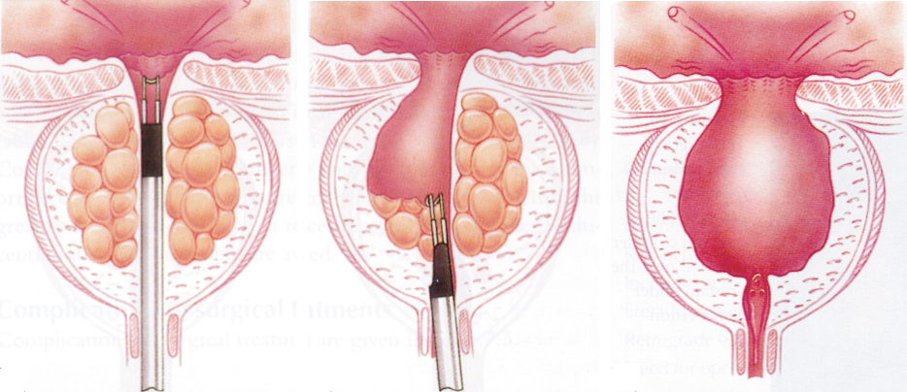
TURP
(transurethral resection of the prostate)
“Gold Standard” of care for BPH
Uses an electrical “knife” to surgically cut and remove excess prostate tissue
Effective in relieving symptoms and restoring urine flow
n
n
n

Slide 88
TURP
“Gold standard” of surgical treatment for BPH
80~90% obstructive symptom improved
30% irritative symptom improved
Low mortality rate 0.2%

Slide 89
The “gold standard”- TURP
Benefits
Widely available
Effective
Long lasting
Disadvantages
Greater risk of side effects and complications
1-4 days hospital stay
1-3 days catheter
4-6 week recovery
n
n
n
n
n
n
n

Slide 90
Complication of TURP
Immediate complication
bleeding
capsular perforation with fluid extravasation
TUR syndrome
Late complication
urethral stricture
bladder neck contracture (BNC)
retrograde ejaculation
impotence (5-10%)
incontinence (0.1%)

Slide 91
Open Simple Prostatectomy
“too large prostate” -- >100 gm
Combined with bladder diverticulum or vesical stone surgery
Suprapubic or retropubic method

