Slide 1
Professional Relationships

Slide 2
Contents
What is a professional relationship?
Comparison between professional and non professional
Communication
Types of communication

Slide 3
What is a professional relationship?
A professional relationship is a good understanding between colleagues, clients or any other important person for various reasons. The relationship involves work related issues and businesses.

Slide 4
Comparison between professional and non professional relationship
Milgrom , J. (1992)

Slide 5
Professional relationship
A professional relationship is a good understanding between colleagues, clients or any other important person for various reasons. As a nurse, it is a therapeutic relationship.

Slide 6
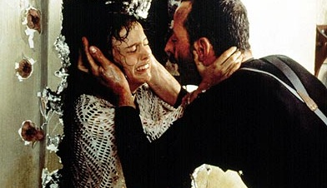
Non professional relationship
Non-professional relationships are social relationships which may be casual, friendly, or romantic in nature.

Slide 7
Professional relationship | Friendship
The professional puts the consumer first. | Each friend gives support to the other
The professional does not invite the consumer to his or her home. | Friends can go to each other ’ s home
The professional does not engage in discussions with the consumer about the professional ’ s personal problems. | Friends confide in each other equally and discuss each other ’ s personal problems.
Professional relationship
The professional puts the consumer first.
The professional does not invite the consumer to his or her home.
The professional does not engage in discussions with the consumer about the professional ’ s personal problems.

Slide 8
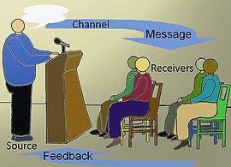
What is communication?
Communication is simply the act of transferring information from one place to another.
Types of communication:
Non verbal communication
Verbal communication

Slide 9
What is verbal communication?
It is written or spoken message that uses words to exchange ideas/information.
http://www.slideshare.net/zia_jaan/verbal-communication-10154800

Slide 10
Types of Verbal Communication
Oral Communication
Written Communication

Slide 11
Oral and written communication
Oral communication
Anything that emanates from the mouth is called as oral communication.
Written communication
Anything that involves writing, typing is called written communication.

Slide 12
Non verbal communication

Slide 13
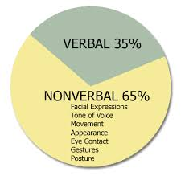
What is non verbal communication?
When we interact with others, we continuously give and receive wordless signals.

Slide 14
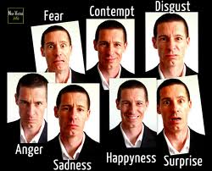
Types of non verbal communication
Facial expressions
The human face is extremely expressive, able to express countless emotions without saying a word.

Slide 15
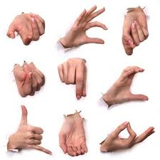
Body movements and posture
Consider how your perceptions of people are affected by the way they sit, walk, stand up, or hold their head.

Slide 16
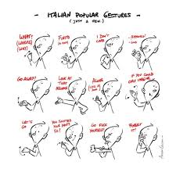
Gestures
Gestures are woven into the fabric of our daily lives. We wave, point, beckon, and use our hands when we’re arguing or speaking animatedly.

Slide 17
Eye contact
Since the visual sense is dominant for most people, eye contact is an especially important type of nonverbal communication.

Slide 18
Touch
We communicate a great deal through touch. Think about the messages given by the following: a weak handshake, a timid tap on the shoulder, a warm bear hug, a reassuring slap on the back, a patronizing pat on the head, or a controlling grip on your arm.

Slide 19
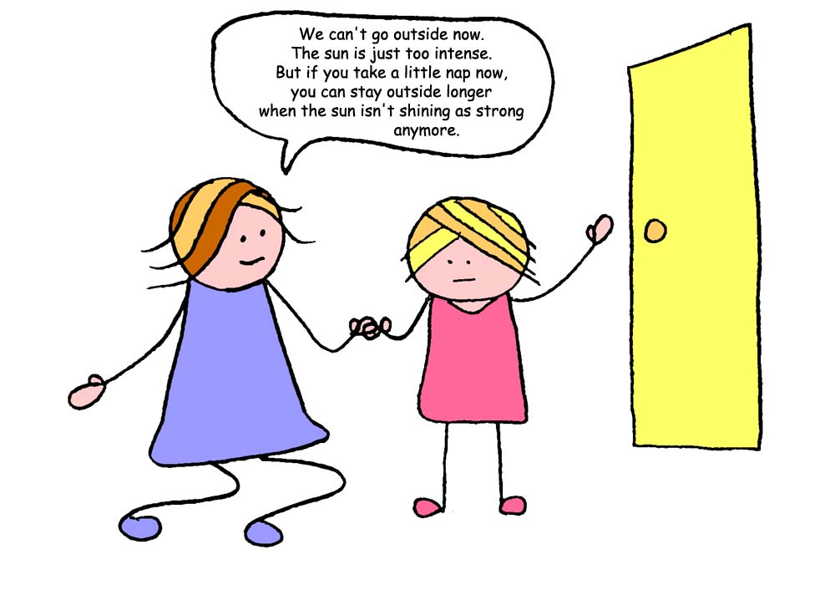
Voice
It’s not just what you say, it’s how you say it. When we speak, other people “read” our voices in addition to listening to our words.

Slide 20
Therapeutic communication
What is it?
Therapeutic communication is defined as the face-to-face process of interacting that focuses on advancing the physical and emotional well-being of a patient
Watson J. Caring Science as Sacred Science. Philadelphia, PA: FA Davis Company; 2005.

Slide 21
Thankyou,
Any questions?

