Slide 1
CODE OF ETHICS IN NURSING

Slide 2
“It is not how much you do but how much love you put in the doing.”
- Mother Theresa

Slide 3
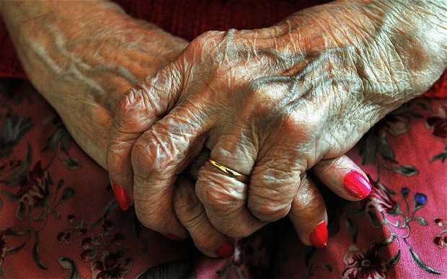
VALUES AND QUALITIES OF NURSING CARE
Treating them as our own family.
Attention
Quality
Proper care

Slide 4
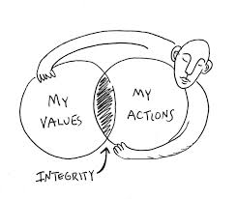
RESPONSIBILITY TO PRESERVE INTEGRITY
Moral self respect.
Professional growth and maintenance.
Wholeness as a character.

Slide 5
RESPECT AND KINDNESS
Respecting every age category.
Been kind to them in every situation.
Agree to all decision and then make your choice on making it right.

Slide 6
Value the diversity of people and value access to quality for all people

Slide 7
INFORMED DECISION MAKING

Slide 8
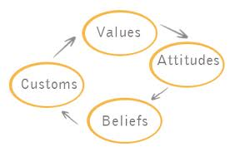
CULTURE AND SAFETY
Mortal values.
Influence of the environment.
Responsibilities

Slide 9
COLLABORATION

Slide 10
“They may forget your name but they will never forget how you made them feel.
-Maya Angelou

