Slide 1
Restraints in Health Care
Presented by: Deshani & Mahi (Group 3)

Slide 2
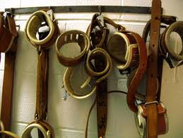
Introduction
Restrain: Definition
Types of Restrains
Physical Restrains
Mechanical Restrains
Chemical Restrains
Psychological Restrains
Technological Surveillance
When to use Restrains
Restraints as a last resort
Patient Rights

Slide 3
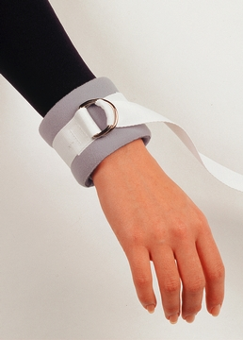
Restraints: Definition
Form of medical treatment
Used to limit a patient’s movement
Used as a last resort

Slide 4
Types of Restraints
Physical restraint
Mechanical restraint
Technological surveillance
Chemical restraint
Psychological restraint

Slide 5
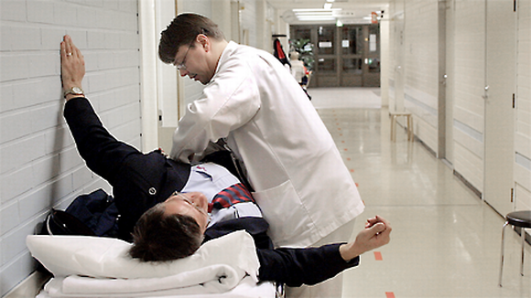
Physical Restraint
One or more members of the staff hold the patient to restrict movement.

Slide 6
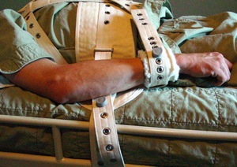
Mechanical Restraint
Use of specialized equipment
Examples:
Special mittens in ICU
Heavy belts in chairs
Bedrails

Slide 7
Mechanical Restraint cont’d

Slide 8
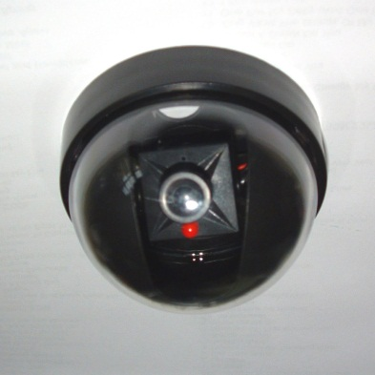
Technological Surveillance
Used to alert staff
Can monitor client’s movements
Examples:
Closed circuit television (CCTV)
Pressure pads
Door alarms

Slide 9
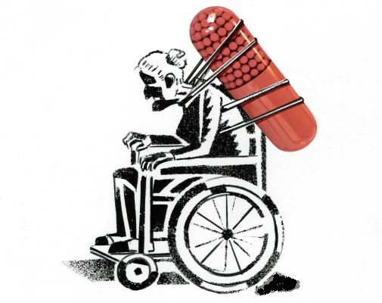
Chemical Restraints
Use of medication as restraints

Slide 10
Psychological Restraints
By giving instructions
Take away a person’s lifestyle choices
Example:
“You are not allowed to…”

Slide 11
When to use Restraints
To restrict movement
For safety of client and others

Slide 12
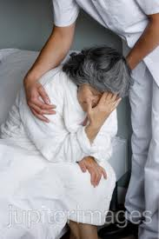
Patient Rights
ONLY as a Last Resort.
Need special care
Example: hygiene
Need close monitoring

Slide 13
Ethical Dilemma of Restraints
Beneficence Vs. Autonomy

Slide 14
Ethical Dilemma cont’d
Restraints
Autonomy
Beneficence
Non-maleficence
Justice

Slide 15
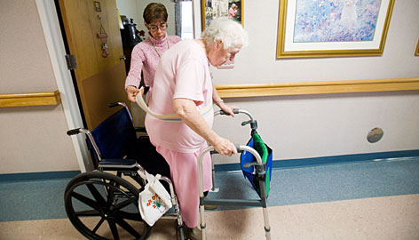
Case Study
88 year old woman with Dementia
Treated in a nursing home to walk (rehabilitation)
Falls while walking and get injured

Slide 16
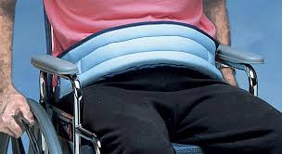
Case Study
Restraint: Wheel chair with a lap tray
Patient complains about the restraint
Regular re-evaluation of patient’s condition
Use of lesser restraints

Slide 17
References
Dugdale, D. C. (2012, February 26). Use of Restraints. Retrieved February 16, 2014, from MedlinePlus: http://www.nlm.nih.gov/medlineplus/ency/patientinstructions/000450.htm
Minnesota Department of Health. (2010). Safety. Retrieved February 16, 2014, from Minnesota Health Care Facilities: http://www.health.state.mn.us/divs/fpc/safety.htm
Fasano, C. J., & Schneider, G. (2010). Physical and Chemical Restraint. Philadelphia: Elsevier.

Slide 18
Questions?

Slide 19
Thank You!

