Slide 1
SCOPE OF PRACTICE FOR NURSES

Slide 2
Nursing…
A nurse is a health care professional who cares for ill or disabled individuals, their families and communities ensuring that they attain, maintain or recover optimum health and functioning.

Slide 3
Nurses are classified according to their education and experiences as,
In US,
Licensed practical nurses
Registered nurses
Advanced practice nurses
In UK,
First level nurses
Second level nurses
Specialist nurses
Manager

Slide 4
SCOPE OF PRACTICE FOR NURSES
Scope of practice refers to the actions, procedures and processes that are permitted to be done by a professional in his/her profession by the law.

Slide 5
According to the International Council of Nursing (ICN),
“Nursing encompasses autonomous and collaborative care of individuals of all ages, families, groups and communities, sick or well and in all settings. Nursing includes,
Promotion of health
Prevention of illness
Care of ill, disabled and dying people
Also advocacy,
Promotion of a safe environment
Research
Participation in shaping health policies
Patient and health system management…”

Slide 6
According to the Queensland nursing council a nurse will,
Give direct care, including assessing, planning, implementation and evaluating care
Coordinate care and supervise others
Lead, manage
Teach, educate, promote health and do counseling
Undertake researches
Develop health, nursing and midwifery policies

Slide 7
Understanding wether a task is within the scope of practice
3 specific steps,
1.Defining the task
2.Reveiws, Rules, Laws and Standards
3.Making the decision

Slide 8
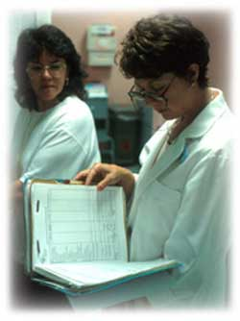
1.Defining the task
Obtain additional information
Self-assessment
Documented competency

Slide 9
2.Review rules, laws, standards
Rules
Laws
Standards

Slide 10
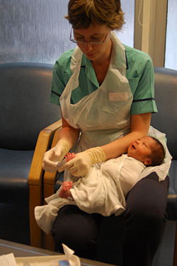
3.Making the decision

Slide 11
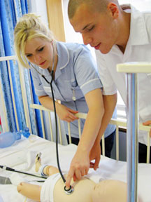
CONCLUSION 1.undestand the scope of practice 2.work within it

Slide 12
Thank you ☺

