Slide 1

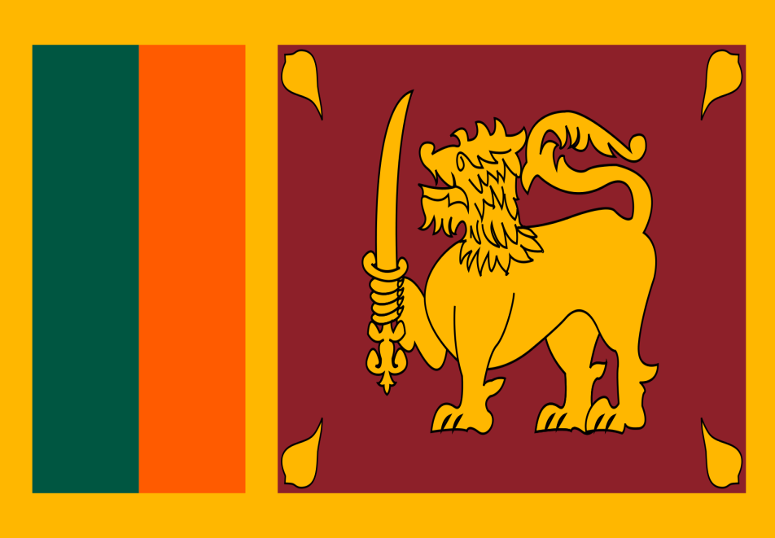
LAW SYSTEMS IN AUSTRALIA AND SRILANKA

Slide 2
CONTENTS
1.0What is a law?
1.1 Classifications of law
1.2 The structure of federal government
  1.2.1 Legislative
  1.2.2 Executive
  1.2.3 Judicial
2.0 The difference between law and Ethics
2.1 Where does law come from?
3.0 Law system in Australia
4.0 Law system in Srilanka

Slide 3

Law : Is a system of rules and guidelines which are enforced through social institutions to govern behavior.

Slide 4
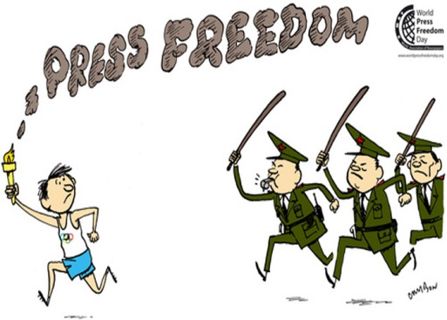
Classifications of law
Civil law
Criminal law

Slide 5
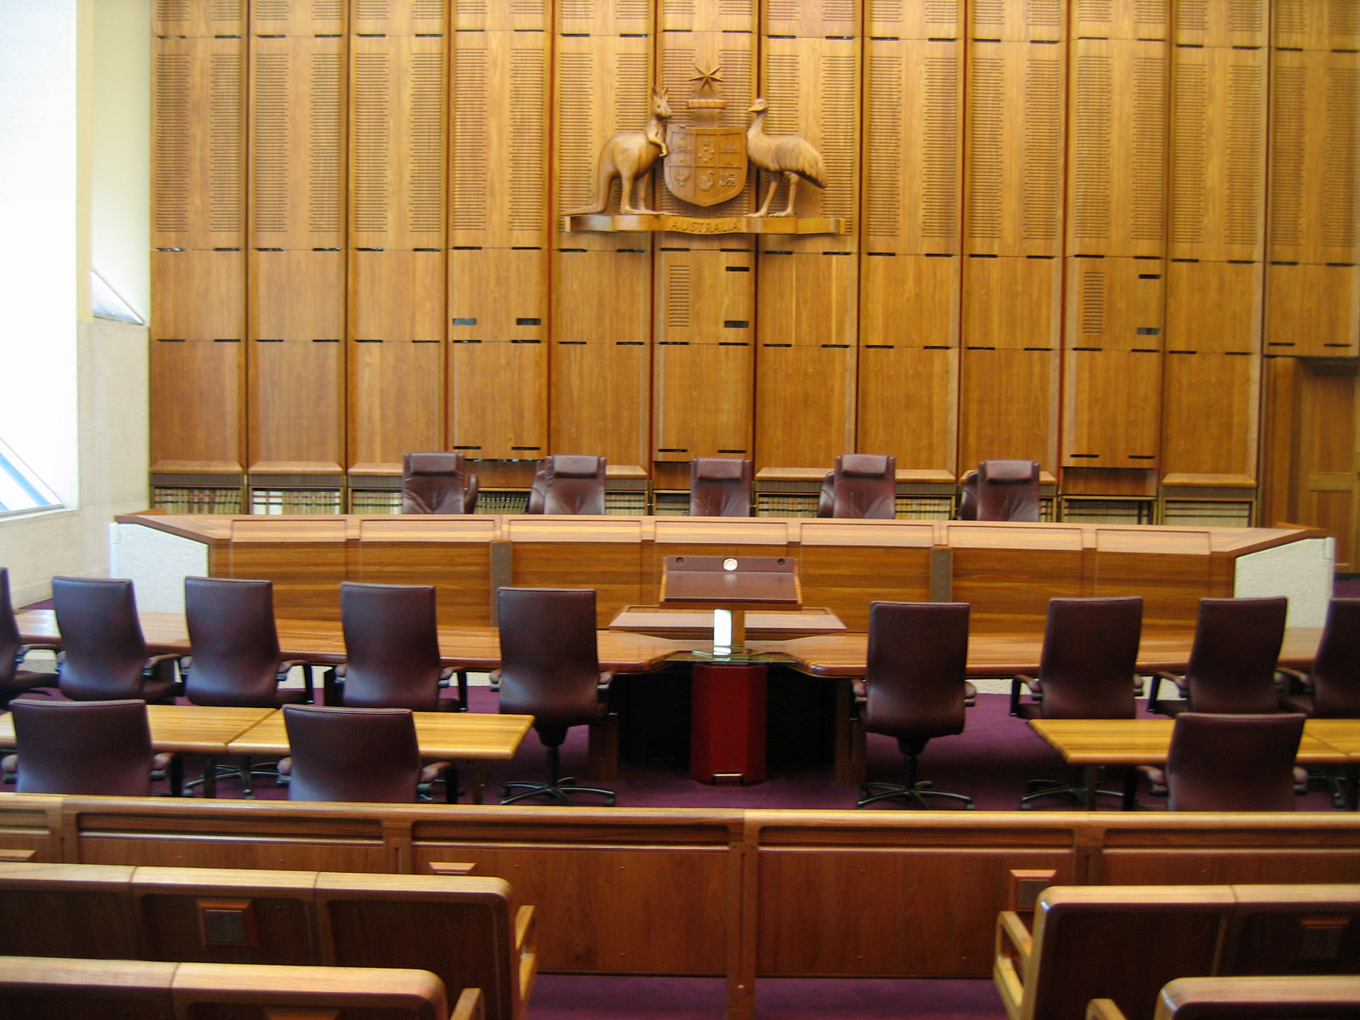
Structure of the federal government,
There are three branches of the government.
  Legislative
  Executive
  Judicial

Slide 6

Differences between laws and ethics
Laws are the regulations established, and usually written, by a governing power. Ethics are the morals of a culture, and often times, they inform the laws that are made

Slide 7

The law of torts
A tort is usually described as a civil wrong
The torts most relevant to nursing are:
 Assault
 False imprisonment
 Negligence
 Negligent advice
 Defamation
 Bailment

Slide 8

Where does law come from :
2 main sources of law in Australia are the common law and legislation
Common law consists of the principles developed by judges in cases that come before them
Legislation is the law passed by the Parliament, or some other bodies under delegation.

Slide 9
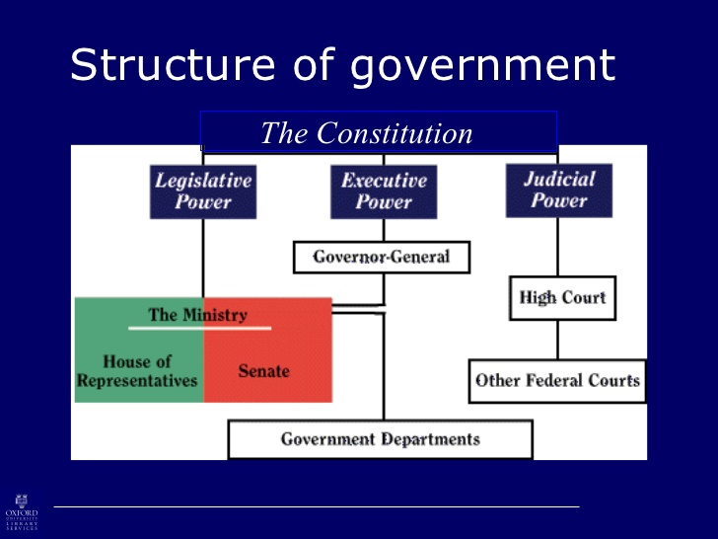
AUSTRALIAN LAW SYSTEM :

Slide 10
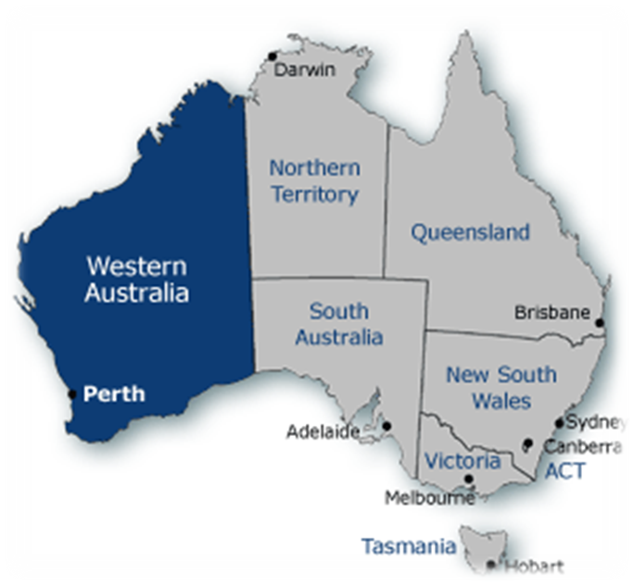
☺Australian politics operates as a two-party system, as a result of the permanent coalition between the Liberal Party and National Party

Slide 11

☺SRILANKAN LAW SYSTEM:
The Legal system of Sri Lanka is a highly complex mixture of several laws.

Slide 12
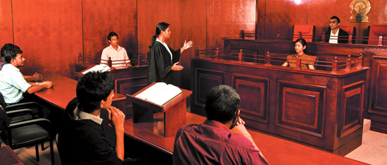
☺Sri Lankan Legal system is influenced by English common law and Roman-Dutch owing to it’s the colonial history.

Slide 13

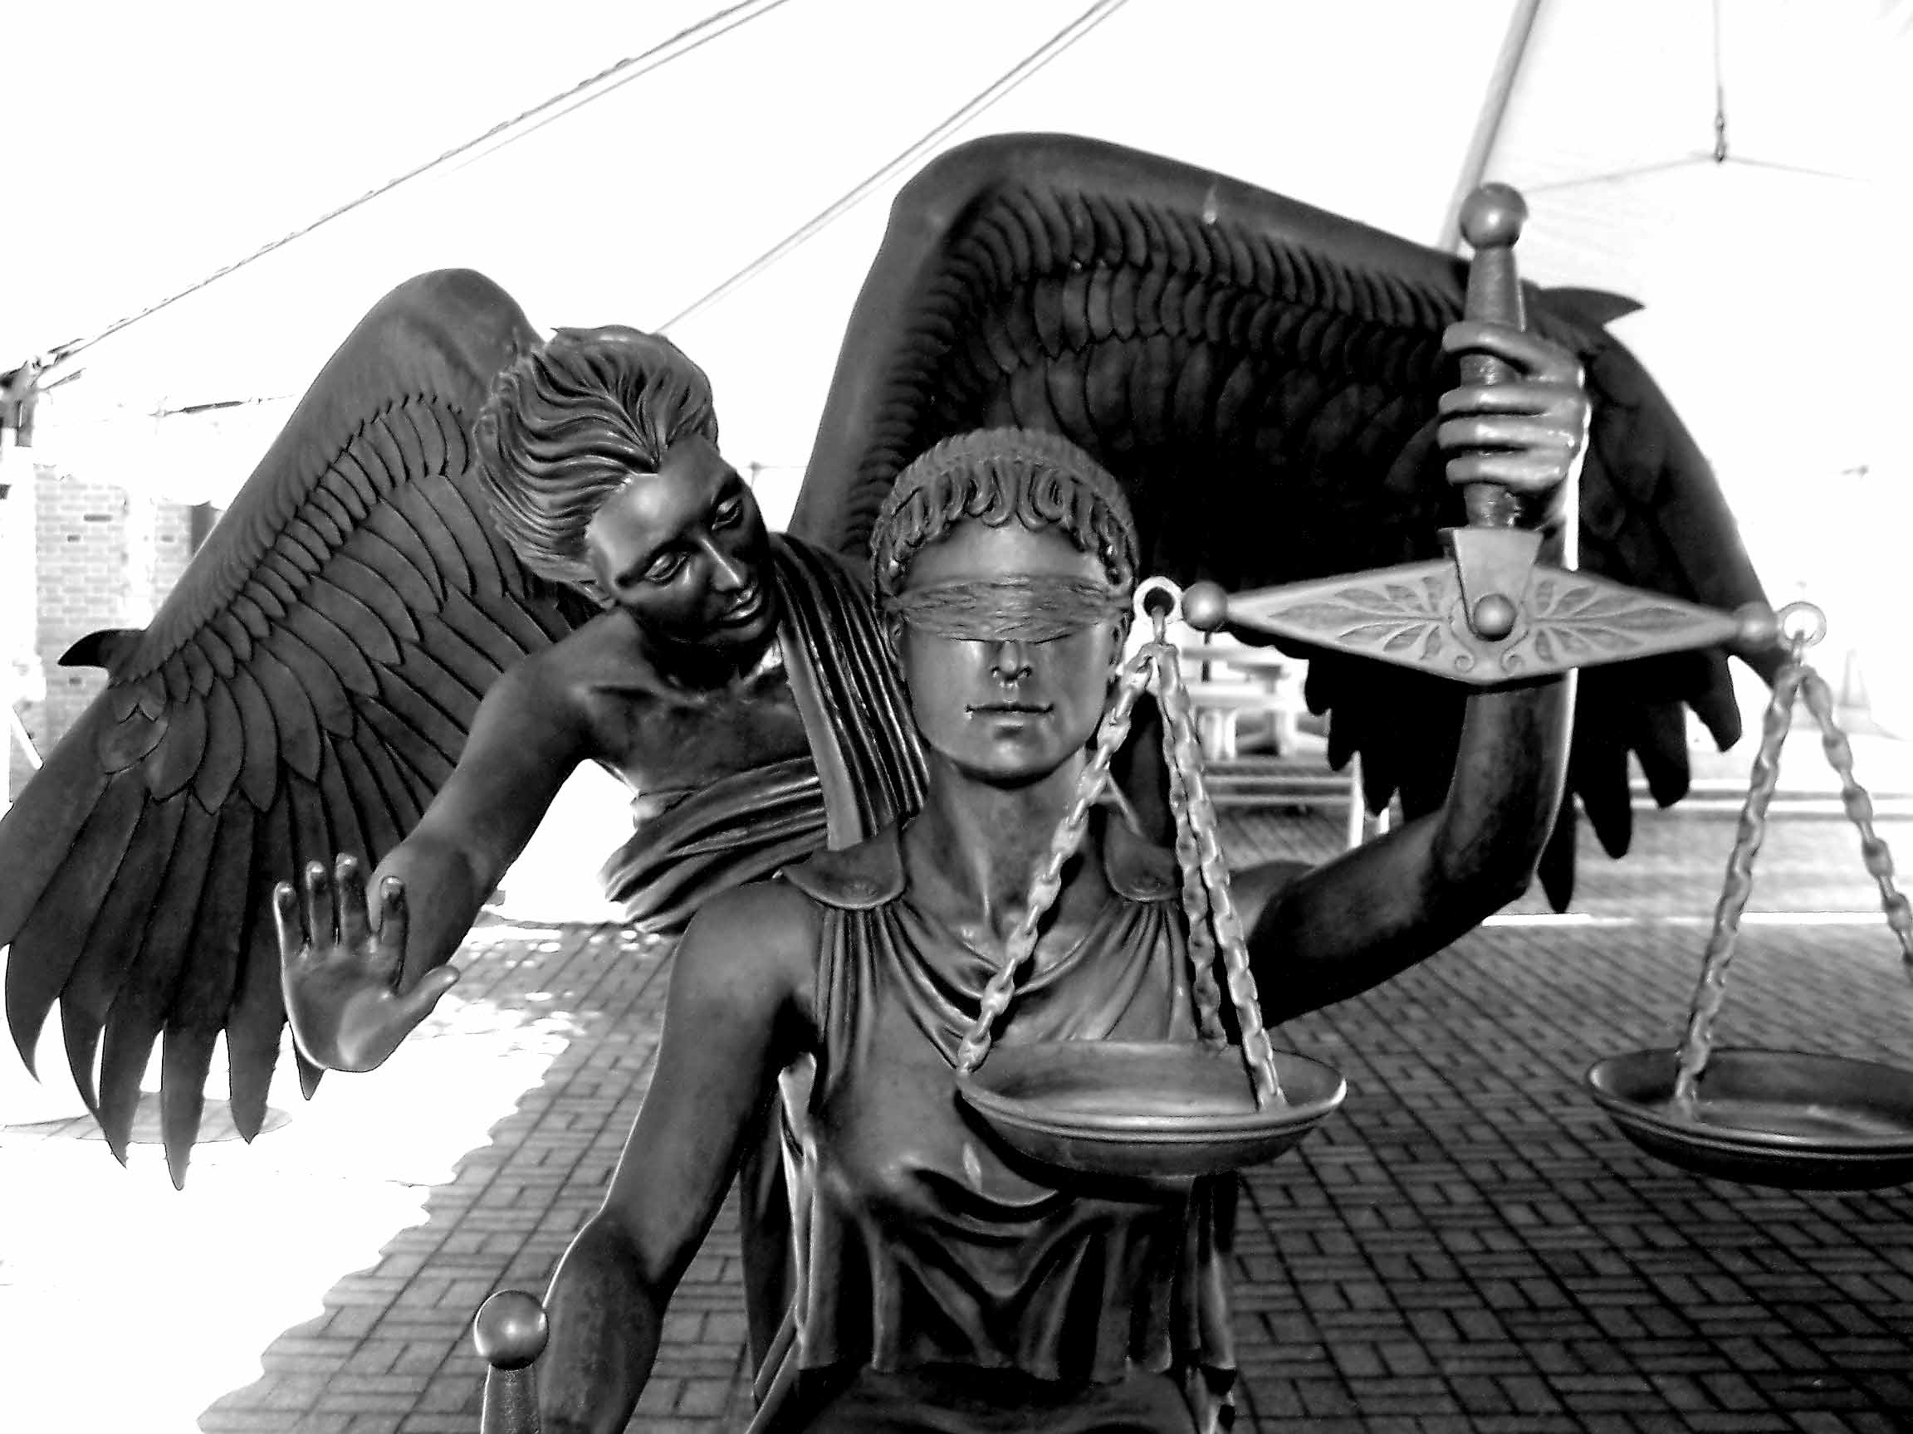
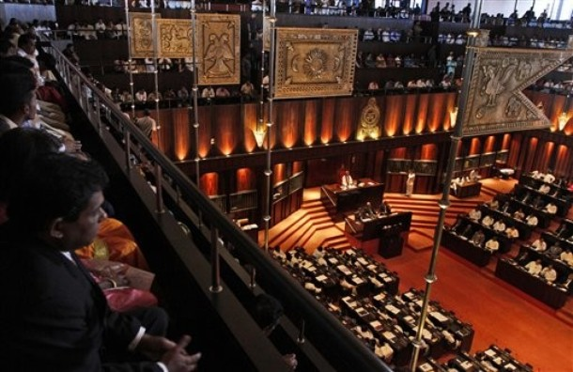


Slide 14
REFERENCES :

Slide 15

ANY QUESTIONS ?

