Slide 1
Incident Reports
Presented by
Pavan & Kurinchi

Slide 2
Content
Introduction
What is Incident?
Types of Incidents
Types of Incident Reports
Should include
Process
Purpose
References

Slide 3
Introduction
Not a peace of paper…
A process in which event that are inconsistent with routing operation or patient care are documented

Slide 4
What is incident?
An event or circumstance resulting from health care or occurring in a health care setting, which could have or did lead to…
Unintended or unnecessary harm to a person
A potential harm, loss or damage
Events may affect any person, including patients, employees, physicians , visitors, students or volunteers
Whether or not they cause injury

Slide 5
Types of incidents
Adverse events-medical errors that could and should have been avoided by health care facilities
Near misses
International unsafe acts
Sentinel events- unanticipated event in a health care setting resulting in death or serious physical or psychological injury to a patient or patients, not related to the natural cause of the patients illness

Slide 6
Types of Incident Reports
INCIDENT/COMPLAINT REPORT
LABORATORY INCIDENT REPORT

Slide 7
Should include
What???

Slide 11
Why???

Slide 12
INCIDENT REPORT NO:
Complete this form to report accidents, incidents, near misses, hazards or harassment.
Location of Incident: ……………………………………………
Date of incident:
........................................
Time of incident:
.......................
Individual/s involved
.......................................................................................................................................
.......................................................................................................................................
Nature of incident:
.......................................................................................................................................
.......................................................................................................................................
.......................................................................................................................................
Injuries sustained:
.......................................................................................................................................
.......................................................................................................................................
Treatment given:
.......................................................................................................................................
.......................................................................................................................................
Damage incurred:
.......................................................................................................................................
Witnesses:
Name:
........................................
Position:
.........................................
Contact Details:
......................................................................................................................................
Name:
........................................
Position:
.........................................
Contact Details:
.......................................................................................................................................
Incident Report submitted by:
.......................................................................................................................................
Office use only:
Date:
OHS Incident record/logged by:
Date

Slide 13
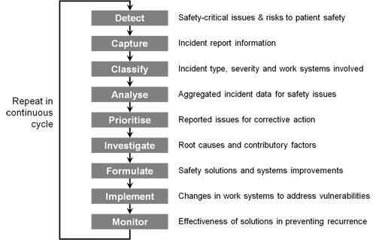
process

Slide 14
Purposes
Legal documentation
Communication
Help to Diagnostic and Therapeutic Orders
Care Planning: Outlining Nursing or interdisciplinary goals for the patient’s care

Slide 15
Historical Documentation: because entries are by date and time, can give a history of patient’s condition
Decision Analysis: Organizational strategic planning about treatment methods, patient services
Auditing/Monitoring (Quality Improvement)

Slide 17
References
http://www.monash.edu.au/lls/llonline/writing/medicine/reflective/5.xml
https://www1.imperial.ac.uk/cpssq/research_themes_2/cpssq_research_themes/feedback_from_incident_reporting_systems/
http://www.kevinmd.com/blog/2009/10/incident-reporting-effective-reducing-medical-errors-increasing-patient-safety.html
http://www.nso.com/nursing-resources/article/43.jsp
http://www.tru.ca/hsafety/incident_reporting.html
http://www.ncbi.nlm.nih.gov/pmc/articles/PMC1490252/

Slide 18
Thank you!!!!

Slide 19
Any questions????

