Slide 1

BOARD OF NURSING

Slide 2
CONTENTS
What is board of nursing?
Roles of board of nursing.
Criminal liability.
Code of ethics.

Slide 3

WHAT IS BORD OF NURSING??

Slide 4


Slide 5
ROLE OF BOARD OF NURSING
The Board is responsible for regulating of nursing act.
They make up administrative rules and regulations.
They involve in issueing of license.
Notes:
Basically they tell nurses what they can and cannot do under the scope of practice(BUL1)
They advice on licensing requirements, licensing examination and practice issues, and they provide community outreach
They also conduct hearings for licensees and prosecution of violations of nurse practice acts.
(BUL 3)

Slide 6
The state board have the legal right authority to implement and enforce the laws
They reinforce the importance for nurses to practice within the limit of the law of the state they reside in and that they are responsible for their own actions.
Authority for discipline actions
Notes:
The State Board have the legal right authority to implement and enforce the laws that govern nursing practice, nursing education and licensure(BUL4)
Actions taken are based upon the severity of the violation.(BUL5)

Slide 7

WHAT IS THE FUNTION OF THE BOARD OF NURSING?
The primary function of the State Board of Nursing is to protect the public’s safety.
The State Board of nursing is a regulatory agency created by the state government, which is devoted to monitor nurse’s personal and professional behaviors.

Slide 8
The Nurse Practice Acts delineate the educational requirements, roles and functions, and disciplinary actions of a nurse.
This agency is also responsible for approving schools of nursing curriculum as well as renewing and issuing licenses
The State Board of Nursing has, “the legislative power to initiate, regulate, and enforce the provision of the Nurse Practice Act.”

Slide 9

Criminal liability

Slide 10
If a nurse commits violation.
Private reprimand or warning
Public reprimand
probation
Suspension of license
Refusal to renew license
Revocation of license
Notes:
Nurses under suspension or probation who are found liable of drug abuse, unprofessional conduct, fraud or violation of the provisions of the Nurse Practice Act may be asked to attend special counseling or substance abuse rehabilitation.

Slide 11
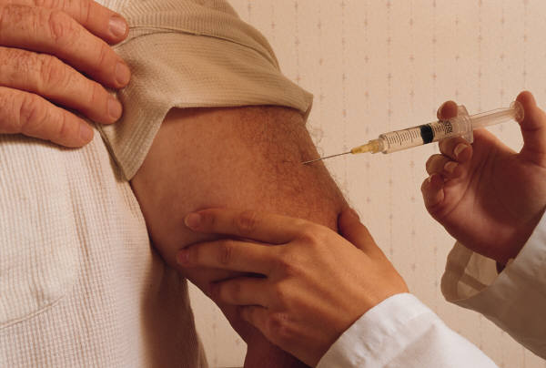

Slide 12
A nurse commits a violation
Written complaint filed by
an individual, a health agency
or professional organization
Complaint is screened and
an investigation is set up

Slide 13
Board decides whether to
schedule a hearing with
legal counsels for both sides
Nurse will be requested to
-have a written response regarding the allegation.
-Entitled to some rights such a clear statement
of the charges; question and produce witnesses;
Right to an attorney

Slide 14
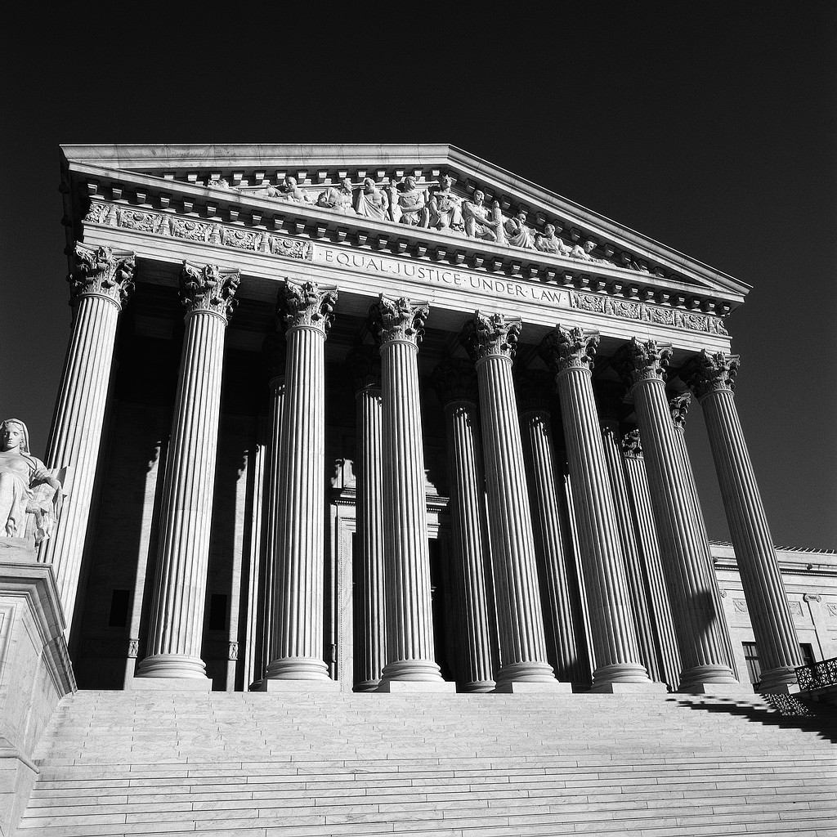
Code of ethics…

Slide 15
Nurses respect individuals needs, values, culture and vulnerability in the provision of nursing care.
Nurses accep the rights of individuals to make informed choices in relation to their care.
Nurses promote and uphold the provision of quality nursing care for all people.
Nurses fulfill the accountability and responsability inherent in their roles.

Slide 17
THANK YOU!!

Slide 18
ANY
QUESTIONS??

