Slide 1
Roles and responsibilities of a coroner.
Group 6
Sonali weerakkody
Kisara arambepola

Slide 2
Contents
Who is a coroner?
History of a coroner
The role of the coroner today
Duties and responsibilities of a coroner

Slide 3
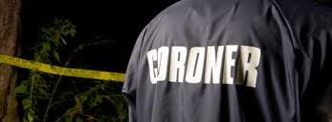
Who is a coroner?
A coroner is a government official who confirms and certifies the death of an individual within a jurisdiction.

Slide 4
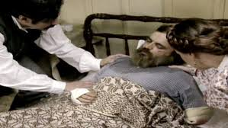
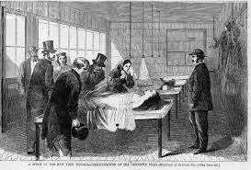
The history of the coroner…

Slide 5
The role of the coroner today…

Slide 6
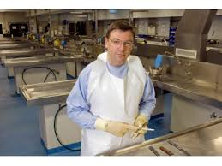
Duties and responsibilities of the coroner…

Slide 7
References…
1.www.gov.uk
2.www.manchester.gov.uk
3.www.indy.gov
4.www.coronerscourt.vic.gov.au

Slide 8
Any questions?

Slide 9
Thank you..

