Slide 1
Male Genital Surgical Conditions
Dr. S. Nishan Silva
(MBBS)

Slide 2
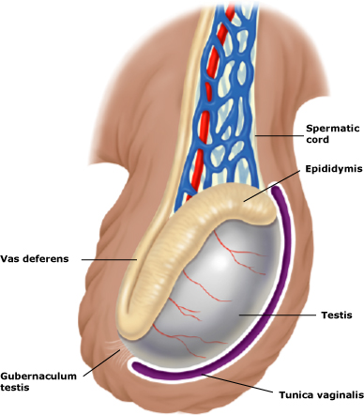
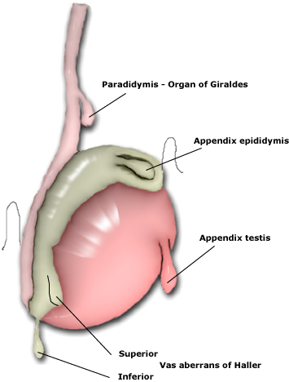
Anatomy

Slide 3
Congenital Anomalies : Hypospadias and Epispadias
Malformations of urethral groove and/or urethral canal:
Abnormal opening on ventral surface: hypospadias (1/300 live male births)
Abnormal opening on dorsal surface: epispadias (less common than hypospadias)
Associated with:
Failure of normal descent of testes
Other malformations of urinary tract
Clinical sequelae: urinary tract obstructions, infections, sterility

Slide 4
Phimosis
Phimosis is the inability to retract the prepuce (foreskin) of penis over the shaft due to a narrow opening. Phimosis can be congenital or acquired:- In acquired phimosis there is chronic inflammation of the tip of the penis and prepuce (fore skin) or there are adhesions between glans & prepuce or due to malignancy. In congenital causes it is present since birth. Phimosis is usually caused by thickening and repeated inflammation of the foreskin.

Slide 5
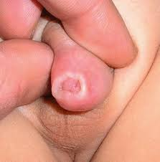

Slide 7
Symptoms of Phimosis ?
Inability to retract foreskin.
Straining during urination.
Thin stream of urine.
Recurrent urinary infections.
Pus from penis - due to belanophosthitis. How can we diagnose Phimosis ? From history & examination On Examination:
Pin hole opening of foreskin
Difficulty to push back the foreskin over the shaft of the penis.
Balooning of foreskin - A bulge in the tip of penis as urine accumulates under the foreskin.

Slide 8
How can Phimosis be treated ? Circumcision
If untreated complications of phimosis can occur:
Infected foreskin leads to infection of glans also.
Paraphimosis
Back pressure due to obstruction of flow of urine.
Meatal Stenosis - narrowing of penile opening.
Sometimes a cancerous ulcer on glans can cause the adhesion to take place.

Slide 9
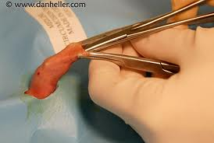

Slide 10
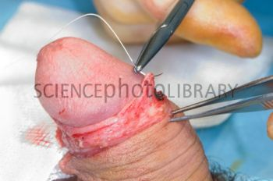
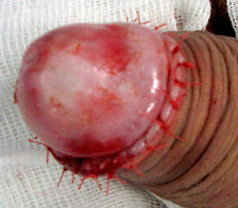

Slide 12
ParaPhimosis
Paraphimosis occurs when the foreskin has been retracted and narrows below the glans, constricting the lymphatic drainage and causing the glans to swell.
If not corrected, blood flow in the penis becomes impeded by the increasingly constricting band of foreskin, which causes further swelling of the glans. Because lack of oxygen from the reduced blood flow can cause tissue death (necrosis)
paraphimosis is considered a medical emergency and requires immediate treatment.

Slide 14
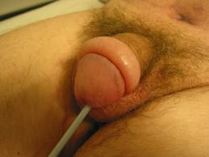

Slide 15
Causes:
Bacterial infection (e.g., balanoposthitis)
Catheterization (i.e., if the foreskin is not returned to its original
position after a urethral catheter is inserted, the glans may become swollen, which can initiate paraphimosis)
Poor hygiene
Swelling-producing injury
Vigorous sexual intercourse
Symptoms and Signs :
Inability to urinate (urinary retention)
Penile pain
Swollen glans (the shaft of the penis is not swollen)
Redness, Black tissue on the glans (indicates necrosis
Band of retracted foreskin tissue beneath the glans
Tenderness

Slide 16
Diagnosis
Paraphimosis is diagnosed during physical examination.
Treatment
Injection of hyaluronidase with lidocane followed by gentel pressure. This usually results in reduction
Failure ➔ incision of he constricting band
Circumcision to prevent reoccurrence

Slide 17
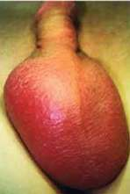
Epididymo-orchitis
This is primarily an infection of the epididymis, but some oedema & inflammatory changes spread into the testis
There maybe an associated urinary tract infection.
Types:
Acute
Under 40 years old →chalmydia trachomatis & gonorrhea
In old pt →enterococci, E.coli
Chronic
Follow recurrent acute attacks
TB

Slide 18
Hisory:
Sever pain (comes quickly-hrs- ,can be relieved by scrotal support) & swelling in one side of the scrotum
Malaise, fever, sweating &loss of appetite
Symptoms of urinary tract infection
O/E:
Swelling confined to one side of the scrotum
Scrotal skin red &shiny, four days later become bronze in color
Scrotal skin hot
Not-tender but the testis& epididymis are very tender
Surface of epididymis smooth
Swelling is fluctuant (secondary hydrocele)

Slide 19
Investigation:
CBC ,Leukocytosis
MSU
U/S & doplar
Treatment:
Bed rest
Analgesia
Scrotal support
Broad spectrum Ab (ciprofloxacin)
**The swelling may take as long as 2 months to resolve

Slide 20
Case 1: Patient T.R. What is the Differential Diagnosis?
HPI:
21 yo man presents with 3 hours of intense, constant testicular pain
Began several hours after college track meet
Associated nausea and vomiting
PMH: None
Meds: Glucosamine, condroitin, creatine supplements
Alls: PCN
FH: Non-contributory
SH: Sexually active, multiple partners

Slide 21
Differential Diagnosis
Testicular Torsion
Appendiceal Torsion
Epididymitis
Trauma
Inguinal Hernia
Henoch-Schonlein Purpura
Mumps
Fournier’s Gangrene
Referred Pain

Slide 22
Case 1: Patient T.R.
Exam:

Slide 23
Case 1: Patient T.R. What is the Next Step?
Exam:
Right testicle higher than left
Long axis oriented horizontally
Significant swelling
No cremasteric reflex on either side
No relief of pain on elevation

Slide 24
Case 1: Patient T.R. Next Step
If Diagnosis Certain (Torsion):
To the OR.
Outcomes directly related to length of time from onset
Irreversible ischemia at mean of 12 hours
If Diagnosis Less Obvious
Doppler Ultrasound
Test 82% sensitive, 99% specific for torsion (loss of flow)

Slide 25
Case 1: Patient T.R.
Operation:
testicular detorsion and fixation
Unilateral or bilateral? Why?

Slide 26
Case 1: Patient T.R.
Operation
testicular detorsion and fixation
Unilateral or bilateral? Why?
ANSWER: Bilateral-- Torsion associated with absence/insufficeincy of gubernaculum. Often bilateral.
What if surgery not an option?

Slide 27
Testicular torsion
This is twisting of the testis with interference to the arterial blood supply.
the actual torsion is usually of the spermatic cord
Possible mechanism; it is associated with:
Imperfectly descended testis
High investment of tunica vaginalis with a horizontal lie of testis
Epididymis& testis are separated by a mesorchium, & twisting occurs at the mesorchium.
The incidence is highest between 10 & 20 years.

Slide 28
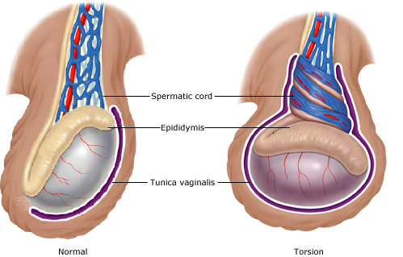
Testicular Torsion
40% over 21
Associated with physical activity/sleep
Exam
Absent cremasteric
Doppler
Surgical Emergency

Slide 30
Symptoms:
pain in the scrotum &groin:
Sever
Sudden onset
Radiating to the lower abdomen
Associated with vomiting
May follow strain, lifting, exercise, or masturbation
Signs:
Swollen testis
Tender
Drawn up to the groin

Slide 31
Torsion of Testis

Slide 32
Treatment:
Explore testis as soon as possible (untwisting should be carried out within 6 hrs of symptoms).
Check that it is not irreversibly infarcted.
Fix it to the scrotal septum.
The other testis should be fixed at the same operation, since it is likely to have abnormal position.
However
If the testis is infarcted, it should be removed

Slide 33
Testicular torsion

Slide 34
Management – Orchiopexy

Slide 35
Management – Orchidectomy

Slide 36
Scrotal Swellings

Slide 37
Scrotal
swllings
Cystic
Hydrocele
Epididymal
cyst/
spermatocele
Hematocele
Solid
Tumor
(benign/
Malignant)
Neither
varicocele
Hernia

Slide 38
Hydrocele
A collection of serous fluid in the tunica vaginalis
Types:
Congenital: occurs in infants due to patent processus vaginalis ➔ peritoneal fluid can enter the scrotum
Primary. (idiopathic)
Develop slowly
Large
Hard & tense
No defined cause
Over 40s
Secondary
develop rapidly
small
lax
secondary to inflammation, trauma or tumor of underling testes
younger age group(20-40)

Slide 39
Congenital hydrocele: processus vaginalis is patent & connects to the peritoneal cavity. In children <3yrs
Infentile hydrocele: the tunica and processus vaginalis are distended to the superficial inguinal ring. There is no conection. Occurs in all ages
Hydrocele of the cord: swelling near the spermatic cord. D/D hernia, lipoma of the cord

Slide 40
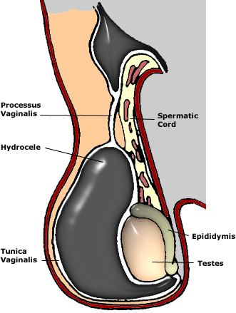
Symptoms:
Scrotal swelling
Pain & discomfort if its secondary
Frequent &painful micturation if secondary to epididymo-orchitis
Malaise & weight loss if secondary to tumor with distant metastases
Don’t affect fertility

Slide 41
O/E:
often bilateral
Can “get above it”
Testes cannot be felt separately
Transilluminates
Fluctuant
Fluid thrill
Dull to percussion
Not campressible or pulsatial
Can’t be reduced
Normal skin color & temp
Not tender if primary (may be tender if secondary)
Size can be reach up to 10-20cm in diameter
Surface smooth

Slide 42
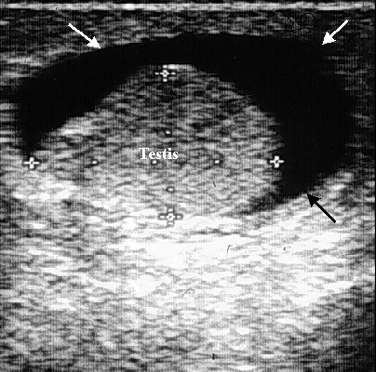
U/S of hydrocele
Done to exclude testicular tumor or epididymitits

Slide 43
Treatment
If congenital hydrocele persists beyond the age of 1year, surgical treatment is indicated. This involves the division and ligation of the processus.
In an adult with primary hydrocele
Surgery
Opening the tunica vaginalis longitudinally
Emptying hydrocele
Everting the sac
Suturing it behind the cord thus obliterating the potential space
Aspiration ➔ reccurance
In elderly patient who are not fit for surgery
Secondary hydrocele ➔ treat the underlying cause

Slide 44
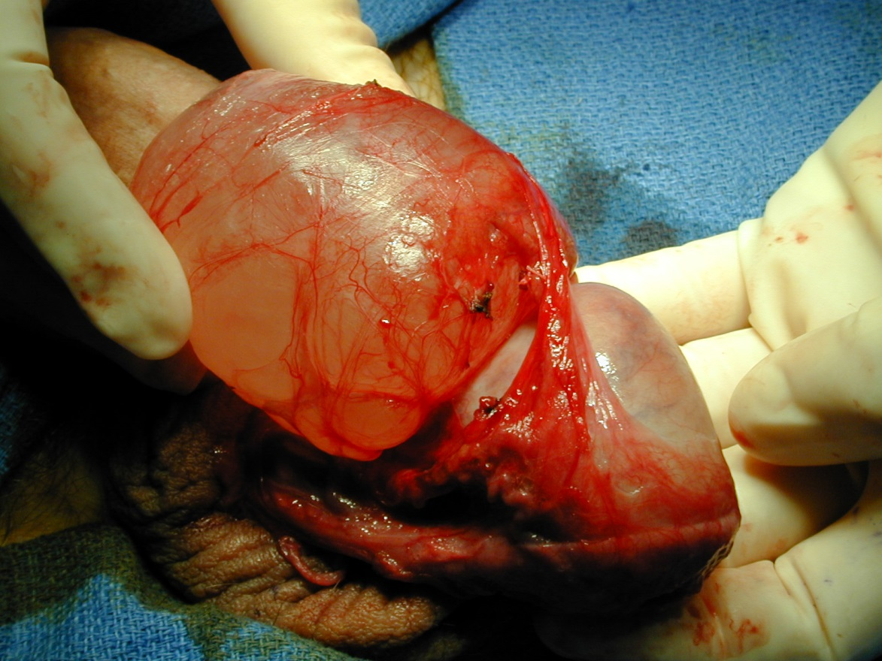
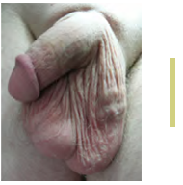
Lesions of tunica vaginalis, cont.
spermatocele
Hematocele: post-trauma or torsion
Spermatocele: cystic accumulation of semen in dilated efferent ducts of testis
Varicocele: dilated veins of pampiniform plexus within spermatic cord; may cause infertility
testis
rope-like mass of dilated veins

Slide 45
Epididymal cyst
Fluid-filled swellings connected with the epididymis.
If cyst contains clear fluid ,it is called epididymal cyst .
However, if the fluid is grey opaque &contains few spermatozoa, it is called spermatocele (after aspiration)
Symptoms:
Over age of 40 years
Scrotal swelling (as if having a 3rd testis)
Painless
Often multiple, bilateral
Enlarge slowly
Doesn’t affect fertility (maybe after surgical removal)

Slide 46
O/E:
Frequently bilateral
Lies above & slightly behind the testes, the cord is felt above it
Cysts are not tender
Elongated, measures from few millimeters to 5-10cm diameter
Smooth surface
Testis can be felt separately
Can “get above it
Fluctuant, fluid thrill, dull to percussion
Can’t be reduced
Transilluminates if contains clear fluid i.e Epididymal cyst (spermatocele; sometime depend on density of the fluid)

Slide 47
U/S
Must be done to confirm your diagnosis & R/O testicular tumore
spermatocele

Slide 48
Treatment:
None if asymptomatic
But if large & interfere with walking:
Aspiration may help
Excision for large cysts; this may affect fertility of the testis

Slide 49
Testicular tumors
Commonest malignancy in men < 35
Rare in men of African ancestry and before puberty
Peaks in the early twenties
90% arise from germ cells &are either seminomas(30-40 years) or teratomas(20-30 years)
10% are lymphomas, sertoli cell tumors or leydig cell tumors
One in 10 testicular tumors occurs in association with maldescent of the testis.
Prognosis is good particularly if there was no lymph node involvement

Slide 51
Symptoms:
Painless swelling of the testis, (sometime dull aching, dragging pain )(80%)
Heaviness in the scrotum
Maybe history of trauma ➔delays diagnosis
General malaise, wasting ,loss of appetite
Abdominal pain if lymph nodes are enlarged
Swelling of legs caused by lymphatic or venous obstruction
Infertility
Secondary hydrocele

Slide 52
Signs:
can “get above it”
Testes can not be felt separately
Not translucent
Not fluctuant
Harder than normal testis
Dull to percussion ➔ hydrocele
If skin is affected, it maybe warm & discolored
Usually not tender
Irregular, different sizes
Surface usually smooth (sometime irregular or nodular)
Examine the para-aortic & supraclavicular lymph nodes for metastasis
The liver maybe enlarged & there maybe sign of pulmonary secondaries (collapse, consolidation or a pleural effusion).

Slide 53
Investigation:
US testis
CXR ➔ mets
Tumor markers :AFP (yolk-sac cell), βHCG (trophoblastic cells).
CT scan ➔abdomen and chest to identify lymph nodes and pulmonary mets

Slide 54
Treatment:
Explore testis through an inguinal incision
Orchidectomy
Further treatments depends on the type and stage
Staging | Treatment of seminoma | Treatment of non-seminomatous germ cell tumor
stageI confined to the testis | DXT to abdominal nod | Observation or RPLND
stageII retroperitolneal LN involvement IIa: nodes <2cm IIb: nodes 2-5cm IIc: nodes >5cm | DXT to abdominal nodes “ Chemotherapy | Chemo &RPLD of residual dx “ “
stageIII nodal dx above the diaphragm | DXT to abdominal wall & thoracic nodes or chemo | Chemo
stageIV visceral mets | Chemo | Chemo
DXT=deep x-ray therapy, RPLND=retroperitoneal lymph node dissection

Slide 55
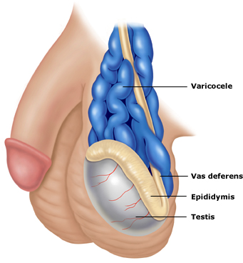
Varicocele
It is a bunch of dilated& tortuous veins of the pampiniform plexus i.e. (varicose vines in the spermatic cord).
More common on the left side
25% of normal men have small symptomless varicoceles.
Causes of varicocele
Incompetent valve btw the renal and testicular veins
Nephrectomy
Lt. Renal neoplasm
Lymphadenopathy

Slide 56
Symptoms:
Varicose veins in the scrotum on standing. Disappear on lying down
Heavy or dragging sensation in scrotum
Aching pain
Bilateral varicoceles may case subfertility
O/E:
The pt must be examined standing, not to miss the diagnosis
Vein often visible
They are also palpable & fell like a “bag of worms”
Affected testis may be smaller & more soft

Slide 57
U/s PIC

Slide 58
Treatment:
In Asymptomatic pt ,no treatment is required
Scrotal support for aching &discomfort
If symptoms fail to settle or there is evidence of subfertility; there are two options for treatment:
Embolization &obliteration under radiological control (majority)
Surgery is via an inguinal approach, all testicular veins bar on being ligated at the deep inguinal ring.
Microsurgery is used in most cases. Has less recurrence rate and better success.
Embolization is preferred in case of recurrence

Slide 59
Indirect inguinal hernia
A peritoneal sac protrudes through the deep inguinal ring, passes down the inguinal canal, &may extend as far as the upper pole of the testis.
The defect is congenital & is due to persistent processus vaginalis
Symptoms:
Often none (scrotal swelling that can be pushed back by the pt.
Aching dragging sensation in the groin
Some pt relate the development to an episode of straining or lifting

Slide 60
Signs:
Can’t “get above it”
There is a cough impulse
Reducible
Treatment:
Herniotomy& Herniorrhaphy (excision of the sac &repair of the defect) in adult By:
Lichtenstein repair (tension free mesh repair)
Shouldice repair

Slide 61
History
Age➔tumors (20-40). Rare before puberty
Torsion usually in teens and children
Hydrocele in an infant→communicating
H/o trauma
Pain➔epididymo-orchitis, varicocele, torsion
Infertility
Constitutional symp➔malignancy
PSH➔varicocele
SOH➔ marital status & extramarital relation➔ epididymo-orchitis

Slide 62
investigations
CBC➔ WBC
MSU for culture and sensitivity
Tumor markers if indicated
U/S ± doplar
CT if indicated➔ tumor

Slide 63
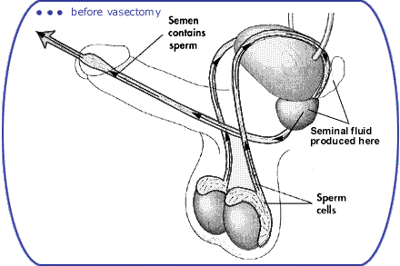
Vasectomy – Male Sterilization

Slide 64
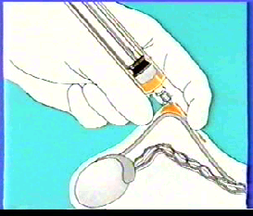
LOCAL ANAESTHESIA

Slide 65
3 Finger technique for vas fixation

Slide 66
Holding with ringed clamp

Slide 67
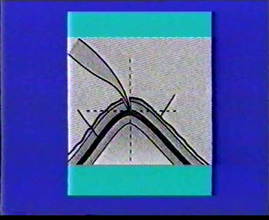
Piercing the skin with dissecting forceps

Slide 68
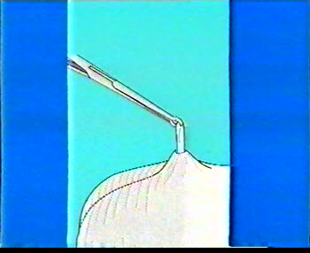
Delivery of vas

Slide 69
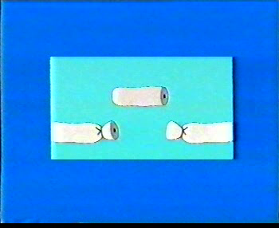
Vas occlusion Ligature Cautery Haemoclips

Slide 70
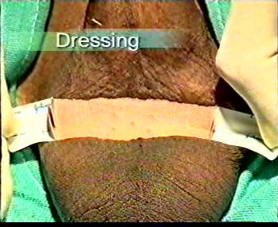
Dressing

Slide 71
