Slide 1
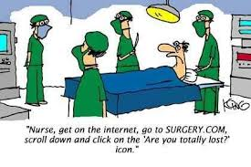
Common procedures in Eye, ENT and Plastic Surgery
Dr. S. Nishan Silva
(MBBS)

Slide 2
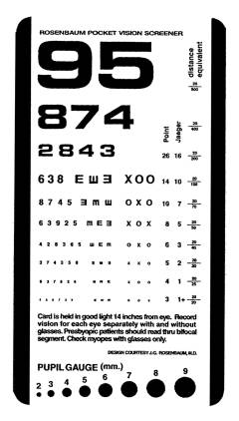
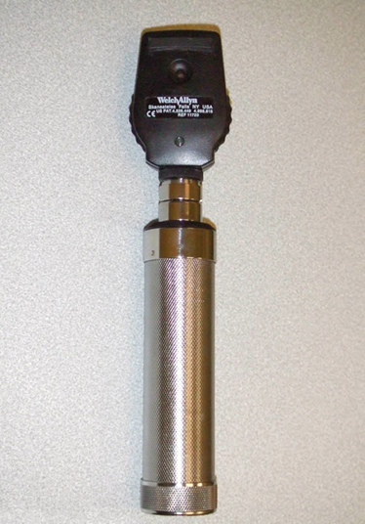
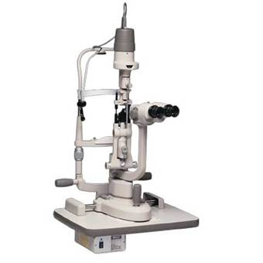
The basic eye exam
*
*
Snellen’s Chart ; Ophthalmoscope ; Slit lamp

Slide 3
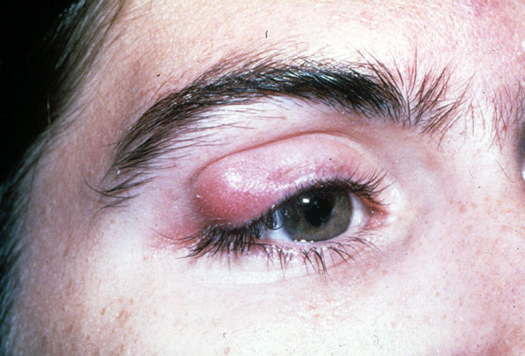
Case 1

Slide 4
Chalazion
Treatment
warm compresses
lid hygiene
surgical incision and curettage
steroid injection
pathological examination for suspicious lesion

Slide 5
Chalazion

Slide 6
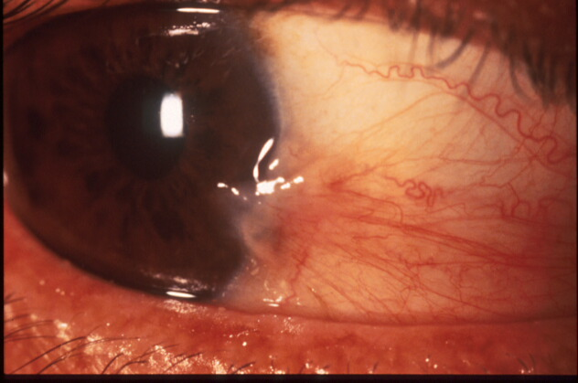
Pterygium

Slide 7
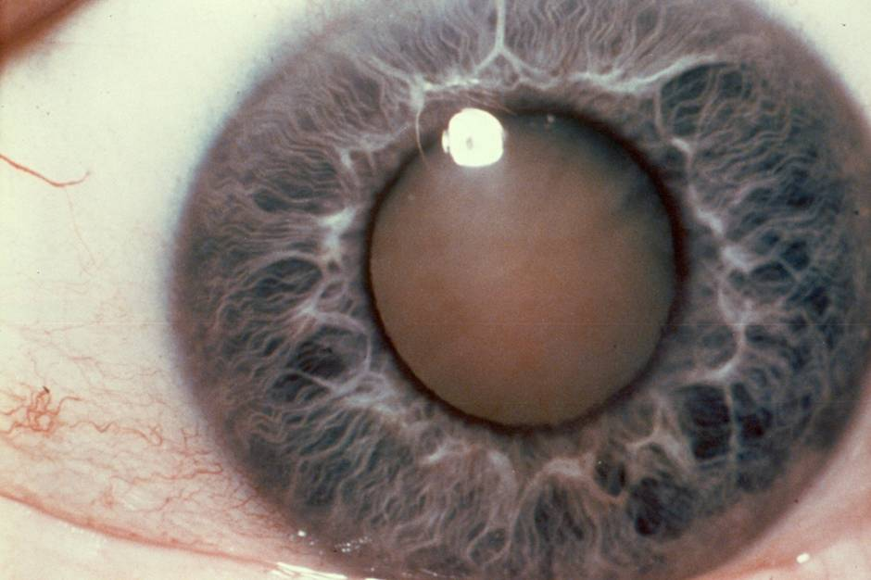
Cataract

Slide 8
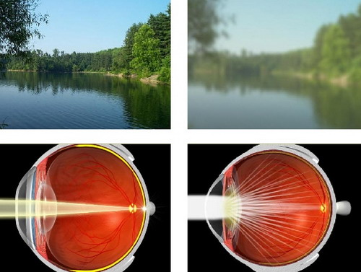

Slide 9
Cataract surgery is typically an outpatient procedure that takes less than an hour
Most people are awake and need only local anesthesia
On rare occasions some people may need general anesthesia if they have difficulty laying flat or have claustrophobia

Slide 10
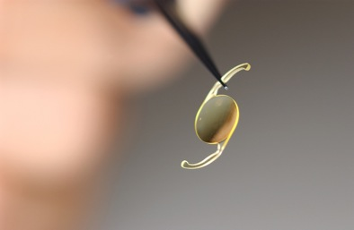

Slide 11
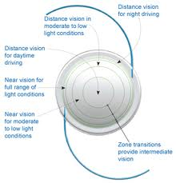

Slide 12
Two things happen during cataract surgery — the clouded lens is removed, and a clear artificial lens is implanted

Slide 13
Phacoemulsification
During phacoemulsification, phaco for short, the surgeon makes a small incision, where the cornea meets the conjunctiva

Slide 14
The surgeon then uses the probe, which vibrates with ultrasound waves, to break up (emulsify) the cataract and suction out the fragments

Slide 15
Once the cataract is removed, a clear artificial lens is implanted to replace the original clouded lens
This lens implant is made of plastic, acrylic or silicone and becomes a permanent part of the eye

Slide 16
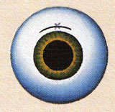
Some IOLs are rigid plastic and implanted through an incision that requires several stitches (sutures) to close
However, many IOLs are flexible, allowing a smaller incision that requires no stitches

Slide 17
Phaco+IOL surgery Foldable IOL insertion

Slide 18
Typical injectable IOL
Superflex lens: 6.25mm x 12.50mm
C-Flex lens 5.75mm x 12.00 mm

Slide 19
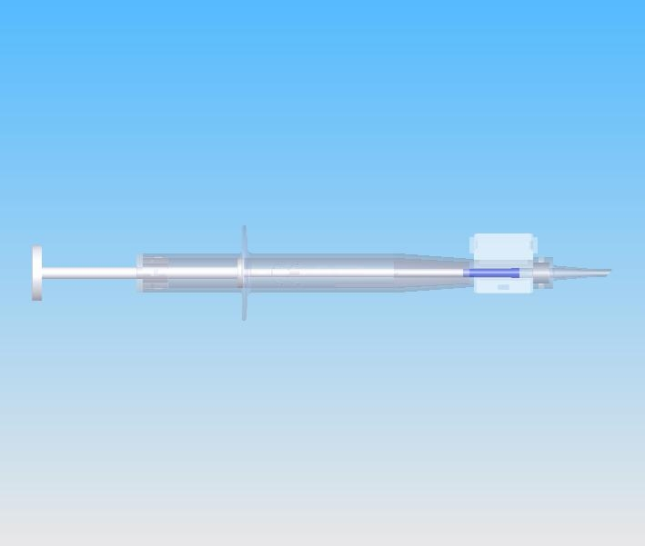
Cflex/Superflex injector

Slide 20
Loading the Superflex IOL

Slide 21
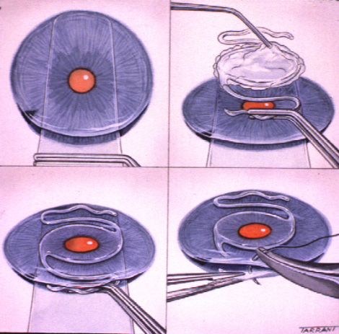
Insertion of AC-IOL
If adequate capsular support absent
1. Constriction of pupil
2. Peripheral
iridectomy
4. Coating of IOL
with viscoelastic
substance
3. Glide insertion
5. Insertion of IOL
6. Suturing of
incision

Slide 22
Patients usually go home the same day
Patients are seen in the office the next day, the following week, and then again after a month so that he or she can check the healing progress
It's normal to feel mild discomfort for a couple of days after surgery
You may wear an eye patch or protective shield the day of surgery
Your doctor may prescribe medications to prevent infection and control eye pressure

Slide 23
Post-op Course
Patients are usually examined 1 day, 1 week and then one month after the surgery date

Slide 24
Complications of Surgery
Vitreous Loss- 3.1%
Vitreous Hemorrhage-0.3%
Uveitis-1.8%
Increased Eye Pressure- 1.2%
Retinal Detachment- 0.7%
Endophthalmitis- 0.13%

Slide 25
Post Operative Period
Contact your doctor immediately if you experience any of the following signs or symptoms after cataract surgery:
Vision loss
Pain that persists despite the use of over-the-counter pain medications
A definite increase in eye redness
Light flashes or multiple spots (floaters) in front of the eye
Nausea, vomiting or excessive coughing

Slide 26
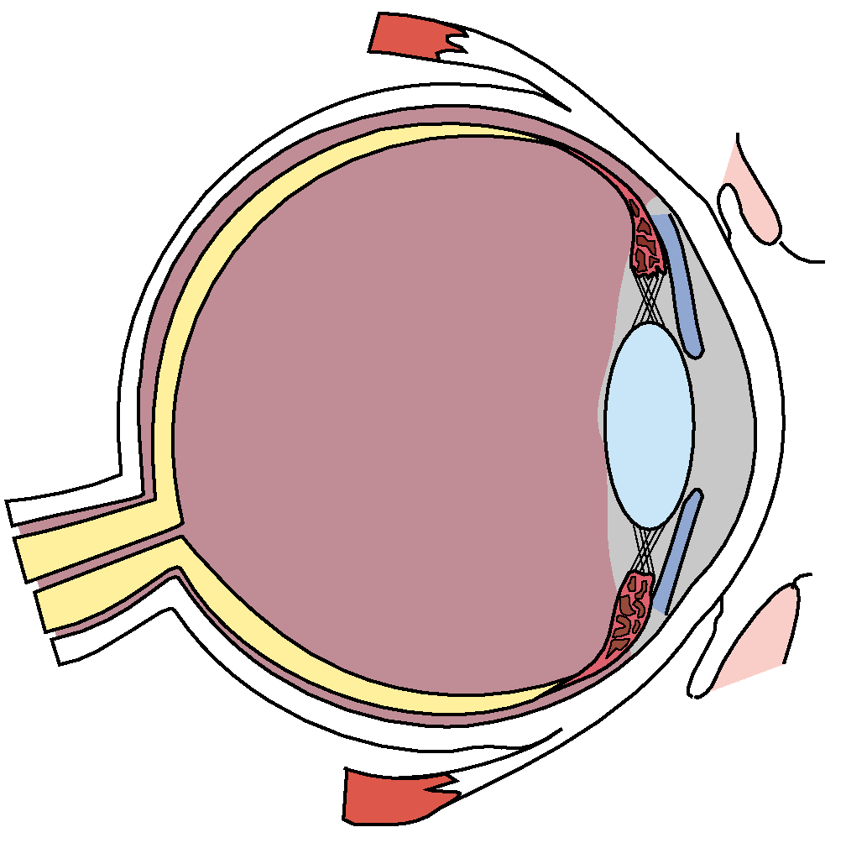
Diabetic Retinopathy
Diabetic retinopathy is the most common cause of new cases of blindness among adults 20-74 years of age.
Each year, between 12,000 to 24,000 people lose their sight because of diabetes.
During the first two decades of disease, nearly all patients with type 1 diabetes and over 60% of patients with type 2 diabetes have retinopathy
Notes:
Diabetic retinopathy develops, to some degree, in nearly all patients with diabetes, and is the most common cause of new cases of blindness among adults. The most predominant causes of vision loss are clinically significant macular edema (CSME) and proliferative diabetic retinopathy (PDR). Vision loss can be avoided or minimized with proper ophthalmic care and examination to identify retinopathy in its early stages.

Slide 27
A classification of diabetic retinopathy
A useful classification according to the types of lesions detected on
fundoscopy is as follows:
Non-proliferative diabetic retinopathy (NPDR)
Mild non-proliferative diabetic retinopathy
Microaneurysms
Dot and blot haemorrhages
Hard ( intra-retinal ) exudates
Moderate-to-severe non-proliferative diabetic retinopathy
The above lesions, usually with exacerbation, plus:
Cotton-wool spots
Venous beading and loops
Intraretinal microvascular abnormalities ( IRMA )
Proliferative diabetic retinopathy
Neovascularization of the retina, optic disc or iris
Fibrous tissue adherent to vitreous face of retina
Retinal detachment
Vitreous haemorrhage
Pre retinal haemorrhage
Maculopathy
Clinically significant macular oedema (CSME )
Ischaemic Maculopathy

Slide 28
Pathogenesis of Diabetic Microangiopathy
Hyperglycaemia causes-
BM thickening
non enzymaitc glycosylation
increased free radical activity
increased flux through the polyol pathway
osmotic damage
Haemostatic abnormalities of the microcirculation-
.

Slide 29
Non-proliferative diabetic retinopathy (NPDR)

Slide 30
Cotton Wool Spots

Slide 31
Hard exudates ( Intra-retinal lipid exudates )
Accumulations of lipids leak from surrounding capillaries and microaneuryisms, they may form a circinate pattern.

Slide 32
Ischaemic Maculopathy

Slide 33
Proliferative diabetic retinopathy

Slide 34
Proliferative diabetic retinopathy

Slide 35
Proliferative diabetic retinopathy

Slide 36
Hypertension

Slide 37
Panretinal laser photocoagulation

Slide 38
Iris Neovascularisation

Slide 39
Panretinal laser photocoagulation for proliferative DR

Slide 40
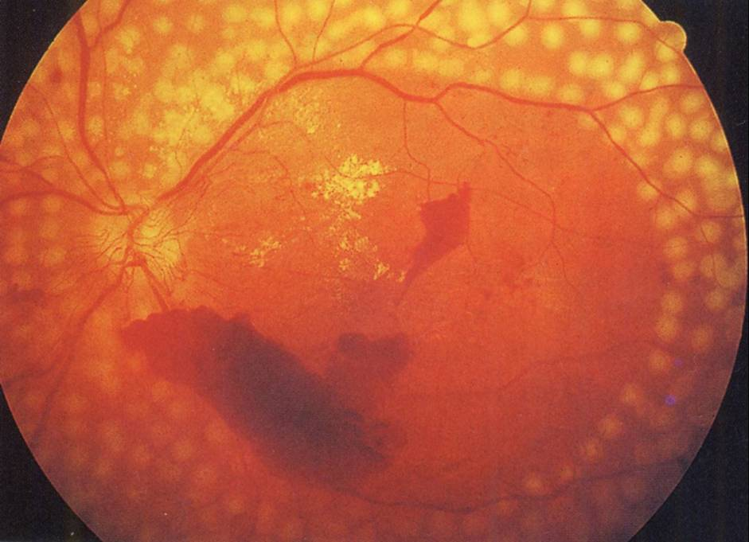
Diabetic retinopathy

Slide 41
Laser Eye Surgery

Slide 42
What is LASIK?
LASIK stands for Laser-Assisted In Situ Keratomileusis and is a procedure that permanently changes the shape of the cornea, the clear covering of the front of the eye, using an excimer laser.
LASIK is the most advance form of laser vision correction that is currently available.

Slide 43
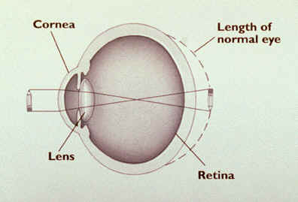
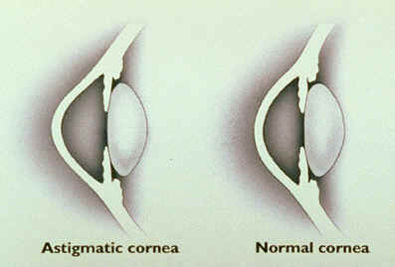
Problems Corrected By Surgery
Myopia
Hyperopia
Astigmatism

Slide 44
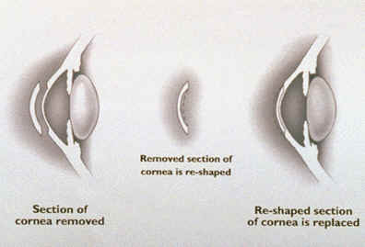
LASIK
Laser-Assisted In Situ Keratomileusis
Uses a knife, called a microkeratome, to cut a flap in the cornea and an eximer laser to reshape the exposed stroma (the middle layer of the cornea)
Keratomileusis, a predecessor
to LASIK, involved removing
a section of the cornea,
reshaping it, and then
replacing it

Slide 45
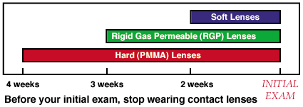
Procedure
Contact lenses change the shape of the cornea for up to several weeks after they’re worn. Glasses, therefore, must be worn for 2-4 weeks before the initial visit as well as in the time before surgery.
The contours of each eye are mapped out in a computerized topographical analysis, to provide a detailed plan for what will be removed during surgery. The thickness of the cornea will also be measured.

Slide 46
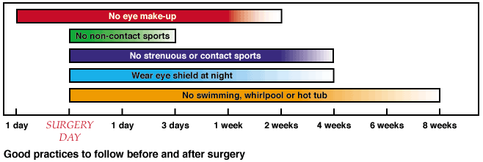
Before surgery, analgesic drops will be administered to numb the eye. The area around the eye will be cleaned, and a speculum will be inserted to keep the eye open.
A ring will be applied to create suction to the cornea. The microkeratome is then attached to the ring and a flap is cut into the cornea.
The ring and microkeratome are removed and the flap is folded back to expose the sclera. The laser is then positioned over the eye, whereupon the patient must fixate upon a red light.
Pulses of energy will destroy the pre-selected areas of tissue. Any debris are then washed from the eye, and the flap is returned to its original position.
A clear shield is placed over the eye,
and the patient is then allowed to
leave, returning for check-ups 1
day, 1 week, 2 weeks, 3 months,
6 months, and 1 year after
surgery

Slide 47
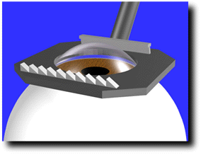
How LASIK is Performed
Step 1.
A suction ring is centered over the cornea of the eye

Slide 48
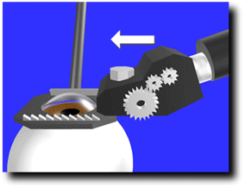
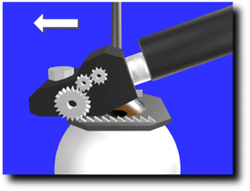
Step 2: The microkeratome creates a partial flap in the cornea of uniform thickness

Slide 49
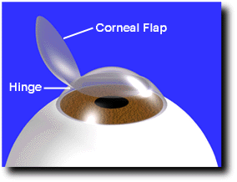
Step 3: The corneal flap is folded back on the hinge exposing the middle portion of the cornea.

Slide 50
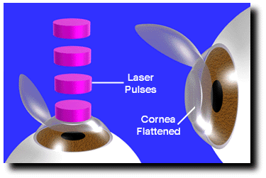
Step 4: The excimer laser is then used to remove tissue and reshape the center of the cornea.

Slide 51
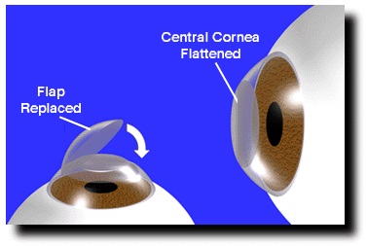
Step 5: In the final step, the hinged flap is folded back into its original position.

Slide 52
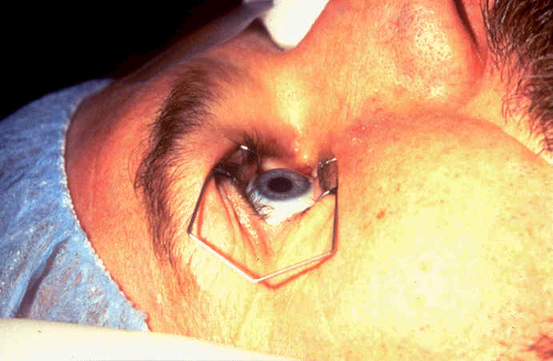
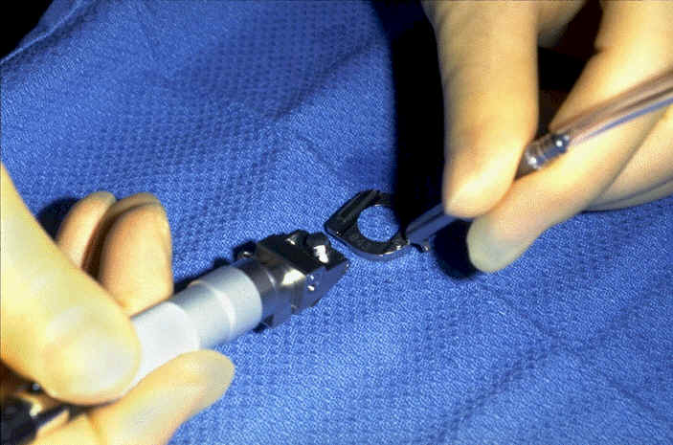

Slide 53
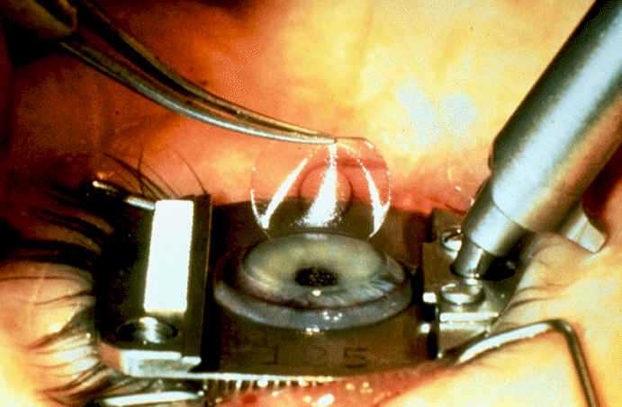

Slide 54
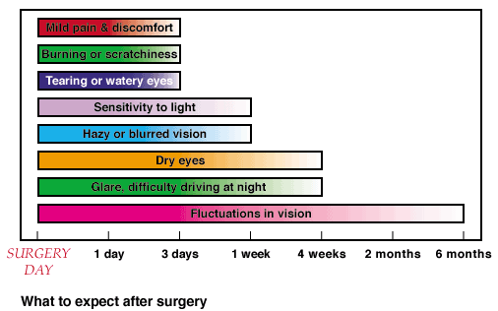
Afterwards
For the first few months after
surgery, visual acuity will
fluctuate
Vision will stabilize in 3-6
months, but during that period
of stabilization glares, halos,
and difficulty driving at night
may persist
If touch-ups are needed, they should be done in 3 months time, when the vision is fairly stabilized and a new flap need not be cut. Instead, the old one can simply be pried up. If done later, the progress of the healing will require a new flap to be cut

Slide 55
Corneal Transplantation

Slide 56
Financial Disclosure
I have no financial interest in the subject matter presented

Slide 57
Corneal Opacity
Corneal scarring from firework accident

Slide 58
Corneal Clouding
Granular stromal dystrophy
Fungal keratitis

Slide 59
Corneal Clouding

Slide 60
Corneal Donations
National Eye Bank of Sri Lank
http://www.nationaleyebank.lk/
Tel : Hotline 2915 and 0112267266
Eye donors society Sri Lanka
http://www.eyedonation.slt.lk/

Slide 61
Storage Media
Optisol GS allows for storage up to 10 days. Allows surgery to be scheduled electively
D to P (death to preservation) preferably less than 12 hours

Slide 62
Surgery: Full Thickness Surgery
Donor tissue sutured into recipient
Recipient tissue removed
Central trephine cut
made
Full thickness block
of tissue removed just
to get to the endothelium
Sutures create an
irregular surface
with astigmatism
and blurring
Smooth Surface with only
endothelial disease

Slide 63
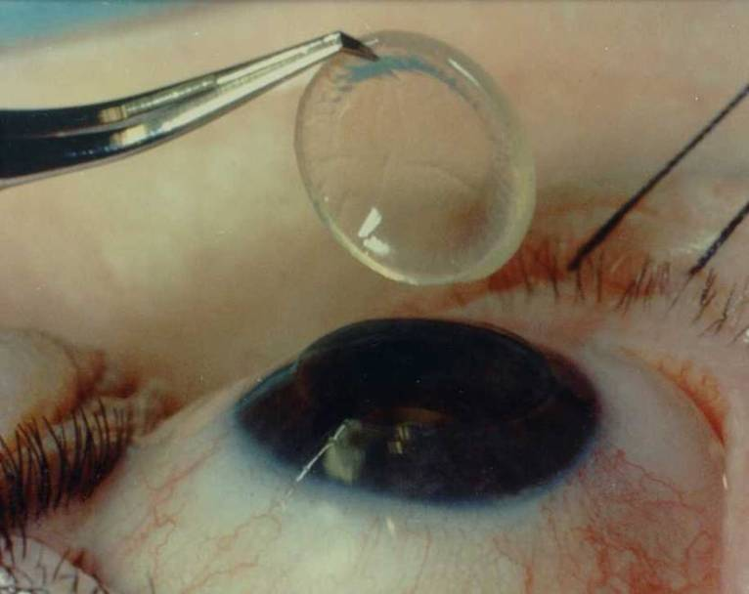
Penetrating keratoplasty
Notes:
“open sky”

Slide 64
Common Ear Conditions

Slide 65
Ear Drum-normal

Slide 66
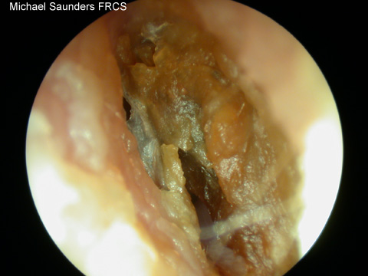
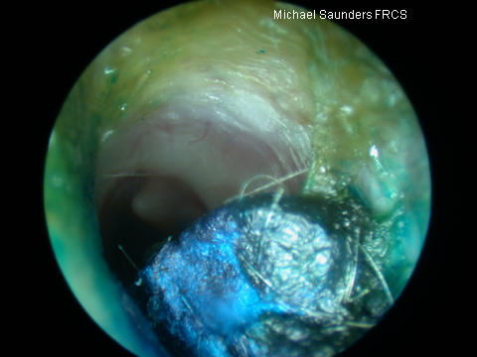
Ear Wax
Wax is produced in the outer half of the ear canal and migrates outwards along with the canal skin. Inappropriate instrumentation can cause impaction.
Wax impaction can cause hearing loss, pain, tinnitus, vertigo, or chronic cough but not usually discharge.
Sudden expansion after getting water in can cause sudden deafness or pain, but needs careful exclusion of other pathology behind it e.g. cholesteotoma
Be mindful of other possibilities
FB(crayon) in a child’s ear

Slide 67
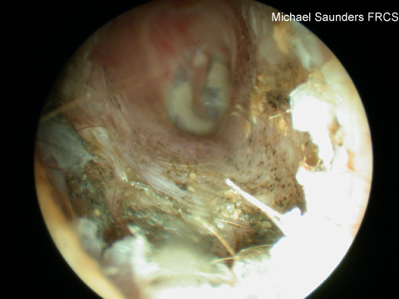
Otitis Externa
Infection of the external auditory canal. Mediterranean ear/Swimmers ear
Usually unilateral
Gradual onset pruritis, pain, hearing loss, and ear discharge which varies in consistency and colour. Discharge not mucoid in consistency as no mucin glands are present in the ext aud canal.
The pt is usually well.
Can result in a featureless ext aud canal
Risk factors: trauma, water, Immunosuppression, eczema
Can be fungal- spores might not always be visible
If treatment fails or otitis externa recurs
frequently consider sending an ear swab
for bacterial and fungal microscopy
and culture

Slide 68
Syringing / Irrigation

Slide 69
Otitis Media
Can be acute or chronic
Can be with or without serous effusion (acute or chronic)
Can be Acute or chronic suppurative
Can co-exist with Otitis externa
Otitis media with serous effusion= Glue Ear

Slide 70
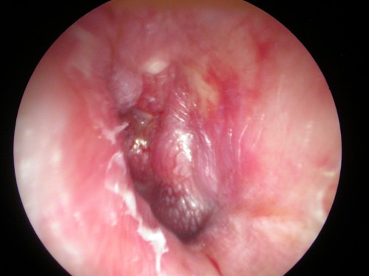
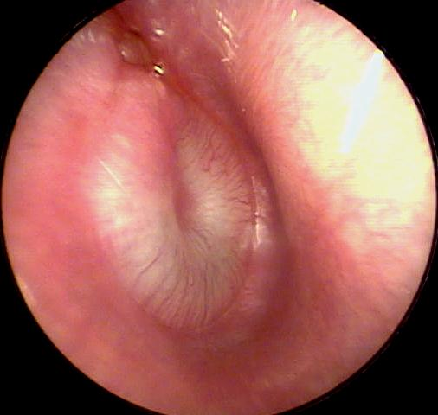
Acute Otitis Media
Common in children
Unwell/pyrexia, otalgia/discharge
there may be tenderness over the mastoid
discharge in meatus
loss of outline of drum and landmarks
TM: red, bulging,oedematous or perforation.
Mostly viral but can be Streptococcus/Haemophilus
Risk factors:
Passive smoker
Male
Family history of otitis media.
In day care
On formula feed

Slide 71
AOM (pus behind the eardrum)

Slide 72
Serous Otitis Media

Slide 73
Otitis media+effusion-Glue ear
Features
Dull retracted TM
May show air-fluid level
Conductive hearing loss(whisper test, Rinne/weber tests)
Notes
Common in children; often after AOM and can persist for weeks
Reduced hearing noticed by parents/teacher
Unsteadiness- child falling over
80% clear at 8 weeks

Slide 74
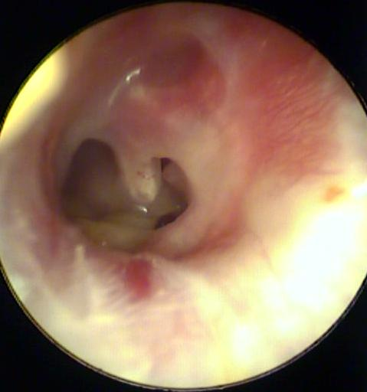
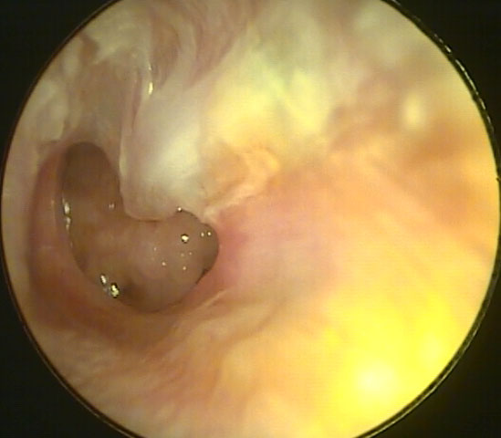
Chronic Otitis Media
Recurrent ear discharge
Hearing loss, painless
Perforation of the TM – central
Presence of cholesteatoma
Marginal, Attic perforation
Offensive discharge, bleeding, granulations
Complications:
. Vestibular symptoms
. Facial palsy
. Intracranial complications

Slide 75
Myringotomy

Slide 76
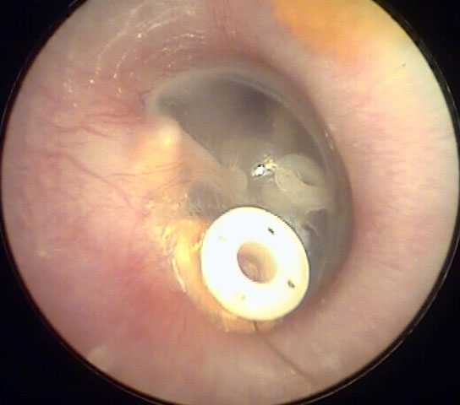

Slide 77
Cholesteotoma

Slide 78
Cholesteatoma
Cholesteatoma is "a three dimensional epidermoid structure exhibiting independent growth, replacing middle ear mucosa, resorbing underlying bone, and tending to recur after removal." There is usually a persistent or recurrent scanty cream coloured offensive discharge and progressive hearing loss due to ossicular destruction or toxin induced sensory hearing loss.

Slide 79
Epistaxis Management
Pain meds, lower BP, calm patient
Prepare ! (gown, mask, suction, speculum, meds and packing ready)
Evacuate clots
Topical vasoconstrictor and anesthetic
Identify source

Slide 80
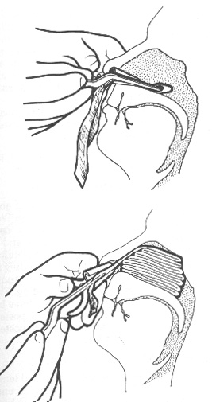
Epistaxis Management
Anterior Sites
- Pressure +/- cautery and/or tamponade
- all packs require antibiotic prophylaxis

Slide 81
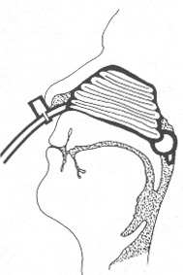
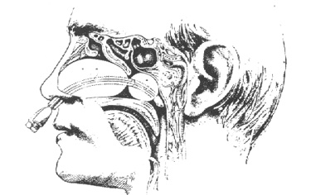
Epistaxis Posterior Packing
Need analgesia and sedation
require admission and 02 saturation monitoring

Slide 82
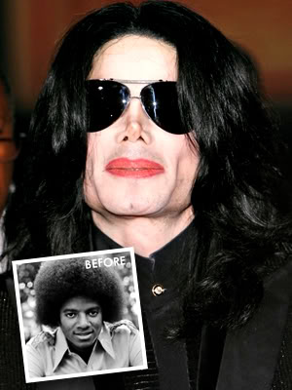
Plastic Surgery

Slide 83
Introduction
Plastic surgery is defined as any procedure used to correct or restore either form or function to a body part.
It deals with body modification and reconstructive surgery as well as surgery for aesthetically pleasing purposes.

Slide 84
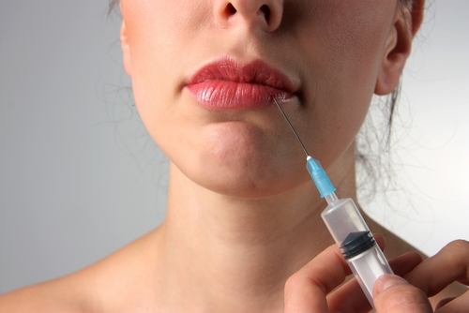
Techniques and Procedures

Slide 85
1) Skin Grafting
A skin graft is the replacement of a patient’s skin.
Required after major skin loss from a burn, major trauma or infection (i.e. flesh eating bacteria).
Usually plastic surgeons are called in to do skin grafts.
They plan their cut lines on the patients and close and remove sutures or staples in a particular sequence in order to minimize scarring.

Slide 86
Padgett Dermatome

Slide 87
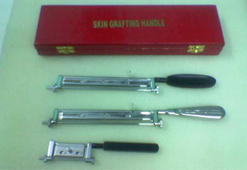

Slide 88
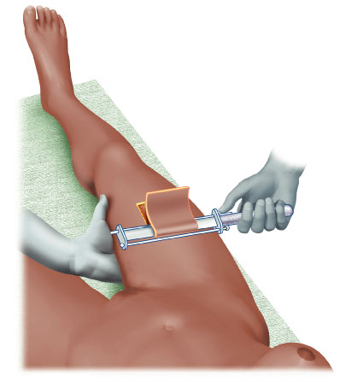

Slide 89
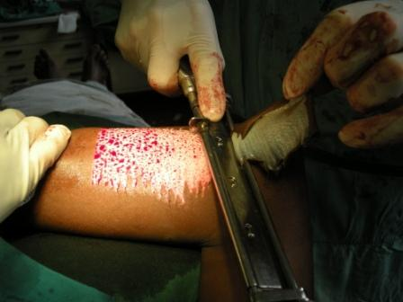

Slide 90
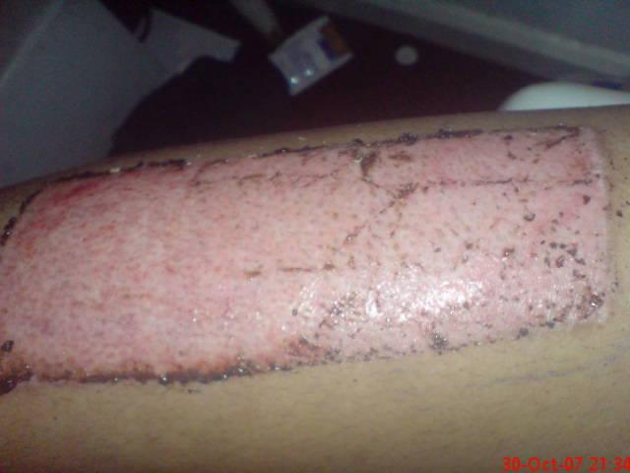

Slide 91
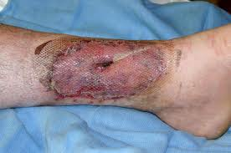

Slide 92
2)Reconstructive Surgery
It is performed to correct function, but in some cases may be used to generate a more normal appearance.
Common procedures include tumour removal, facial reconstruction, hand repair, breast reduction and breast reconstruction (after a mastectomy).

Slide 93
3) Microsurgery
The reconstruction of missing tissues usually by the transfer of tissue from another part of the body.
Called microsurgery because the doctor uses a microscope in order to see the vessels and fibres he/she needs to connect after the tissue has been transferred.

Slide 94
4) Cosmetic Surgery
Deals with enhancement of appearance for non-medical reasons.
Includes any “lifting”, augmentation or implant insertion.
Nose jobs, face lifts, Botox, collagen injections, breast augmentation and tummy tucks are the most common.
Brazilian Butt lifts are starting to challenge though. ;)

Slide 95
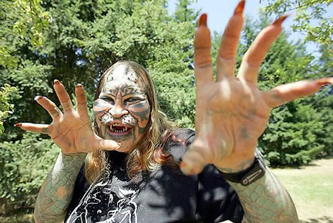
5) Body Modification
Similar to cosmetic surgery, it is the deliberate altering of the human body for non-medical reasons.
The difference is that it may not be done for a more pleasing appearance.

Slide 96
5) Body Modification
Includes:
Any piercings or tattoos.
Genital modification including circumcision.
Binding procedures like corsetry, foot-binding, etc…
Strange things like neck rings, “elfing”, bifurcation of the tongue…

