Slide 1
Evolution of Ethics In HealthCare

Slide 2
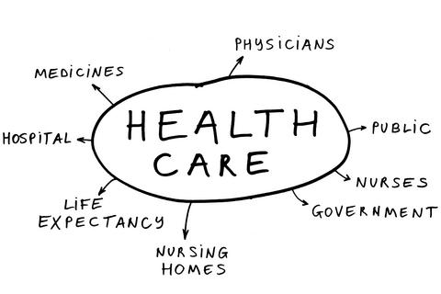
What is HealthCare ?
Care ,Service or Supply related to the mental or physical health of individuals .

Slide 3
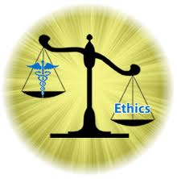
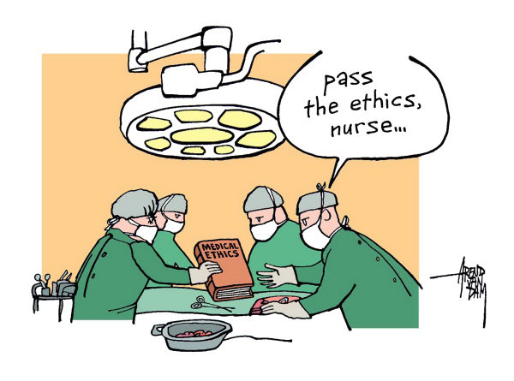
Why do we need Medical Ethics?
Medical Ethics is a man made system of moral principals that apply values and judgment to practice the profession ,
To promote the dignity of the profession.
Support the standards of practice for HealthCare
Professionals.
Respecting all laws and avoiding involvement in any false
fraud or deceptive activity.

Slide 4
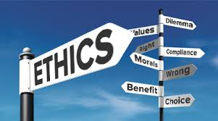
Why Ethics have Become Important
To avoid conflicts between government and medical institutions and between HealthCare professionals , physicians and patients .
The code of medical ethics outlines the proper conduct between medical professionals and their patients, . Each country has a different code of medical ethics.

Slide 5
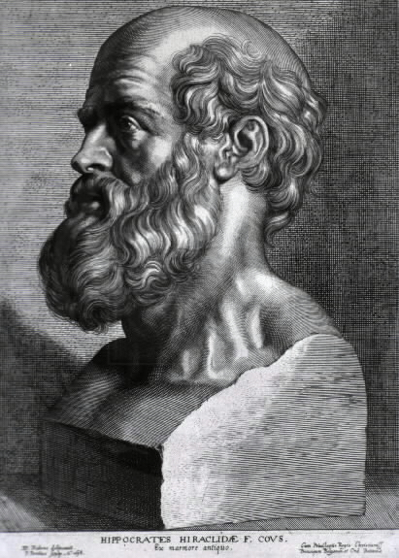
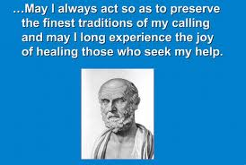
Beginning of Medical Ethics
Medical Ethics has a very different history starting with the “ Hippocratic School “ in Ancient Greece .
Hippocrates lived around 460- 380 BC . The members of the school have written an Oath call Hippocratic Oath providing rules for both doctors and patient .
"First, do no harm."

Slide 6
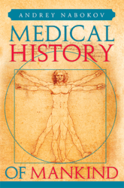
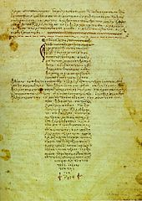
Beginning of Medical Ethics cnt’d…
In the 18th century :-Thomas Percival, a British physician, published his book "Code of Medical Ethics," in the year 1803
In the 19th century :- the American Medical Association was formed in order to establish a definite code of medical ethics
Modern Medical Ethics :- are revised and replaced when ethical issues arise and create concern .

Slide 7
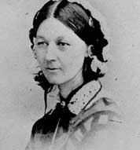
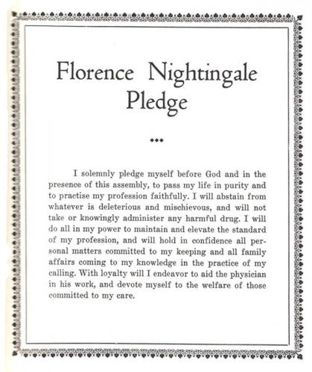
Florence Nightingale (1820 - 1910)
Nightingale established nursing as a respectable profession for women.
In 1860, she established the Nightingale Training School for nurses at St Thomas' Hospital in London.
established nursing training on the Nightingale model. Nightingale's theories, published in 'Notes on Nursing' (1860)

Slide 8
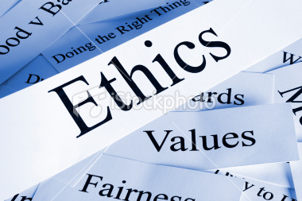
Conclusions Medical Ethics Today
Today medical Ethics are an essential part of democratic society .
Patients expect confidentiality to be absolute and medical ethics require that their information is protected as far as possible .
Human rights and medical ethics have become parallel mechanism and use of the two together , maximizes the protection available to the vulnerable patient .

Slide 9
References
© 1999-2014 Demand Media, Inc. The material appearing on eHow.com and eHow.co.uk is for educational use only. http://www.ehow.com/about_5572014_history-medical-ethics.html#ixzz2sGcYWUcm
World Medical Association, International Code of Medical Ethics (Pilanesberg, South Africa: World Medical Association, 2006). Available at http://www.wma.net/en/30publications/10policies/c8/index.html.

Slide 10
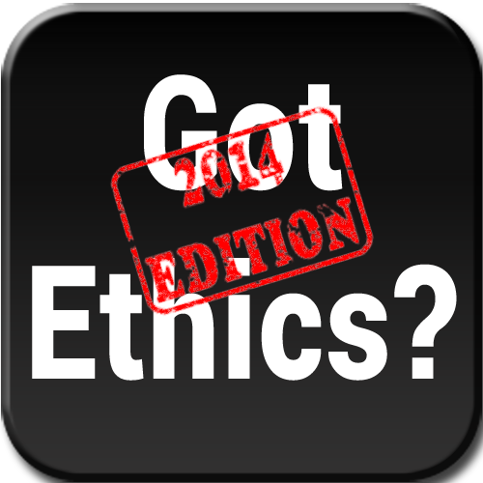
Questions ?

