Slide 1
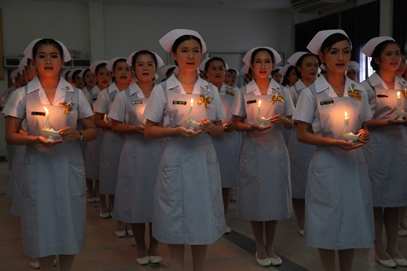
ETHICAL PRINCIPLES

Slide 2
What is the ethical principles
The ethical principle provide a foundation for nursing practice. Ethical principles are defined as basis consequences and of universal moral principles when making clinical judgment.

Slide 3
Ethical principles
Primary ethical principles
Secondary ethical principles

Slide 4
The primary ethical principles
There are three primary ethical principles that are traditionally cited when discussing ethical concerns in human subjects research.
Justice (fairness)
Respect for autonomy (the right to make one’s own decision )
Beneficence (doing good )

Slide 5
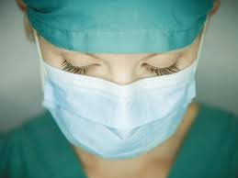
Autonomy
self-governing; having the freedom to make independent choices
self-determination

Slide 6
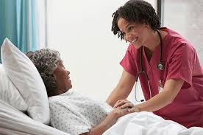
Beneficence
Views the primary goal of health care as “doing good” for clients.
Client approached in holistic manner.

Slide 7
Justice
obligation to be fair to all people
1st statement in ANA Code of Ethics for Nurses

Slide 8
The secondary ethical principles that can be incorporated with the primary principles when interpreting ethical issues and making clinical decisions are ,
Veracity (telling the truth)
Fidelity (duty to keep promises)
Confidential (duty to respect privileged information)

Slide 9
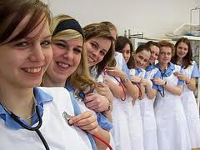
Veracity
Requires the health care provider to tell the truth & not intentionally deceive or mislead clients.

Slide 10
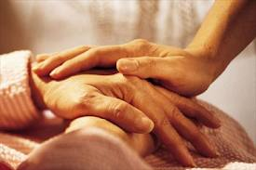
Fidelity
Duty to be faithful to one’s commitments
To keep promises
Fidelity or faithful devotion to duty.

Slide 11
Confidentiality
Keep privileged information private exceptions. Confidentiality means that nurses & doctors should only discuss the medical conditions & issues of a patient when there is a valid reason for doing so.

Slide 12
Reference
http://www.nursingworld.org/MainMenuCategories/EthicsStandards/Resources/Ethics-Definitions.pdf
https://www.google.lk/#q=what+is+the+ethical+principles+in+nursing+ppt
file:///C:/Users/HP/Desktop/Ethics%20Im/UldRrose.htm
http://nursing.citytech.cuny.edu/nu/nursingdocs/FIRST/unit4/Health%20Values.pdf
http://www.ehow.com/about_6648232_principle-veracity_.html#ixzz2sth1py9I

Slide 13
THANK YOU

