Slide 1
ELECTROTHERAPY

Slide 2
CURRENT USE
The use of electrotherapy has been researched and accepted in the field of rehabilitation (electrical muscle stimulation). The American Physical Therapy Association acknowledges the use of Electrotherapy for:
1. Pain management
Improves range of joint movement
2. Treatment of neuromuscular dysfunction
Improvement of strength
Improvement of motor control
Retards muscle atrophy
Improvement of local blood flow
3. Improves range of joint mobility
Induces repeated stretching of contracted, shortened soft tissues

Slide 3
Current use
4. Tissue repair
Enhances microcirculation and protein synthesis to heal wounds
Restores integrity of connective and dermal tissues
5. Acute and chronic edema
Accelerates absorption rate
Affects blood vessel permeability
Increases mobility of proteins, blood cells and lymphatic flow
6. Peripheral blood flow
Induces arterial, venous and lymphatic flow
7. Iontophoresis
Delivery of pharmacological agents

Slide 4
Current use
8. Urine and fecal incontinence
Affects pelvic floor musculature to reduce pelvic pain and strengthen musculature
Treatment may lead to complete continence
Electrotherapy is used for relaxation of muscle spasms, prevention and retardation of disuse atrophy, increase of local blood circulation, muscle rehabilitation and re-education electrical muscle stimulation, maintaining and increasing range of motion, management of chronic and intractable pain, post-traumatic acute pain, post surgical acute pain, immediate post-surgical stimulation of muscles to prevent venous thrombosis, wound healing and drug delivery.

Slide 5
ELECTROTHERAPY
Low frequency
Medium frequency
High frequency

Slide 6
Electric current
Flow of electric charge through a medium
The charge is carried by moving electrons in a conductor(wire),carried by ions in an electrolyte, or both in plasma.
Measured in ampere
Ohms law I= V/R

Slide 7
Low frequency current
Electric current - Alternating current
Direct current
Dc flows in unidirectional (battery cell), magnitude varies but direction is fixed.
Ac – electrons flow in one and then in opp direction, over & over again. Direction varies with time.(light bulb)
Ac with frequency less than 300 kilohertz is LFC.

Slide 8
LOW FREQUENCY
AC Sources:
Power Plant (Mains Supply)
Generators (e.g. Backup and Emergency Generators at Commercial Buildings)
DC Sources:
Dry Cells
Secondary Cells (e.g. Car Battery)
Photovoltaic Cells (Solar Cells)
DC Generators
AC to DC adapters

Slide 9
Types of current
Modified Galvanic Current In this treatment method the duration of current flow is long and continuous. Time duration - 10 - 200 milliseconds
Frequency - 50 - 100 pulses/sec.
Used in cases of severe nerve damage Surged Faradic Current Shorter duration and intermittent flow of current Time duration - .01-1 millisecond Frequency - 50 cycles per/sec. Used in cases of partial nerve damage or nerve compression

Slide 10
Indications & contra- indications
Where useful?
All Nerve injuries(like Radial nerve Injury of the arm or hand)
Muscle weakness(To activate the muscle)
Facial nerve Injury
Where should it not be used?
Individuals who have
recent cuts
Open wounds
Unhealed scars
Recent fracture
Metal plate fixation in their Body
Skin infections
Recent surgery

Slide 11
LFC
This kind of physiotherapy treatment involves use of low frequency current.
Electrical stimulation is used to activate and train a muscle, which has lost its action or in training a muscle which has lost or 'forgotten' its action after an injury / surgery.

Slide 12
Diadynamic current
These devices use variations of the sine wave to produce monophasic and biphasic continuous or pulsed currents.
Two main types which are characterized by the different types of waveforms produced by the device. Half-wave rectification (single phase or monophasé fixe (MF)) Eliminates the second half of each AC cycle to produce a monophasic pulsed current with a pulse duration equal to the interpulse interval and a frequency equal to that of the original AC Full-wave rectification (double phase or diphasé fixe (DF)) Produces a monophasic pulsed current with no interpulse internal at twice the original AC frequency

Slide 13
Half & full wave rectification

Slide 14
Medium frequency current
MFC (Medium Frequency Currents):MFC is found effective for pain modulating and has even nerve block effect, and has long lasting pain relief.
It's programmable computerized unit, where relaxation and contraction of the muscles can be controlled in 1:1 or 2:4 ratio. It gives good relief in post-operative pain.

Slide 15
MICRO CURRENT
Micro current stimulation is a therapy used, where by electric current is provided in literally millionths of an amp.
When micro current stimulations is provided ,it cannot be felt as the sensory receptors are not stimulated.
Because this is believed to be the body’s own natural current strength.
Relives pain, wound healing, regeneration of injured tissues, change scar tissue.

Slide 16
Micro current
The FDA has approved Micro Current therapy for the following conditions:
1. To increase local blood flow and circulation 2. To increase range of motion 3. To decrease muscular spasm 4. For neuro-muscular re education 5. To prevent or retard muscular tissue atrophy 6. For the treatment of calf (lower leg) venous thrombosis

Slide 17
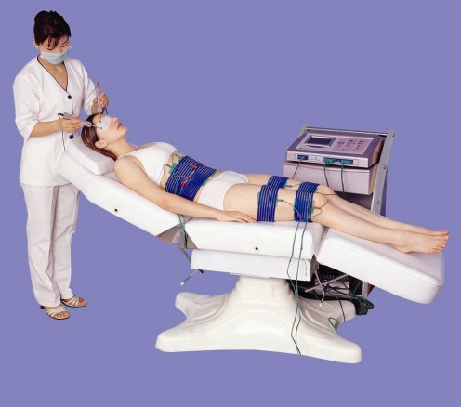
Micro current machine

Slide 18
Conditions treated with micro current
Fibromyalgia
Myofascial Pain
Auto, Work and Sports injuries
Rotator Cuff injuries and frozen shoulders
Scar tissue and Fibroid tissue
Rapid Pain Management
TMJ Dysfunction
Tendon and ligament repair
Fractures
Stimulation of acupuncture points
Trigger point therapy
Oedema / Lymphatic drainage
neuralgia
Wound Healing
Post surgical pain and healing
Carpal Tunnel Syndrome
Neuropathic pain

Slide 19
Diapulse
Diapulse, a device that directs a pulsed-electromagnetic field (PEMF) to an area of injury.
Has a biological effect on recently injured soft tissues esp in the reduction of edma,pain and disability
Accelerate healing of donor site wounds.
Increase neural regrowth of peripheral nerves.
To treat pressure ulcers in SCI patients

Slide 20
Description
Diapulse directs electromagnetic energy to a specific body area, even through clothing, casts, or bandages, via a cylindrical treatment head mounted on an adjustable bracket. The technology does not cause side effects or require patient involvement.
Because the device pulses its electromagnetic output, it emits energy for only a fraction of time, allowing any heat associated with the transferred energy to dissipate. Diapulse’s electromagnetic output is often pulsed at 600 pulses per second with each pulse lasting 65 microseconds (1 second = 1million microseconds). Hence, this pulse rate corresponds to the device being off 25 times longer than it is on.

Slide 21
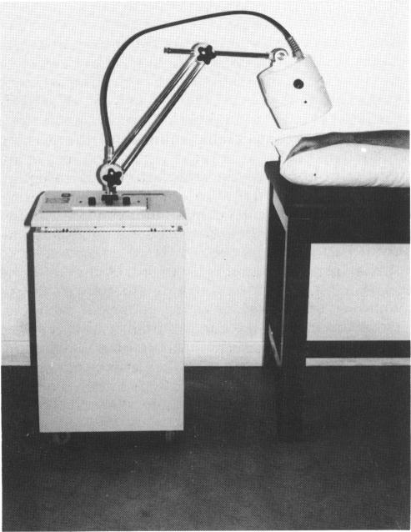
Diapulse machine

Slide 22
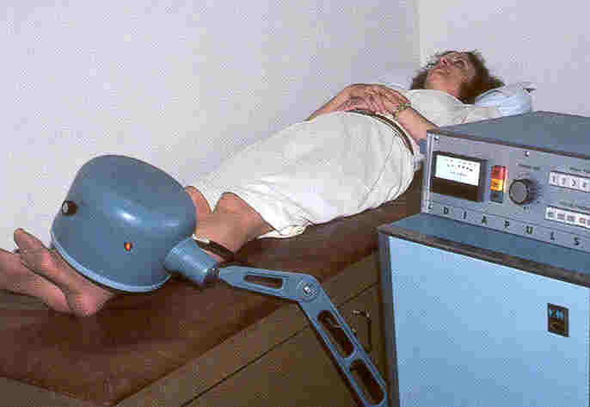
Diapulse treatment

Slide 23
HIGH VOLTAGE CURRENTS
Approximately over 35,000 volts
More than 345,000 volts is extra high voltage current
More than 275,000volts is used for experiments in physics.

