Slide 1
Development of Australian laws and health related laws

Slide 2
Development of Australian law and health related laws
Sources of law
Types of law
The torts of law

Slide 3
Development of Australian law and health related law
Law

Slide 4
Foundation of Australian laws

Slide 5
Why?

Slide 6
Sources of laws
Sources of law
Common law
Parliamentary law

Slide 7
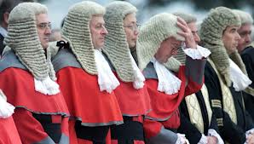
Common law

Slide 8
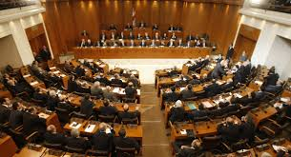
Parliamentary law

Slide 9
Health related acts
Health practitioner regulation law act 2009
Consent to medical treatment and palliative care act 1995
Health regulation act 1996(QLD)
Health care act 2008(SA)
Health act 1937(QLD)
Misuse of drugs act(TAS)

Slide 10
Types of law
Types of law
Criminal law
Civil law

Slide 11
Criminal law

Slide 12
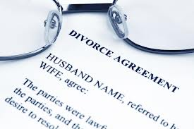
Civil law

Slide 13
The law of torts

Slide 14
Negligence
Negligence advice
Assault
Defamation
Bailment

Slide 15
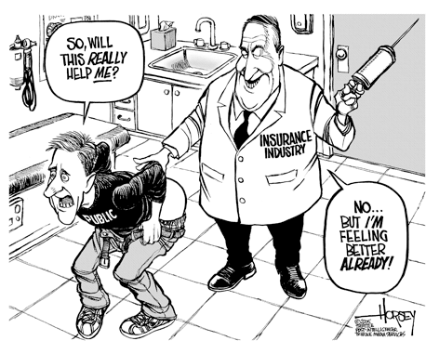
4D’s Negligence
Duty
Dereliction
Damage
Direct

Slide 16
Thank you

Slide 17
References
kerridge l, L. M. (2009). Ethics and law for the health care professions 3rd edn. press;sydney.
kerridge,Lowe,Mcphee 2009. (n.d.). Retrieved from www.elsevierhealth.com.au.
law and legislation. (n.d.). Retrieved from australia.gov.au.

Slide 18
Any questions

