Slide 1
Common Ethical Dilemmas in Nursing
Chathurika Samarasinghe
Dilki Shehani

Slide 2
Dilemma
A situation in which an individual feels compelled to make a choice between two or more actions that he or she can reasonably and morally justify...!
It’s simply; a problem that seems incapable of a solution...!

Slide 3
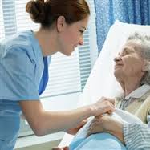
Types of Dilemmas
Dilemmas of Beneficence → what is good & bad.
Dilemmas of Autonomy → what action maximize pt’s right to choose his Rx.

Slide 4
Types of Dilemmas
Dilemmas of justice → fair distribution of limited healthcare resources.
Dilemmas of non-maleficience → avoidance of harm.

Slide 5
Types of Dilemmas
Dilemmas of confidentiality → respecting privileged information.
Dilemmas of veracity → telling the truth.

Slide 6
Dilemmas in Nursing
Occurs Daily
Challenges the personal beliefs, values & experience
Should apply Critical Thinking…!

Slide 7
Dilemmas in Nursing
Telling the Truth vs. Deception
When family asks the nurse to hide the truth regarding the pt’s condition but pt wants to know it.

Slide 8
Dilemmas in Nursing
Freedom vs. Control
When pt refuse to take food or medication but the nurse knows the danger of that.

Slide 9
Dilemmas in Nursing
Pre-choice vs. Pro-life
When pt wants an abortion but the nurse is against the abortion & she supports for Pro-life.

Slide 10
Dilemmas in Nursing
Knowledge vs. Personal Beliefs
When pt refuses blood transfusion due to his religious/personal beliefs but the nurse knows that pt would not survive without transfusion.

Slide 11
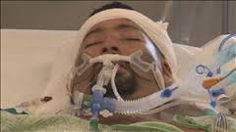
Dilemmas in Nursing
Distribution of Resources
When a pt is in life-support & his family wants to continue it, but the nurse knows that there is no point of continuing; yet there are limited resources for other pts.

Slide 12
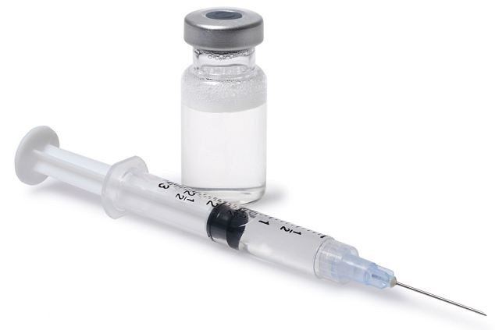
Dilemmas in Nursing
Suicide..?
When pt is in a terminal condition & he chooses to die.
Could you allow it..?
Law..?

Slide 13
What to do..?
Proper Nursing Practice including Ethics

Slide 14
What to do..?
Thompson & Thompson Theory → Review the situation, gather info, identify the issues, evaluate & action…

Slide 15
What to do..?
Be a Critical Thinker…!

Slide 16
References
http://www.businessdictionary.com/definition/ethics.html#ixzz2sGql4xkn
http://www.nursingexplorer.com/nursing-ethics-ethical-dilemma-faced-by-nurses-everyday
http://educationcareerarticles.com/career-information/career-news/5-examples-of-ethical-dilemmas-nurses-face-and-how-to-approach-them/
http://medical-dictionary.thefreedictionary.com/nursing+ethics

Slide 17
Questions…?

Slide 18
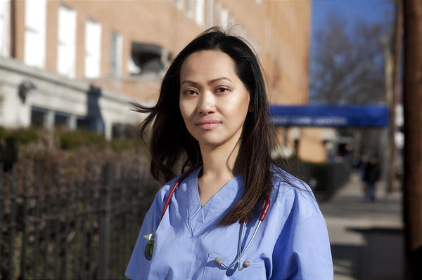
Thank You…!

