Slide 1
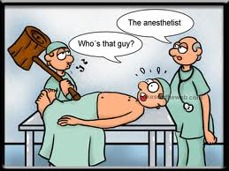
Anesthesia
Dr. S. Nishan Silva
(MBBS)

Slide 2
GENERAL – REGIONAL – LOCAL
ANAESTHESIA

Slide 3
WHAT DOES ANESTHESIA MEAN?
The word anaesthesia is derived from the Greek: meaning insensible or without feeling.
The adjective will be ANAESTHETIC .
The means employed would properly be called the anti-aesthetic agent but it is allowable to say anaesthetic or in American anesthetic

Slide 4
Definition of Anaesthesia
Insensible does not necessary imply loss of consciousness.
So General Anaesthesia can be defined as :
Totally Reversible Induced Pharmacological type of Unconsciousness so it can be differentiated from sleep, head injury, hypnosis, drug poisoning , coma or acupuncture

Slide 5
COMPONENTS OF ANAESTHESIA
The famous components of general anaesthesia are
TRIAD
1. UNCOSCOUSNESS.
2. ANALGESIA
3. MUSCLE RELAXATION.
But those triad are under modifications
Unconsciousness replaced by amnesia or loss of awareness
Analgesia replaced by no stress autonomic response
Muscle relaxation replaced by no movement in response to surgical stimuli

Slide 6
ROLE OF ANAESTHESIOLOGIST
So we can summarize the role of anaesthesiologist in:
Knowing physiology of body well.
Knowing the pathology of patient disease and co-existing disease
Study well the pharmacology of anaesthetic drugs and other drugs which may be used intra-operatively.
Use anaesthetics in the way and doses which is adequate to patient condition and not modified by patient pathology with no drug toxicity.
Lastly but most importantly administrate drug to manipulate major organ system, to maintain homeostasis and protect patient from injury by surgeon or theatre conditions.

Slide 7
APPROACH TO ANAESTHESIA
The empirical approach to anaesthetic drug administration consists of selecting an initial anaesthetic dose {or drug} and then titrating subsequent dose based on the clinical responses of patients, without reaching toxic doses.
The ability of anaesthesiologist to predict clinical response and hence to select optimal doses is the art of anaesthesia

Slide 8
TOOLS OF ANAESTHESIA
Knowing physiology, pathology ,and pharmacology is not enough to communicate safe anesthesia
But there is need for two important tools:
1. Anaesthetic machine.
2. Monitoring system.

Slide 9
ANAESTHETIC MACHINE
Oxygen gas supply.
Nitrous oxide gas supply.
Flow meter
Vaporizer specific for every agent
Mechanical ventilator
Tubes for connection.

Slide 10
MONITORING
Pulse, ECG
Blood pressure
Oxygen saturation.
End tidal CO2
Temperature
Urine output, CVP, EEG, bispectral index, muscle tone, ECHO, drug concentration.

Slide 11
HOW CAN WE ACHIEVE ANAESTHESIA?
General anaesthesia
  Inhalational: by gas or vapor
  IV ,IM or P/R
Regional anaesthesia
Local anaesthesia
Or to combine between them

Slide 12
INHALATIONAL ANAESTHESIA
- Inhalational anaesthesia is achieved through airway tract by facemask, laryngeal mask or endotracheal tube.
- The agent used is a gas like nitrous oxide or volatile vapor like chloroform, ether, or flothane.
- Inhalational anaesthesia depresses the brain from up [cortex] to down [the medulla] by increasing dose.

Slide 13
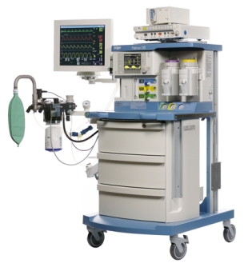
Anaesthesia Machine

Slide 14
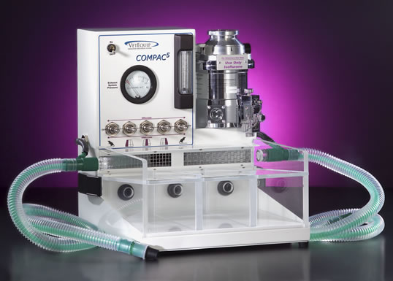
Anesthesia Components
Anesthesia Machine
  Frame
  Regulator
  Flowmeter
  Oxygen Flush Assembly
  Vaporizer
  Anesthetic Supply System
  Scavenging System

Slide 15
General Anaesthesia (GA)
unconsciousness
amnesia
analgesia.
A variety of drugs are given to the patient that have different effects with the overall aim of ensuring unconsciousness, amnesia and analgesia.

Slide 16
Overview
General anaesthesia is a complex procedure involving :
  Pre-anaesthetic assessment
  Administration of general anaesthetic drugs
  Cardio-respiratory monitoring
  Analgesia
  Airway management
  Fluid management
  Postoperative pain relief

Slide 17
Pre-anaesthetic evaluation
History
medical history, current medications.
previous anaesthetics.
Examination.
age, weight, teeth condition.
Airway assessment, neck flexibility and head extension
Investigations.
Relevant to age and medical conditions.

Slide 18
Pre-anaesthetic evaluation
The plan
best combination and drugs and dosages and the degree of how much monitoring is required .
fasting time
If airway management is deemed difficult, then alternative placement methods such as fiberoptic intubation may be used.

Slide 19
Premedication
Aim
induce drowsiness
induce relaxation
Time
from a couple of hours to a couple of minutes before the onset of surgery .
Drugs
narcotics (opioids such as fentanyl)
sedatives (most commonly benzodiazepines such as midazolam).

Slide 20
Induction
intravenous
Faster onset
avoiding the excitatory phase of anaesthesia
inhalational
where IV access is difficult
Anticipated difficult intubation.
patient preference (children)

Slide 21
Intravenous Induction Agents
Commonly used IV induction agents include Prpofol, Sodium Thiopental and Ketamine.
They modulate GABAergic neuronal transmission. (GABA is the most common inhibitory neurotransmitter in humans).
The duration of action of IV induction agents is generally 5 to 10 minutes, after which time spontaneous recovery of consciousness will occur.

Slide 22
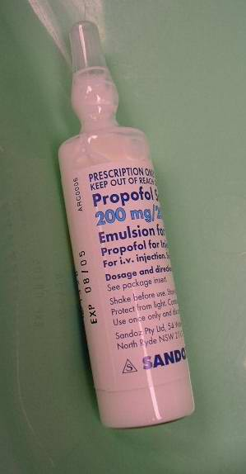
(1) Propofol
Short-acting agent used for the induction, maintenance of GA and sedation in adult patients and pediatric patients older than 3 years of age.
It is highly protein bound in vivo and is metabolised by conjugation in the liver.
Side-effects is pain on injection hypotension and transient apnea following induction

Slide 23
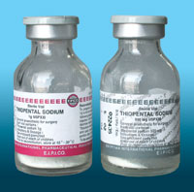
(2) Sodium thiopental
Rapid-onset ultra-short acting barbiturate, rapidly reaches the brain and causes unconsciousness within 30–45 seconds.
The short duration of action is due to its redistribution away from central circulation towards muscle and fat
The dose for induction is 3 to 7 mg/kg.
Causes hypotension, apnea and airway obstruction

Slide 24

(3) Ketamine
Ketamine is a general dissociative anaesthetic.
Ketamine is classified as an NMDA Receptor Antagonist.
The effect of Ketamine on the respiratory and circulatory systems is different . When used at anaesthetic doses, it will usually stimulate rather than depress the circulatory system.

Slide 25
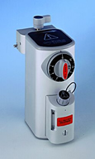
inhalational induction agents
The most commonly-used agent is sevoflurane because it causes less irritation than other inhaled gases.
Rapidly eliminated and allows rapid awakening.

Slide 26
Maintenance
In order to prolong anaesthesia for the required duration (usually the duration of surgery), patient has to breathe a carefully controlled mixture of oxygen, nitrous oxide, and a volatile anaesthetic agent. This is transferred to the patient's brain via the lungs and the bloodstream, and the patient remains unconscious.

Slide 27
Maintenance
Inhaled agents are supplemented by intravenous anaesthetics, such as opioids (usually fentanyl or morphine).
At the end of surgery the volatile anaesthetic is discontinued.
Recovery of consciousness occurs when the concentration of anaesthetic in the brain drops below a certain level (usually within 1 to 30 minutes depending upon the duration of surgery).

Slide 28
Maintenance
Total Intra-Venous Anaesthesia (TIVA): this involves using a computer controlled syringe driver (pump) to infuse Propofol throughout the duration of surgery, removing the need for a volatile anaesthetic.
Advantages: faster recovery from anaesthesia, reduced incidence of post-operative nausea and vomiting, and absence of a trigger for malignant hyperthermia.

Slide 29
Neuromuscular-blocking drugs
Block neuromuscular transmission at the neuromuscular junction.
Used as an adjunct to anesthesia to induce paralysis.
Mechanical ventilation should be available to maintain adequate respiration.

Slide 30
Types of NMB
Non-depolarizing
competitive antagonists against ACh at the site of postsynaptic ACh receptors.
Examples:
Atracurium
Vecuronium
Rocuronium
Depolarizing
depolarizing the plasma membrane of the skeletal muscle fibre similar to acetylcholine
Examples:
suxamethonium.
Osent: 30 seconds,
Duration: 5 minutes

Slide 31
Postoperative Analgesia
Minor surgical procedures
oral pain relief medications
paracetamol and NSAIDS such as ibuprofen.
Moderate surgical procedures
addition of mild opiates such as codeine
Major surgical procedures
combination of modalities
Patient Controlled Analgesia System (PCA) involving morphine

Slide 32
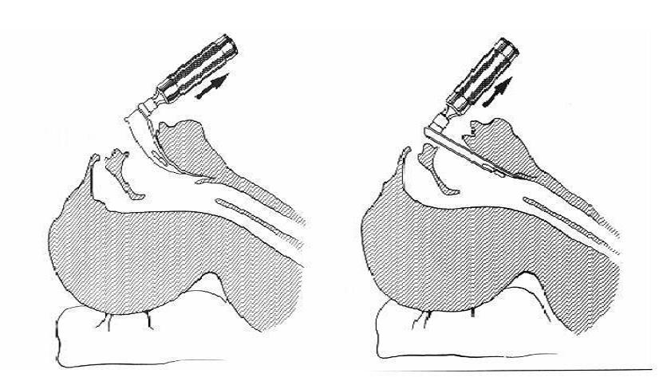
Laryngoscopy – Endotracheal Intubation

Slide 33
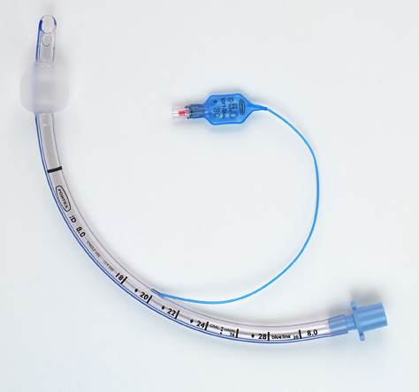
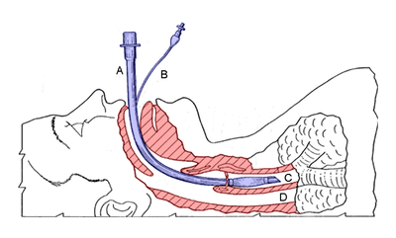

Slide 34
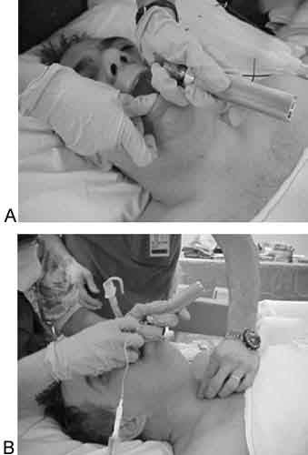
Laryngoscopy – Endotracheal Intubation

Slide 35
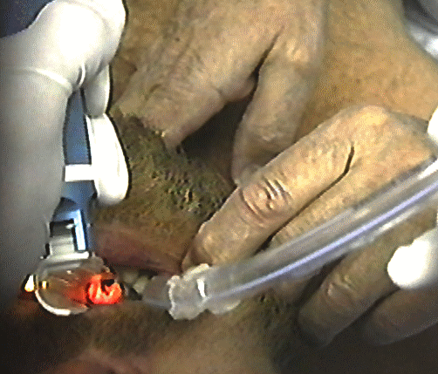
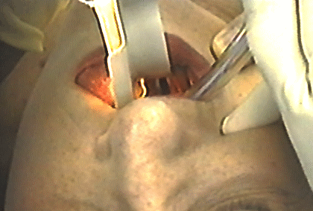
Laryngoscopy – Endotracheal Intubation

Slide 36
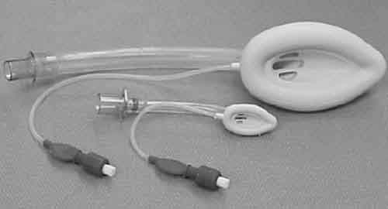
Laryngeal Mask Airway

Slide 37
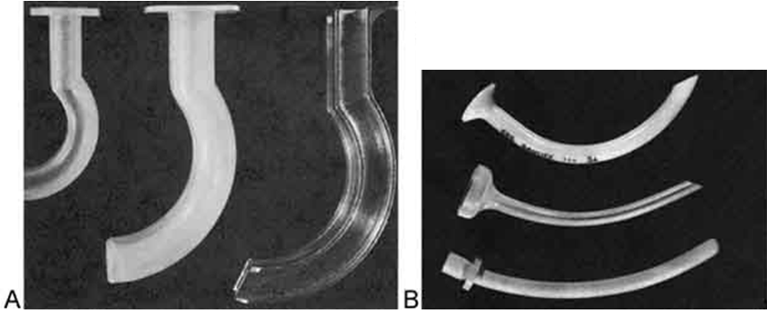
Oropharyngeal and Nasopharyngeal Airways

Slide 38
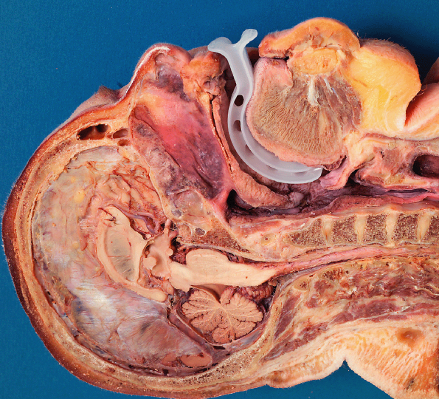

Slide 39
INTRVENOUS ANAESTHESIA
-Very rapid: 10 seconds, for 10 minutes
-Irreversible dose
-It is used in short operation or in induction of anaesthesia and anaesthesia maintained by inhalational route
-New agent now can be used in maintenance by infusion

Slide 40
LOCAL ANAESTHETIC
As anaesthesia means no sense, so there are drugs which can block the nerve conduction peripherally with no need of brain depression .
So patient will be conscious

Slide 41
The attack of nerve may be at the level of:
Spinal cord: By injection of local drug in sub -arachnoid space in CSF, this must be bellow L 2
Epidural: The drug is injected outside dura [no puncture] to block the nerve roots at its exit from spinal cord.
Nerve plexus: Cervical, brachial, lumbosacral
Peripheral nerve: Radial, ulnar, median, sciatic, femoral, popletial, facial, mandibular.
Injection into tissues, skin, subcutaneous.

Slide 42
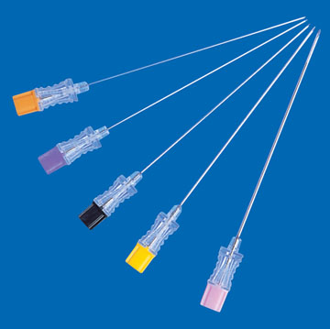
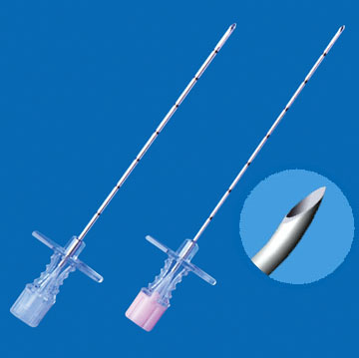
Spinal Needles
Epidural Needles

Slide 43
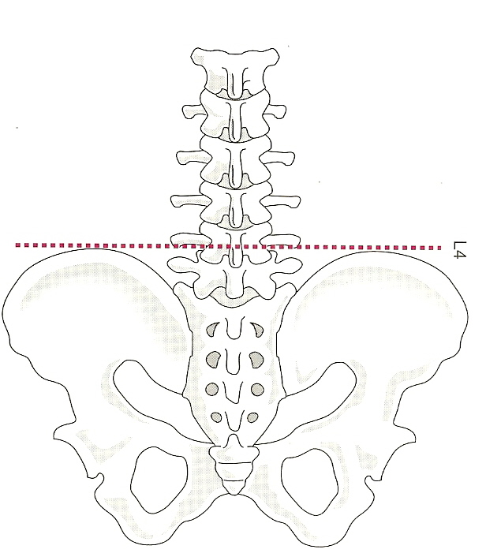

Slide 44
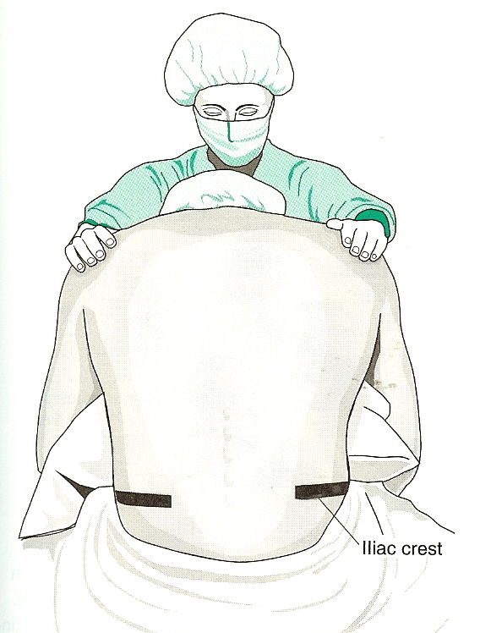

Slide 45
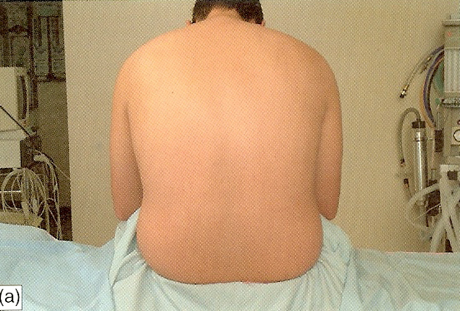

Slide 46
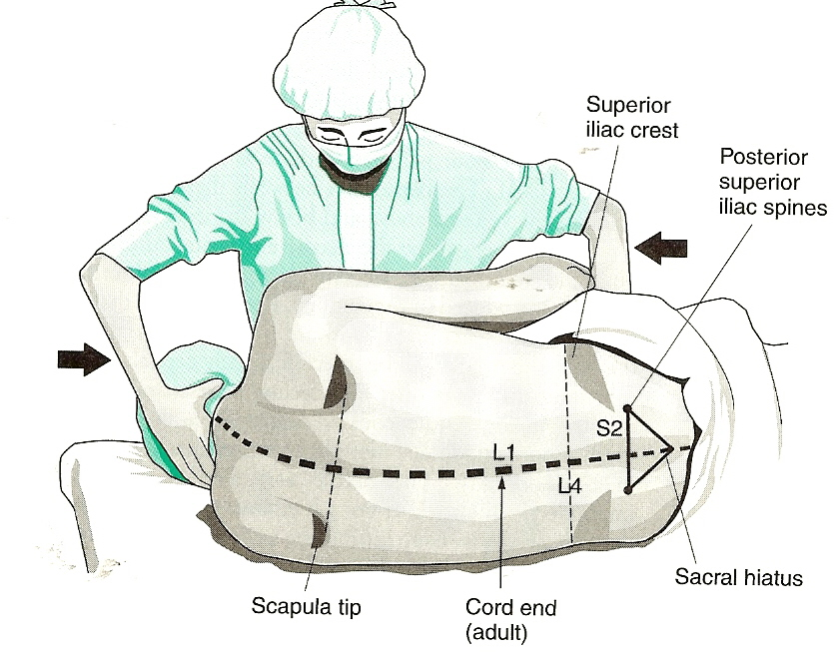

Slide 47
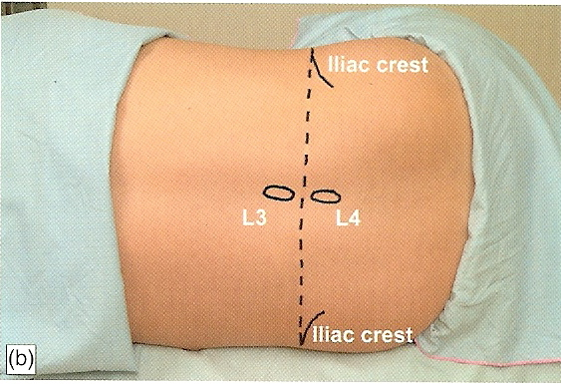

Slide 48
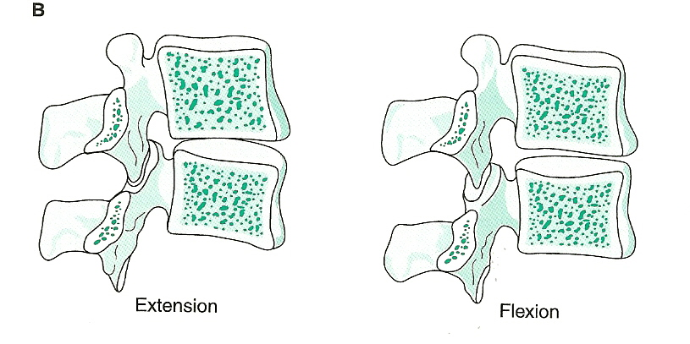

Slide 49
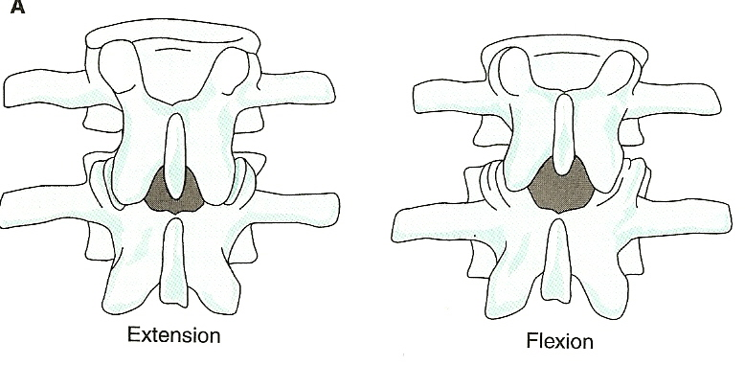

Slide 50
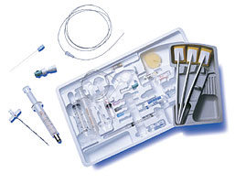

Slide 51
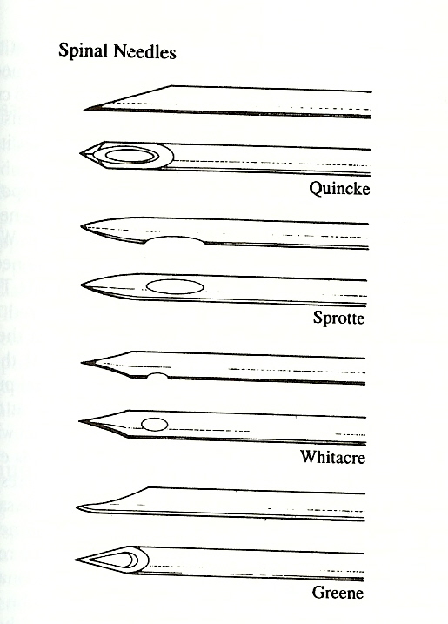

Slide 52
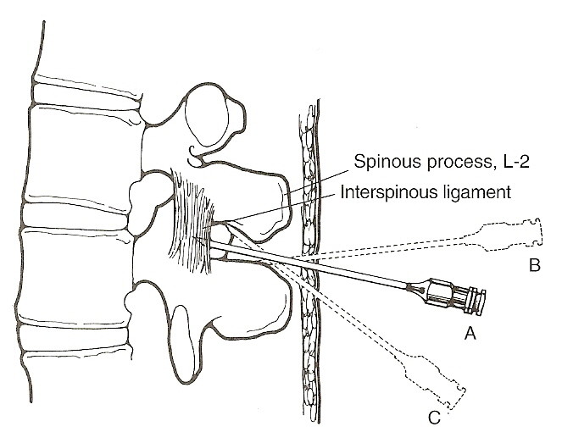

Slide 53
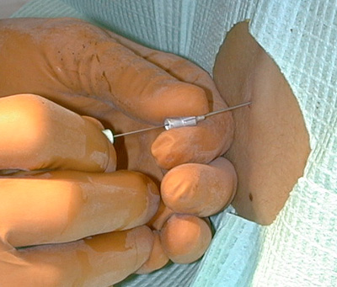

Slide 54
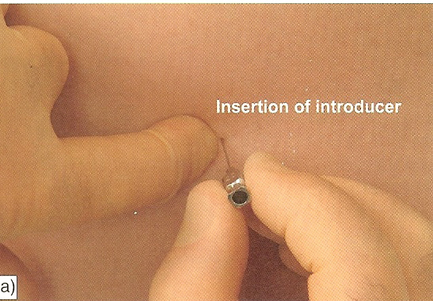

Slide 55
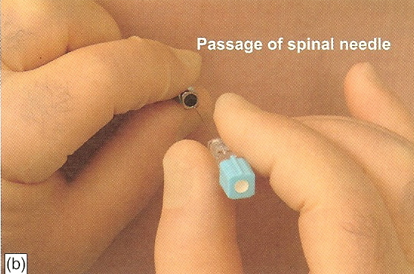

Slide 56
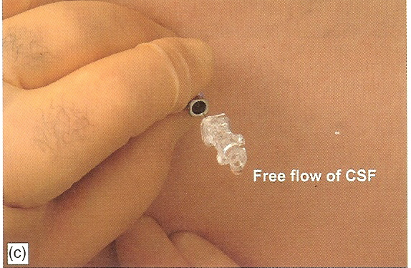

Slide 57
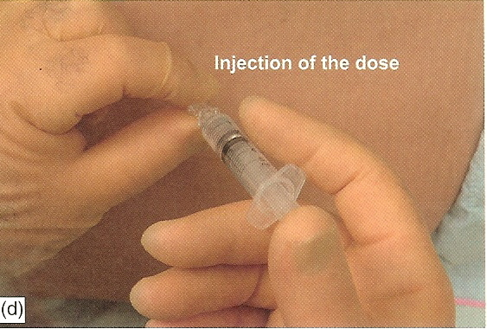

Slide 58
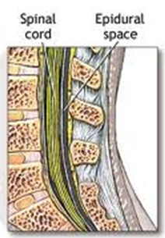
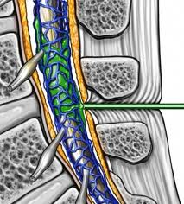
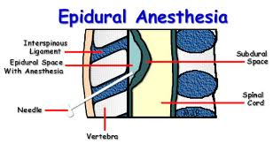
Spinal
Epidural

Slide 59
REGIONAL AND LOCAL ANAESTHESIA
- The subarachnoid, epidural or plexus block are called REGIONAL ANAESTHESIA
- Some called it regional analgesia as patient is conscious.
- Some use sedative with regional analgesia to be anaesthesia.
- Local anaesthesia means block of peripheral nerve or tissue infiltration as in lipoma, circumcision, teeth, eye even craniotomy.

Slide 60

Regional anesthesia
Definition:
Local anesthetic induced blockade of peripheral or spinal nerve impulses from a targeted body part with preserved level of consciousness

Slide 61
Regional anesthesia
Categories:
  Intravenous (Bier block)
  Neuraxial (spinal, epidural)
  Peripheral nerve blocks (PNB)
    Truncal (e.g. paravertebral, TAP blocks)
    Plexus (e.g. brachial plexus, lumbar plexus)
    Distal (e.g. femoral, sciatic)

Slide 62
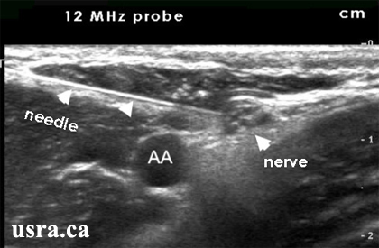
Ultrasound guided PNB

Slide 63
Local anesthetics
Block voltage gated sodium channels on nerve cells preventing impulse conduction
Two classes: amide and ester local anesthetics
Rare allergic reactions
Variable onset and duration
  Quick onset, short acting (lidocaine, mepivacaine)
  e.g. 1-2 hours following subcutaneous infiltration
  Slow onset, long duration (bupivacaine, ropivacaine) e.g. 2-8 hours following subcutaneous infiltration

Slide 64
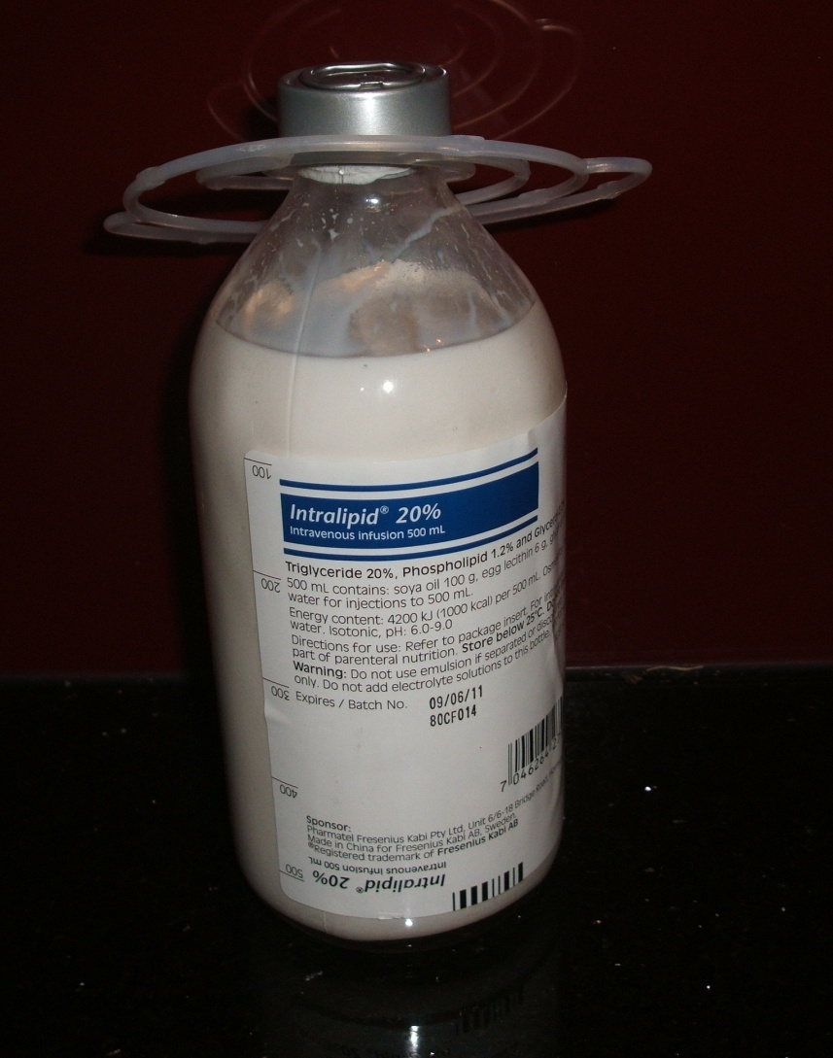
Lipid emulsion

Slide 65
Complications of any PNB
Local anesthetic toxicity
Bleeding/hematoma
Infection
Nerve injury
  Transient paresthesias 1-3%
  Permanent nerve injury ~1/10,000
Failed block

Slide 66
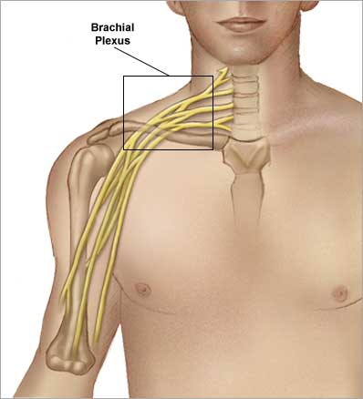
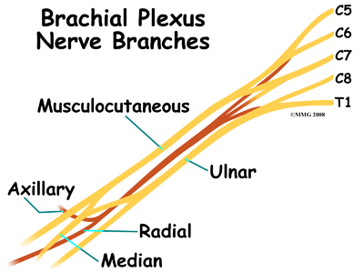
Brachial plexus

Slide 67
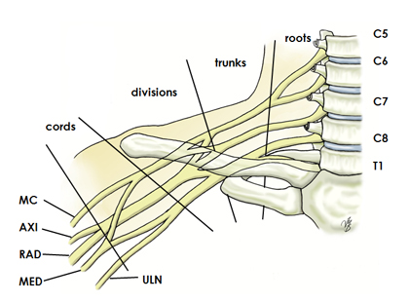
Brachial plexus blocks
Interscalene
Supraclavicular
Infraclavicular
Axillary

Slide 68
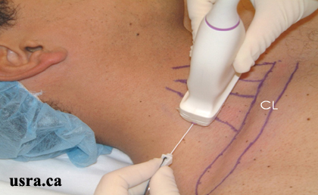
Interscalene block

Slide 69
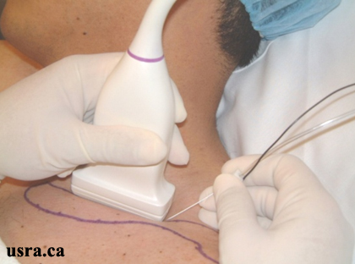
Supraclavicular block

Slide 70
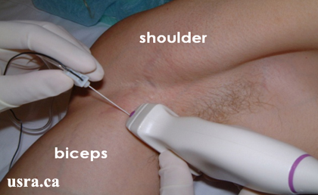
Axillary block

Slide 71
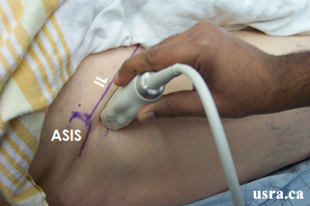
Femoral nerve block

Slide 72
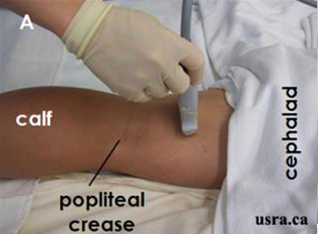
Popliteal block

Slide 73
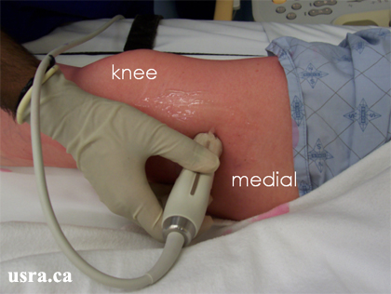
Saphenous nerve block

Slide 74
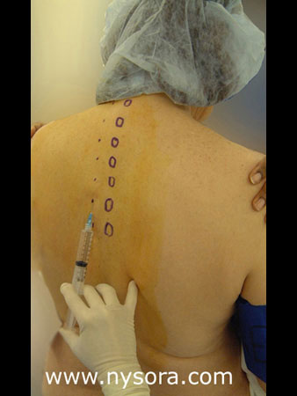
Paravertebral block

Slide 75
NEW TRENDS IN ANAESTHESIA
1. Balanced anaesthesia:
- Use of different potent drugs for every component of anaesthesia :
Unconsciousness by low inhalational
Analgesia by narcotics or nitrous oxide
Muscle relaxation by muscle relaxant.
-So we can get best results with less side effects and can be reversed.

Slide 76
2. Multimodal anaesthesia:
Use of combination
- Regional with light general
- Local analgesia with sedation
- IV induction and inhalational maintenance

Slide 77


Slide 78


